Slide 1

ECZEMA
BY
ASSISSTANT PROFESSOR
DR. NAMEER AL-SUDANY

Slide 2
ECZEMA
Eczema is a distinctive inflammatory response of the skin due to a number of causes and clinically characterized by a triad of itching, erythema and vesicles, papules or scales.
The terms “eczema” and “dermatitis” are synonyms, however all eczemas are dermatitis but not all dermatitis are eczemas e.g. Dermatitis herpetiformis is not an eczema.
The prevalence of eczema is 10% among the general population and it comprise about 1/5 of all new cases in dermatology clinics.

Slide 3
Classification
EXOGENOUS ECZEMA | ENDOGENOUS ECZEMA
IRRITANT CNTACT DERMATITIS | ATOPIC DERMATITIS
 | SEBORRHOEIC DERMATITIS
ALLERGIC CONTACT ECZEMA | NUMMULAR DERMATITIS
 | ASTEATOTIC ECZEMA
PHOTO-ALLERGIC ECZEMA | GRAVITATIONAL ECZEMA
 | POMPHOLYX
Infective eczema | LICHEN SIMPLEX CHRONICUS
 | PITYRIASIS ALBA

Slide 4
HISTOPATHOLOGY
Acute Stage
Spongiosis (Hallmark of acute eczema)
Severe spongiosis may progress to intra-epidermal vesicle formation.
Subacute Stage
Hyperkeratosis
Parakeratosis
Acanthosis
Spongiosis (mild to moderate)
Chronic Stage
Hyperkeratosis + Parakeratosis
Acanthosis (marked) but with no Spongiosis
All Stages
Upper dermal vasodilatation
Perivascular lympho-histiocytic inflammatory infiltrate

Slide 5
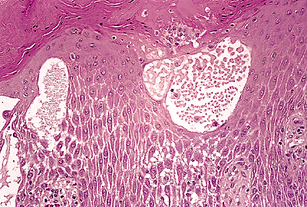
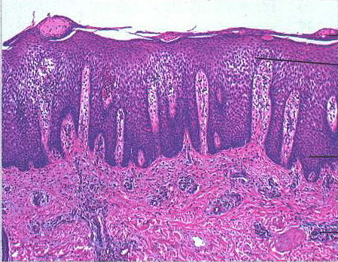
Histopathology of Eczema

Slide 6
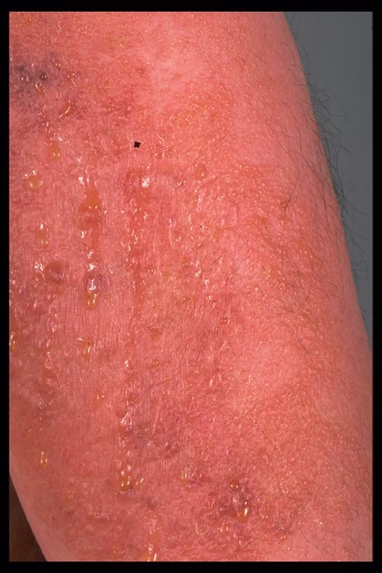
Clinical Stages Of Eczema
1. Acute eczema: usually presents as a vesicular rash with burning sensation.

Slide 7
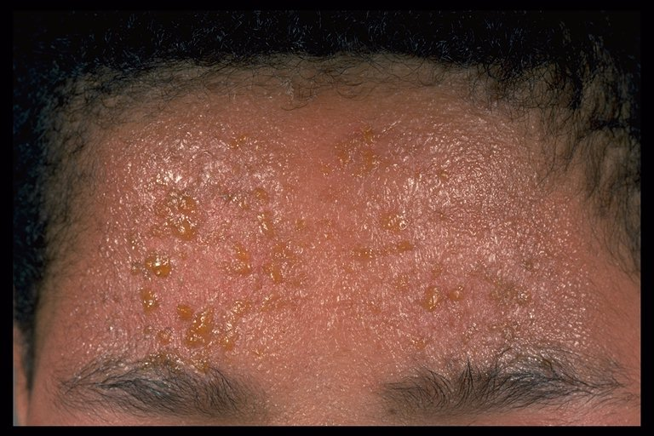
Clinical Stages Of Eczema
2. Subacute eczema: Less pronounced blistering i.e. less serous exudation than acute eczema. The patient usually observes some degree of weeping of serous fluid from vesicles which forms yellow crusts and may become secondarily infected.
Subacute eczema with serum exudation and papuloveiscular rash

Slide 8
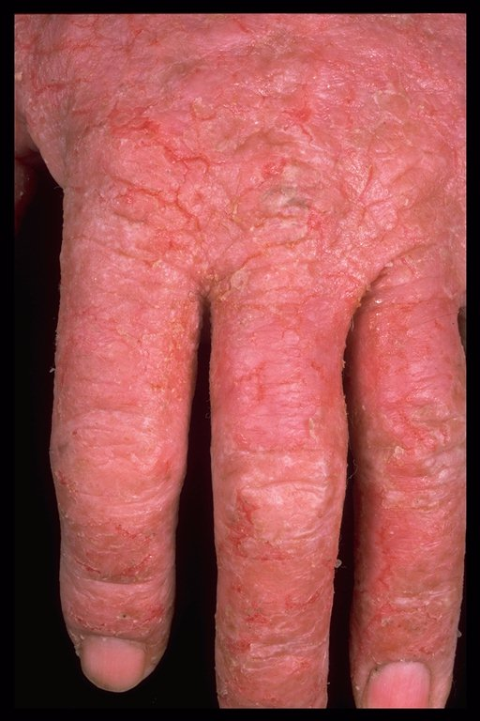
Clinical Stages Of Eczema
3. Chronic eczema: Usually there is redness, dryness and scaling and in some cases thickened and fissured skin. The splits in the skin are painful and may permit entry of bacteria.
Lichenification means thickening of the skin with accentuation of the skin creases. It occurs as a result of rubbing the skin to relieve pruritus. In black skins there is hyperpigmentation in addition.
Chronic contact eczema

Slide 9
Irritant Contact Dermatitis
Exposure to an irritant for a sufficient time may result in an ICD.
Main irritants capable of producing ICD are acids, alkalis, soaps, detergents, solvents, kerosene and others.
Persons with dry skin are more liable to ICD like in old people and patients with atopic eczema.
Industrial workers also have increased incidence of ICD.
ICD may present as itchy erythematous scaly rash with or without vesiculation at areas of contact with the irritant material.

Slide 10
Examples of ICD
House-wife Hand Eczema: it is characterized by an erythematous scaly patches usually involving both hands, but sometimes only the dominant hand is affected. It is caused by the irritant effect of soaps, detergents and excessive use of water. Chronic or severe cases may present with painful fissures of hands palmer surface.
Napkin dermatitis: it is due to the irritant effect of urine and feces that come in contact with the diaper area especially in babies wearing napkins particularly occlusive (Nylon) napkins. It presents as erythematous macerated patches of the napkin area. It usually spares groin folds. Secondary Candidiasis may complicate napkin dermatitis.

Slide 11
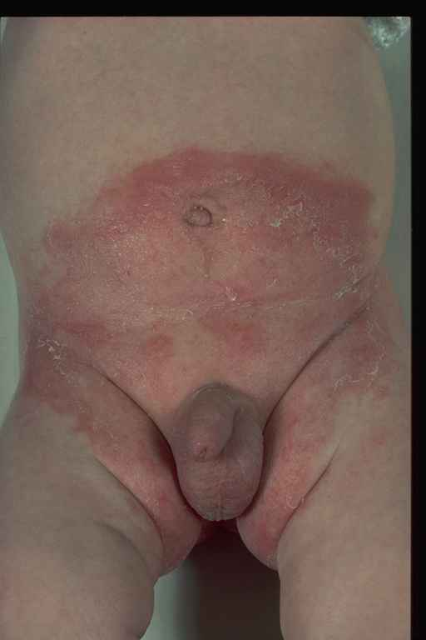
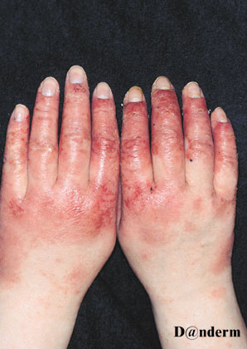
Napkin Dermatitis (ICD)
Hand Dermatitis (ICD)

Slide 12
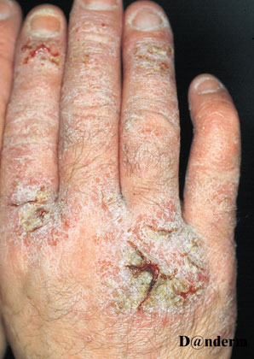
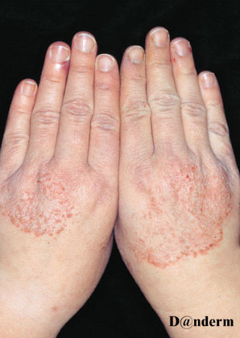
ICD (Chronic Hand eczema with fissuring)
ICD (Hand eczema simulating T. circinata)

Slide 13
Allergic Contact Dermatitis
First exposure to an allergen in a susceptible person usually produces no clinical reaction, however it causes sensitization to that allergen (sensitization phase). Second exposure to the same allergen produces an eczematous rash at that area of contact with that allergen (elicitation phase).
ACD is caused by delayed hypersensitivity reaction (Type IV HSR) that is induced by T-lymphocytes following contact with an allergen.
ACD is characterized by an itchy erythematous rash which can be vesicular, oozy or scaly.

Slide 14
Examples of ACD
Ear lobe dermatitis (Nickel Allergy due to Cheap earrings )
Cement dermatitis (Potassium dichromate Allergy)
Shoe dermatitis (Leather or Rubber Allergy)
Eyelids dermatitis (Nail varnish, Local medicaments, Cosmetics and Air-born dermatitis)
Hair dye dermatitis (Paraphenelyndiamine).

Slide 15
Differences Between ICD & ACD
Features | ICD | ACD
Cause | Irritants | Allergens
Previous exposure | Not needed | Needed
Onset | Immediately or within few hours | 12-48 hours after exposure
Site of reaction | Contact site only | Contact site + Remote sites
Mechanism | Non-immunological (Direct irritant eff.) | Immunological (Type IV HSR)
Patch test | No role in diagnosis | Confirmatory role

Slide 16
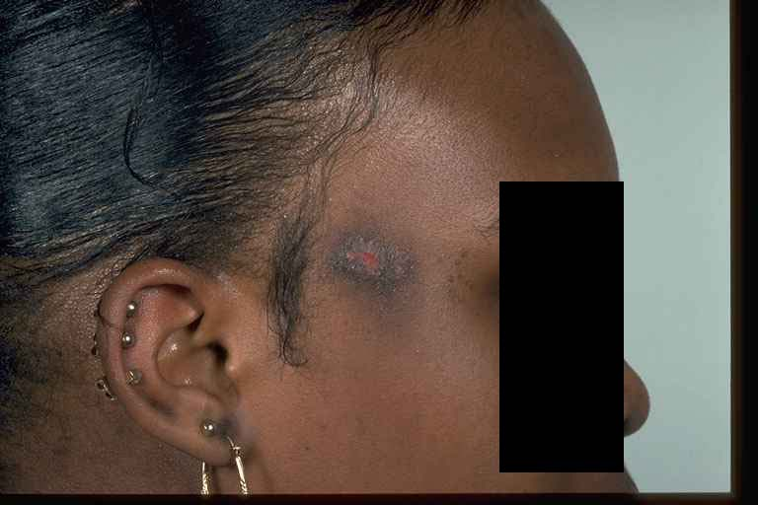
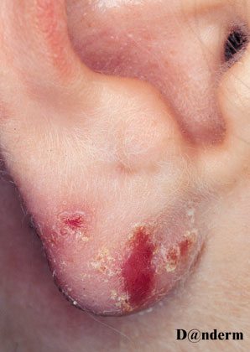
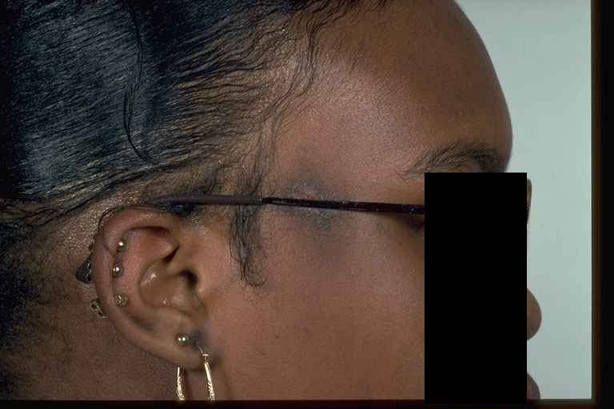
ACD (Nickel Spectacle Frame)
Nickel ACD on the ear lobe

Slide 17
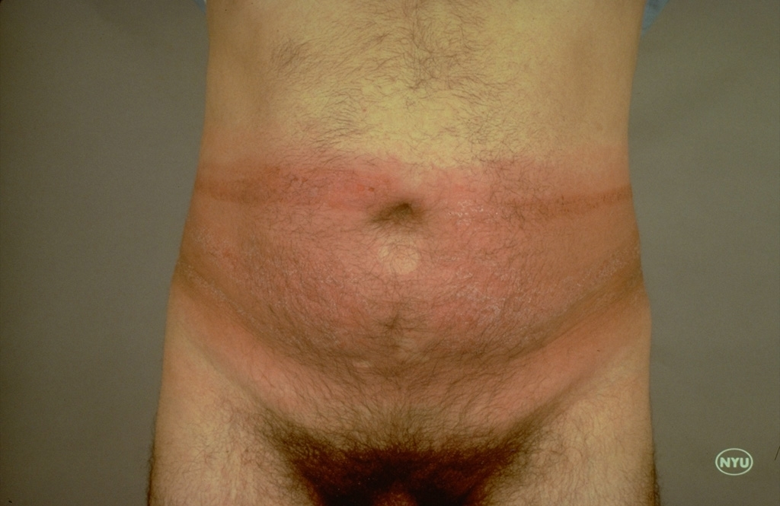
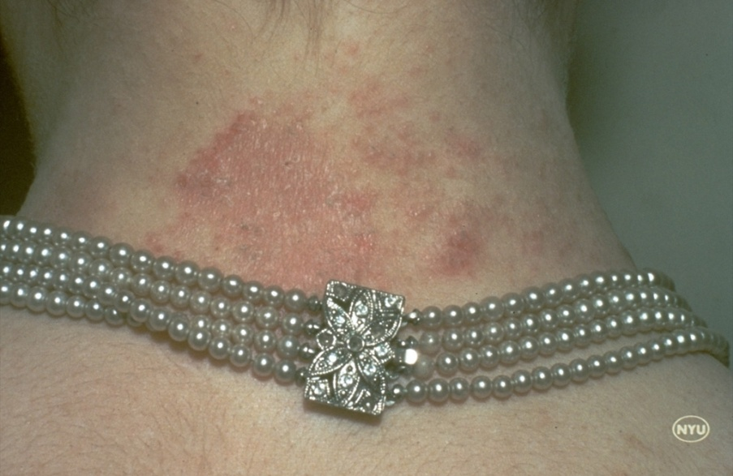
ACD (Rubber )
ACD (Nickel)

Slide 18
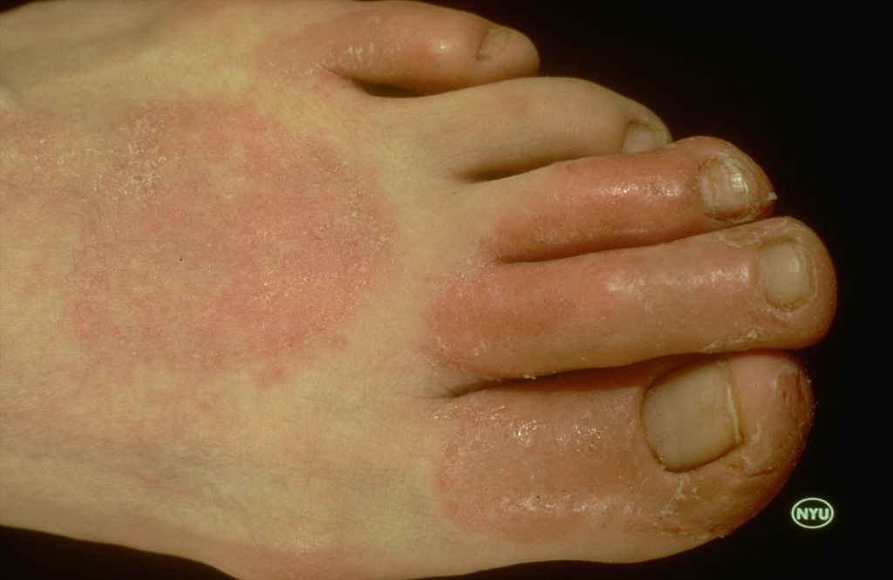
ACD (Shoe)

Slide 19
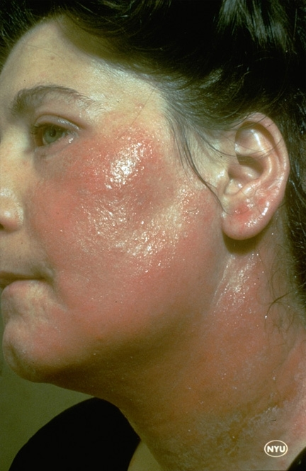
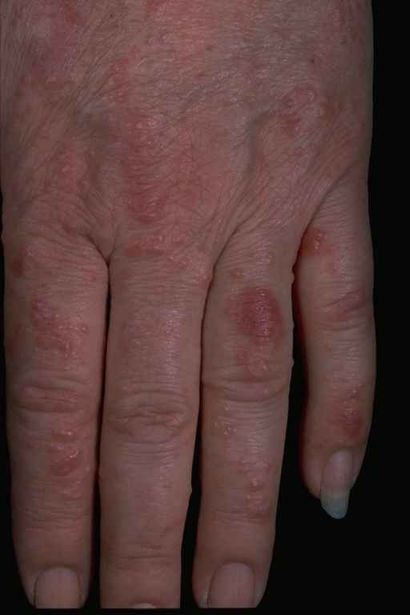
ACD
ACD (Plant)

Slide 20
Patch Test
Patch test is a useful confirmatory but not diagnostic test in ACD (Usually has no role in ICD).
It depends on type IV HSR that is depending on T-helper lymphocytes (cell mediated immunity).
Technique: apply suspected allergens or a battery of allergens on the back of the patient (non-hairy area) under a cover of a non or hypoallergenic plaster for 48 hours then remove the cover and read the tested area.
Positive reaction produces an eczematous reaction (erythema, papules, vesicles or even necrosis depending on the degree of individual’s sensitization) at site of causative allergen.
Query reaction (weak reaction) if disappears on further testing after dilution of suspected allergen may be due to irritant reaction.

Slide 21
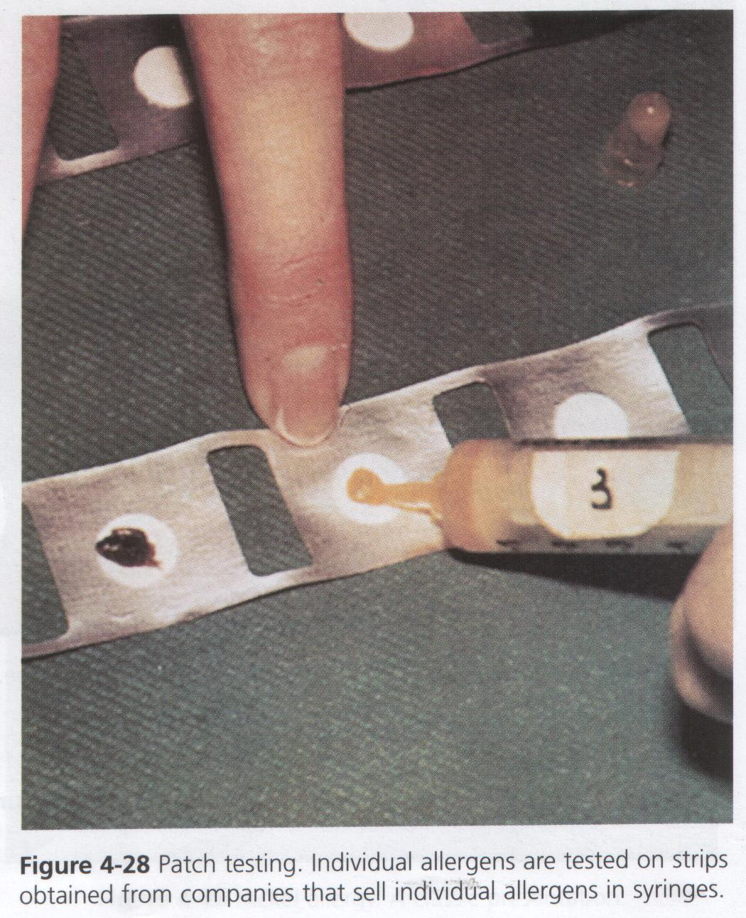
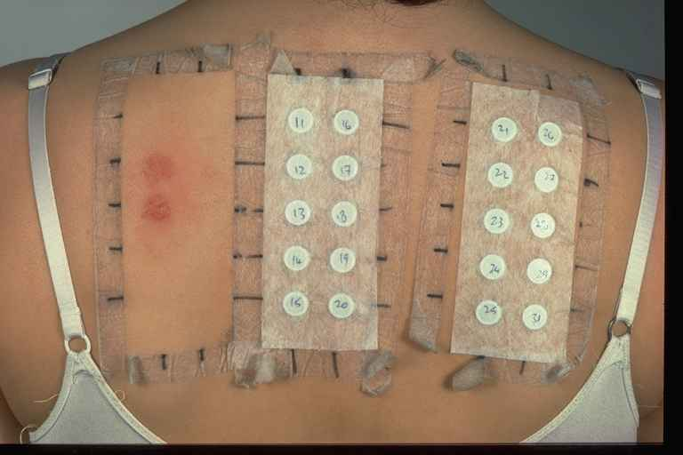
Patch Test Technique

Slide 22
Management of Contact Dermatitis
Avoid precipitating and aggravating factors (irritants and allergens) if possible.
Use protective measures like cotton-lined gloves in house-wife hand eczema or using barrier creams in napkin eczema.
Systemic Antihistamines may help decrease itching.
Systemic or topical antibiotics or antifungals if there is secondary bacterial or fungal infections.
Topical corticosteroids and in severe cases systemic corticosteroids represent the cornerstone of symptomatic therapy in both irritant and allergic contact dermatitis.

Slide 23
Atopic Dermatitis
AD is a common chronic relapsing eczema that occurs in individuals with personal &/or family history of atopy.
Atopy is a genetic predisposition to produce excessive IgE Abs that leads to a generalized and prolonged hypersensitivity to common environmental antigens and liability to manifest one or more atopic disorders.
Atopic disorders are allergic rhinitis, asthma, atopic dermatitis and some cases of urticaria.
Atopic eczema is common in infants and young children (may affect up to 10%), however the prevalence then decreases with increasing age.
About 1/3 of AD patients have personal history of other atopic diseases and about 2/3 of them have family history of atopy.

Slide 24
Aetiology Of AD
Multifactorial aetiology (An interplay between):
Genetic predisposition (Polygenic mode of inheritance).
Defective skin barrier function and widespread skin xerosis.
Abnormal immune responses:
Increased serum IgE
Increased serum histamine (due to active mast cells)
Decreased total number of lymphocytes
Decreased chemotactic function of neutrophils & monocytes.
Environmental factors: exposure to environmental allergens especially in early childhood and mainly at spring such as pollens, house-dust mites, animal dander and hairs, food ……etc.
Climatic Factors: low humidity mainly during winter increases skin xerosis and hence exacerbates AD.

Slide 25
Clinical Picture Of AD
The cardinal features of AD are:
Severe pruritus
Widespread skin xerosis
Personal and/or family history of atopy.
Chronic or chronic relapsing skin rash with characteristic distribution according to age affected:
Infantile AD
Childhood AD
Adult AD

Slide 26
Infantile AD
Usually affects infants after the 2nd month of life and may last to the end of first or second year and then it either disappears or continues as childhood AD.
Usually presents as an acute or subacute weepy erythematous rash involves mainly the cheeks, however it may involve other parts of the body like the scalp, trunk and extremities. It usually spares the napkin area.
Affected infants are usually irritable and may have poor feeding and poor sleeping.
The main differential diagnosis is Infantile Seborrhoeic Eczema.
See Table

Slide 27
Differences Between IAD & ISD
Features | IAD | ISD
Onset | After 2nd month | Before 2nd month
Site | Lateral cheeks | Seborrhoeic areas of face
Scale | White and dry | Yellow and greasy
Symptoms | Itching and irritation | Asymptomatic
G. condition | Poor feeding & sleeping | Good
Course | Disappear at or continue after 1st or 2nd year of life | Self-limiting (6m-1y)
Treatment | CS + Antihistamines | No need

Slide 28
Childhood AD
Affects children 2-15 years old.
Usually presents as a bilateral symmetrical dry erythematous scaly rash involving the antecubital and popliteal fossae. Wrist and ankle flexures may also be involved. At time the rash is confined to the extensor surface of the extremities.
The condition usually remits at late childhood but may continue as an adult atopic dermatitis.
Adulthood AD
It usually presents as a poorly circumscribed very pruritic bilateral scaly erythematous plaques with or without lichenification and/or excoriations.
The predilection sites are the elbow and knee flexures and the neck. However, other sites may be involved like the thighs or extensor extremities or could be generalized.

Slide 29
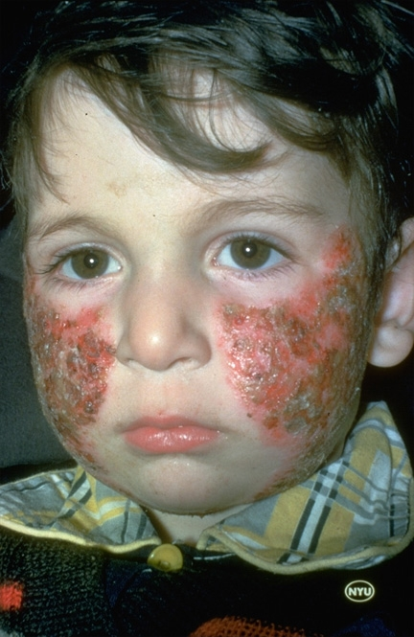
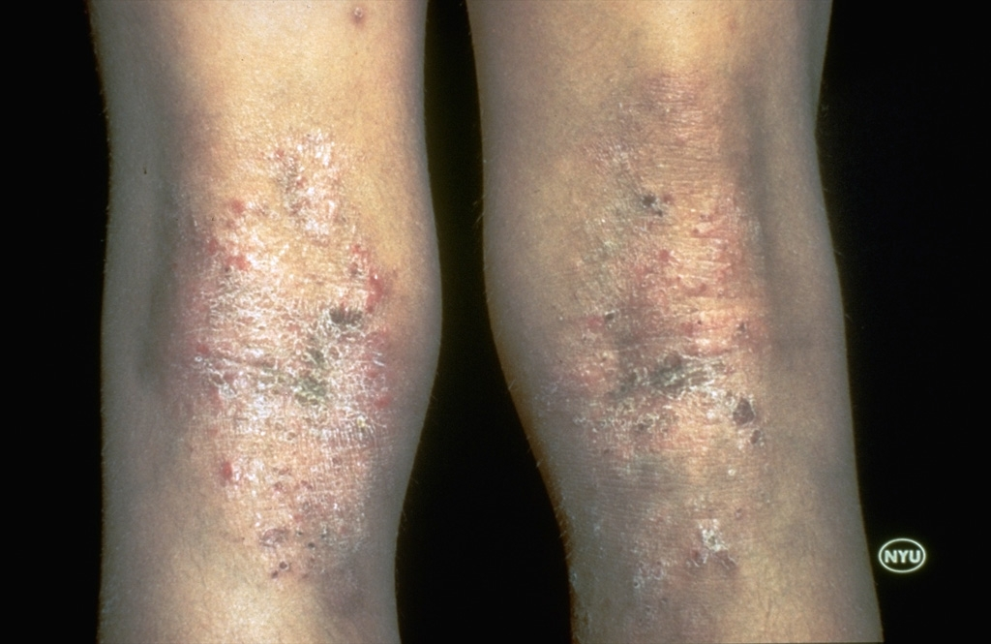
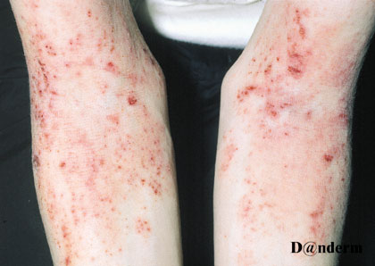
Childhood AD
Infantile AD
Adult AD

Slide 30
Associations Of AD
Dennie-Morgan Fold (Extra-ordinary infra-orbital fold)
Hyperlinearity of the palms
Loss of the outer third of the eyebrows
Keratosis pilaris: Asymptomatic follicular papules involving the lateral aspects of the upper arms and the thighs.
Pityriasis alba: rounded or oval scaly hypopigmented plaques involving chiefly the face and also the neck or upper arms. The lesions are asymptomatic and self-limiting usually disappear within months.
Icthyosis vulgaris (10% incidence in AD patients)
Eye problems (Keratoconus and premature cataract)
Alopecia areata

Slide 31
Complications Of AD
Increased incidence and severity of infections mainly bacterial s especially those caused by S. aureus and less often viral infections like Herpes simplex or Molluscum contagiosum. H. simplex infection in AD patients may present with a severe widespread vesicular rash which may be hemorrhagic. This condition is called Eczema herpeticum or Kaposi’s varicelliform eruption.
Increased incidence of immediate allergies (Type I HSR) to foods (eggs, fish, cow’s milk, wheat…etc.), pollens and drugs (e.g. Penicillin).
Increased incidence of irritant reactions (ICD)due to defective skin barrier function.
Psychological problems due to the chronic severely pruritic nature of the disease.

Slide 32
Management of AD
Avoid precipitating and exacerbating factors (irritants) if possible like wool clothes or garments, lifa, soaps and excessive washing.
Regular use of greasy emollients e.g. Vaseline especially after bathing to decrease skin xerosis.
Oral antihistamines (Sedative type) like Hydroxyzine or Diphenhydramine to ameliorate itching.
Systemic antibiotics if there is secondary bacterial infection.
Topical Corticosteroids are very helpful in most cases.
Short courses of systemic steroids may be given in severe cases.
Children with moderate or severe atopic dermatitis can be treated with Tacrolimus ointment or Pimecrolimus cream (Calcineurin inhibitors act as immunomodulators), they are considered as alternatives to topical corticosteroids.
Severe cases in adults may be treated with PUVA or Cyclosporine A.

Slide 33
Seborrhoeic Dermatitis
SD is an endogenous eczema that involves seborrhoeic areas of the body, these areas include scalp, eyebrows, eyelashes, nasolabial folds, moustache, beard, external auditory canal, retroauricular folds, shoulders, sternal area, interscapular region, axillae and groins). These areas may be involved singly or in combination.
The exact aetiology of SD is unknown, however:
A yeast-flora of hairy skin Pityrosporum ovale has been suggested to induce or perpetuate the condition.
Increased androgen level with resultant seborrhea may also have a role in the aetiology of SD.
According to the age group affected there are tow types of SD:
Infantile SD
Adult SD

Slide 34
Clinical Picture of SD
Adult SD is characterized by pinkish-red patches covered with loosely attached greasy yellowish scales. The rash is usually bilateral and symmetrical.
There may be variable degree of itching in seborrhoeic eczema.
SD usually occurs around and after puberty.
Severe SD may be encountered in patients with Parkinson’s disease or HIV-positive patients.
Infantile SD usually occurs immediately or within 1st tow months of life and characterized by dirty-yellow crust on the scalp called Cradle cap which may be associated with an asymptomatic erythematous rash covered with greasy scales involving the central part of the face like the eyebrows, nasolabial folds and the cheeks. The flexures of axillae and groins may be involved in some cases.

Slide 35
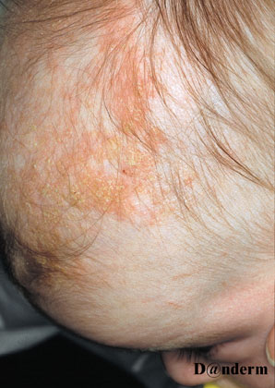
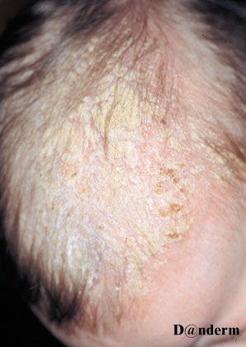
Infantile SD (Scalp)
Infantile SD (Cradle cap)

Slide 36
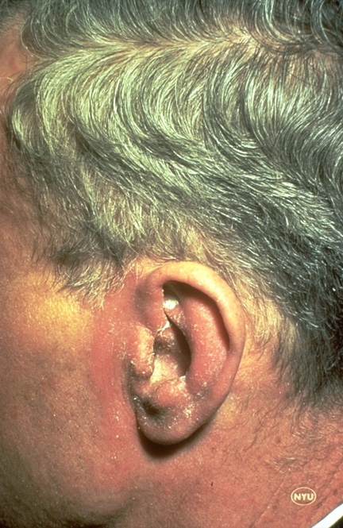
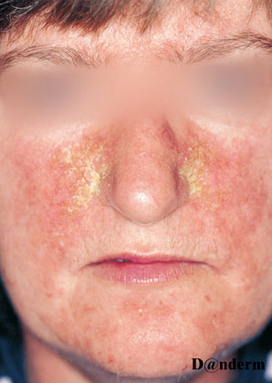
Adult Seborrhoeic Dermatitis
Adult Seborrhoeic Dermatitis

Slide 37
Treatment of SD
Infantile SD is usually a self-limiting condition that disappears spontaneously within the first six months of life and rarely persists to the end of the 1st year, therefore it usually needs no treatment. However, for thick cradle cap, warm olive oil applied to the crust and washed few hours later may provide help.
Adult SD is usually controllable but not curable with treatment. It may be controlled with a combination of topical corticosteroids e.g. Betamethasone cream plus topical anti-fungal agent e.g. Clotrimazole cream.
Scalp SD can be controlled with Selenium sulfide shampoo (Selsun®) or Ketoconazole shampoo (Nizoral®) or topical corticosteroid lotion e.g. Betamethasone lotion.

Slide 38
Discoid Eczema (Nummular eczema)
A common form of endogenous eczema that usually affects adults above thirties of both sexes. It may occur in children 5-15 years old especially those having AD.
The aetiology is unknown, however stress may precipitate it.
Clinically characterized by pruritic rounded or oval coined shaped, hence the name discoid or nummular eczema, dull-red patches. These patches are either wet and studded with pinpoint vesicles (Wet Discoid Eczema) or dry with scaly surface (Dry Discoid Eczema). The sites of predilection are the dorsal surface of the hands and the extensor aspects of the arms and legs while the trunk and face are only occasionally involved.
The course of discoid eczema is usually chronic with relapses & remissions. It tends to be resistant to treatment, however oral antihistamines, topical corticosteroids may help to control the condition.

Slide 39
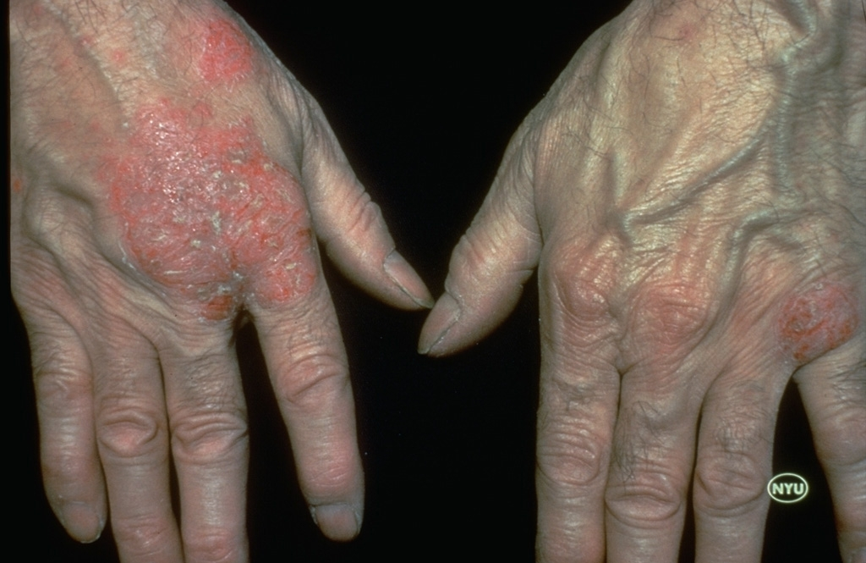
Discoid Eczema

Slide 40
Asteatotic Eczema (Xerotic Eczema)
Occurs predominantly in elderly people due to their xerotic skin.
Low humidity during winter, central heating, excessive washing and the use of diuretics may precipitate the condition.
Clinically , characterized scaly erythematous patches with fine fissuring resembling cracks in porcelain, hence the name Eczema Craquele.
The anterior aspects of the legs are the commonest site involved, however other areas like the forearms or thighs may be affected.
Treatment
Avoid precipitating or exacerbating factors.
Regular use of emollients e.g. Vaseline may be enough in mild cases.
Moderate potency corticosteroids may provide help in moderate to severe cases.

Slide 41
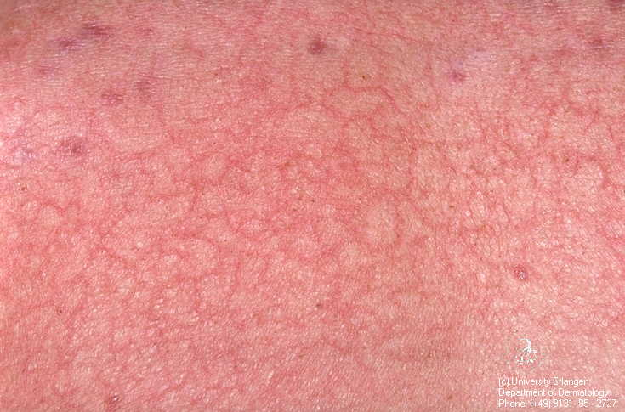
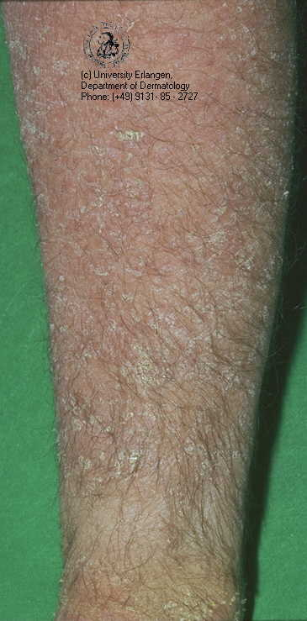
Asteatotic Eczema
Eczema Craquele

Slide 42
Gravitational Eczema (Varicose Eczema)
Stasis dermatitis is a another term used, however it is a misnomer as there is no stasis within the venous system of affected patients but on the contrary those patients have venous hypertension within the veins of their lower limbs.
Usually affects the lower legs of adults and elderly people.
Presents as a dusky-red rash with oozing and crustations and may be complicated by secondary bacterial infection.
Often associated with signs of venous insufficiency (superficial varicosities, leg edema, hemosidrin pigmentation and skin induration).
In advanced cases, varicose ulceration around the medial malleoli may occur .
Treatment:
Use elastic stocking, elevation of feet on sleeping and avoidance of long standing may be helpful prophylactic measures.
Topical corticosteroids may give some relief in many cases.
Advanced cases complicated by venous ulcers should be managed accordingly aiming at correction of underlying venous abnormalities.
Notes:
ordingly

Slide 43
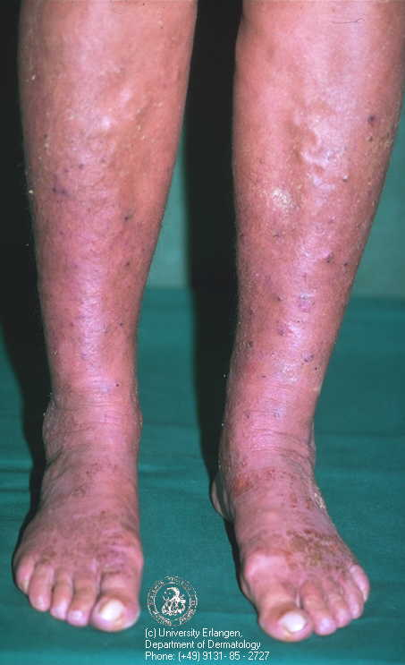
Gravitational Eczema

Slide 44
Pompholyx (Dyshidrotic Eczema)
Pompholyx usually occurs in adults and characterized by recurrent episodes of very pruritic bilateral deep-seated vesicles and sometimes bullae involving the sides of fingers, palms and soles. About 50% of the patients have associated hyperhidrosis of the hands and/or feet.
Aetiology: most cases are idiopathic, however some cases may be provoked by heat, stress and nickel ingestion in nickel-sensitive individuals.
The course of pompholyx is recurrent and the recurrences usually occur during summer time i.e. hot weather. Each episode lasts few weeks and disappears either spontaneously or by treatment. Resolution of the vesicles and bullae occurs by absorption (drying up) rather than by rupture of these blisters. On resolution, the lesions leave up dotted brownish pigmentation which remain for a time and disappears.

Slide 45
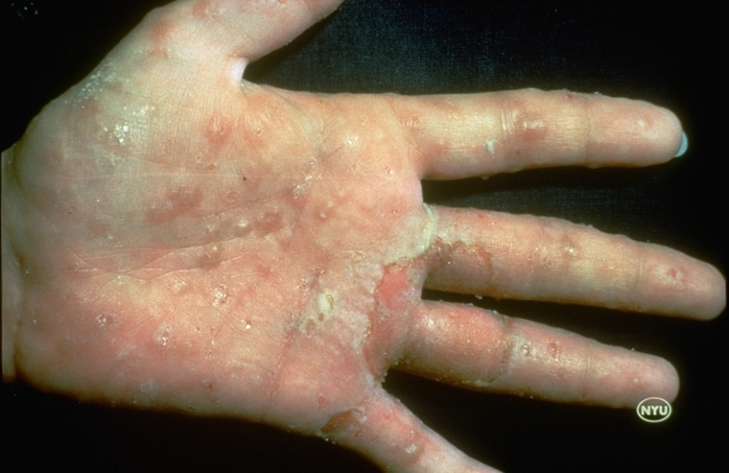
Pompholyx
Treatment
Use Potassium permanganate solution (1/8000) as wet dressings or soaks to dry up the lesions.
Topical corticosteroids and oral antihistamines may be enough to for mild cases.
Severe or resistant cases: short courses of systemic CS to induce remission e.g. 20-30 mg Prednisolone/ day/one week.

Slide 46
Lichen Simplex Chronicus
LSC is also known as Localized Neurodermatitis.
Due to habit of repeated rubbing or scratching the skin in response to psychological upset or stress.
Usually occurs in adults and elderly people.
Clinically presents as very pruritic lichenified plaques with or without excoriations.
Sites of predilection: the lower legs especially around the ankles, the dorsa of the hands, elbow and knee extensors, the nape of the neck (esp. in females), the scalp (esp. in elderly) and the anogenital area especially the scrotum and vulva. However any area accessible to the hands of the patient can be involved.
The course of this problem is chronic and may take many years with relapses occurring chiefly at periods of stress.

Slide 47
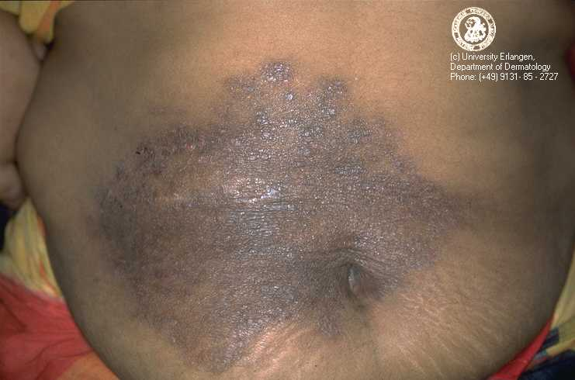
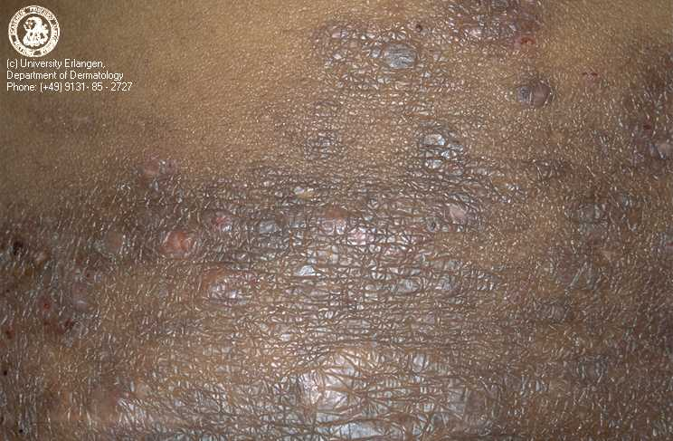
Treatment
Avoid habit of repeated rubbing or scratching of skin.
Use very potent topical steroids e.g. Clobetasol propionate ointment under polyethylene occlusion.
Give oral antihistamines (sedative type) to decrease itching.
Solitary lesion of LSC resistant to treatment can be treated with intralesional corticosteroid infiltration e.g. Triamcenolone acetonoide .
LSC

Slide 48

الحمد لله رب العالمين
Thank you

