Slide 1
LICHEN PLANUS
الحزّاز المسطّح
Dr. Nameer Al-Sudany

Slide 2
Lichen planus
Lichen planus is a relatively common itchy mucocutaneous disorder affecting all ages and races and both sexes with a distinctive purple papular morphology and characteristic histology which persists for a number of months before resolving with temporary post-inflammatory hyperpigmentation.
The primary lesion is a characteristic, almost pathognomonic, small, intensely pruritic violaceous, flat-topped, polygonal, shiny papule.
Prevalence is < 1% in the general population.
Commonest age affected are adults between 30 and 60 years.
Rare in children (< 4%) who often have atypical lesions.
Equal sex incidence.

Slide 3
Aetiology of Lichen Planus
The exact aetiology of LP is unknown. However:
Autoimmune pathogenesis has been suggested based on histological and clinical evidences.
Histological evidence: Band-like inflammatory infiltrate in the upper dermis consists mainly of T-helper lymphocytes.
Clinical evidence: association of LP with many autoimmune disorders such as alopecia areata, vitiligo, myasthenia gravis and graft versus host disease.
Emotional stress may precipitate or exacerbate lichen planus in some cases.
Infection: HCV infection is associated with increased incidence of erosive lichen planus of the oral mucosa.
Drugs: lichenoid drug reactions may be caused by gold, captopril, thiazide diuretics, antimalarial drugs, penicillamine, methyl dopa, beta-blockers, and contact with the color-film developer.

Slide 4
Histopathology
Hyperkeratosis
Wedge-shaped hypergranulosis
Irregular acanthosis with saw-tooth appearance of the epidermal rete ridges.
Basal cell liquefactive degeneration.
Heavy band-like upper dermal histio-lymphocytic inflammatory infiltrate hugging the dermo-epidermal junction. Most of the inflammatory cells are T-helper cells.
Pigmentary incontinence (melanophages in the upper dermis).
Civatte (Cytoid) bodies: degenerated basal cells in the upper dermis.
The diagnosis of LP usually is clinical, however skin biopsy and occasionally immunofluorescence are needed to confirm the diagnosis.

Slide 5
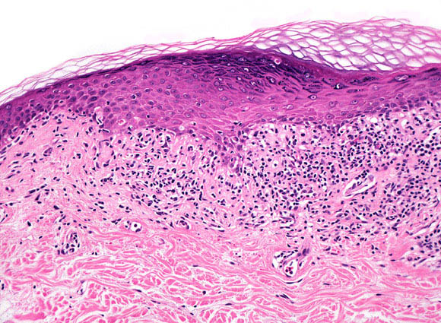
Histopathology of lichen planus

Slide 6
Clinical Picture
Classical LP ( Chronic localized LP): is characterized by violaceous papules described as 5Ps which is a mnemonic for: Pruritic, Purplish, Plane-topped, Polygonal Papules. The papules have a dry, shiny, scaly surface. The scales are branny and may form whitish streaks (lines) or puncta across the surface of the lesions. These streaks are known as Wickham’s striae which are best seen with a magnifying lens.
Pruritus is often a prominent feature in LP and may be intolerable and most patients react to itching by rubbing rather than scratching, therefore scratch marks are usually absent in LP.
New lesions of lichen planus may appear at site of trauma i.e. Koebner’s (Isomorphic) phenomenon.
Post-inflammatory hyperpigmentation occurs in all subjects but is most marked and persistent in brown and black skin.

Slide 7
Clinical Picture
Any body site can be involved by lichen planus, however the sites of predilection in classical lichen planus are:
Flexor surface of the wrists and forearms
Dorsal surface of the hands
Shins
Trunk
Sacral region
Genitalia (especially the glans penis)
Oral mucosa
The face is rarely affected by lichen planus and if it is involved, usually on the lips or eyelids.
The scalp and nails may be affected in some patients.
Involvement of the palms and soles with small papules and plaques may result in palmo-planter keratoderma.

Slide 8
Clinical Picture
The natural history (course) of LP is highly variable and depends on the clinical pattern and the site of involvement. Two-thirds of cases have < 1 year duration and about 85% of cases clear spontaneously in the second year.
Familial LP is about 1-2% of the cases (often in children).
The main differential diagnoses of classical lichen planus are:
Guttate psoriasis
Pityriasis rosea
Secondary syphilis
Pityriasis lichenoides chronica
Lichenoid drug eruption

Slide 9
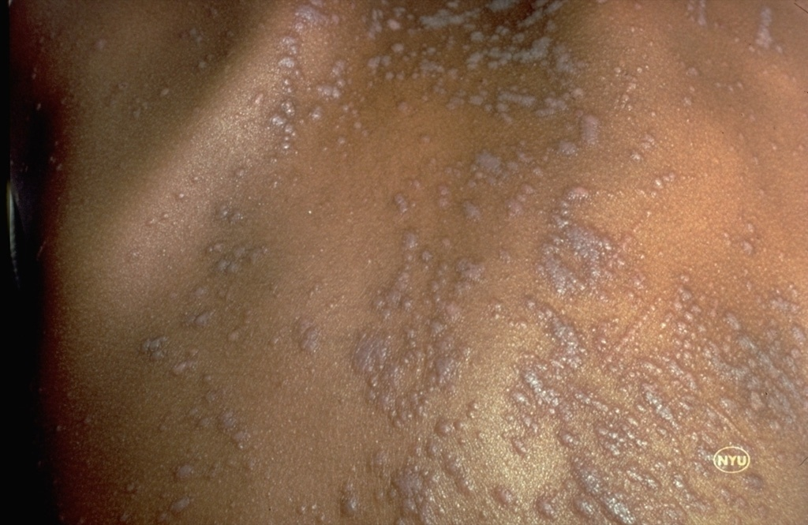
Characteristic papules of lichen planus on the back with positive Koebner’s phenomenon.

Slide 10
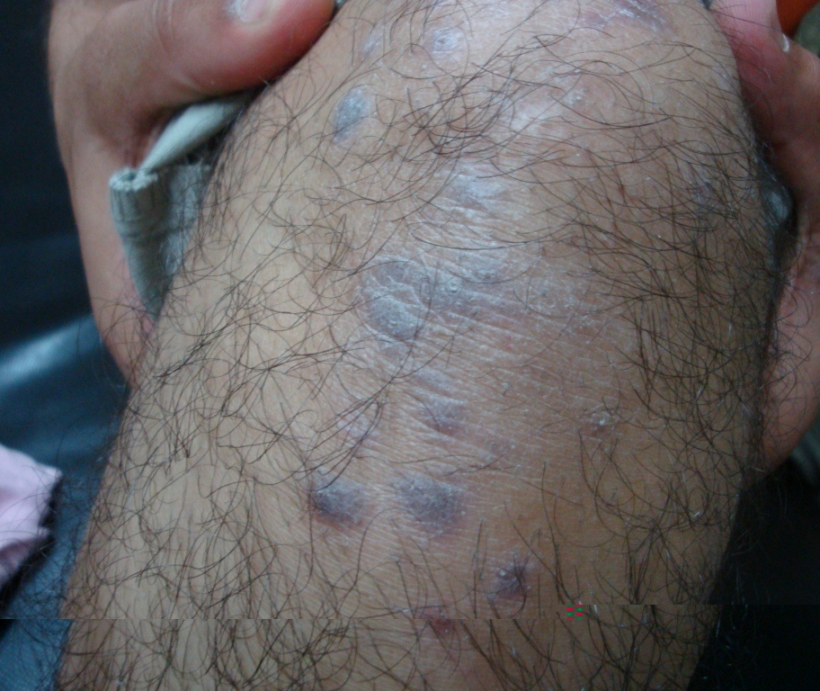

Slide 11
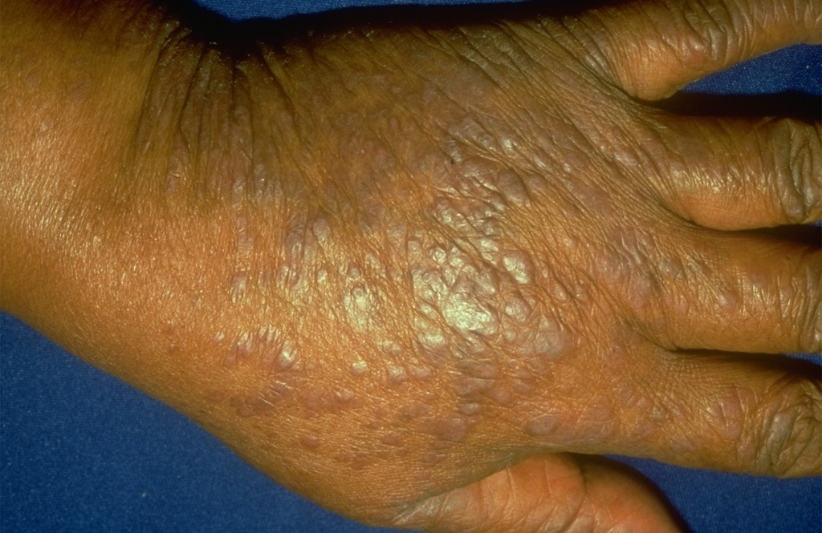

Slide 12
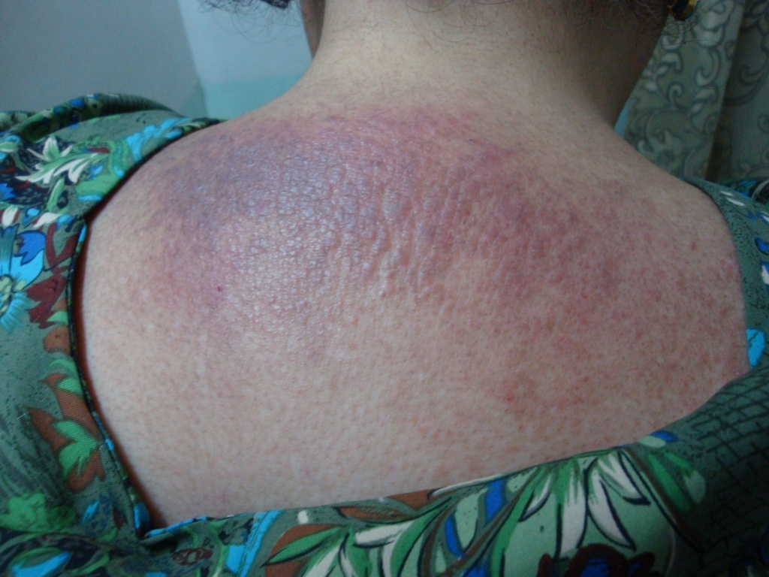

Slide 13
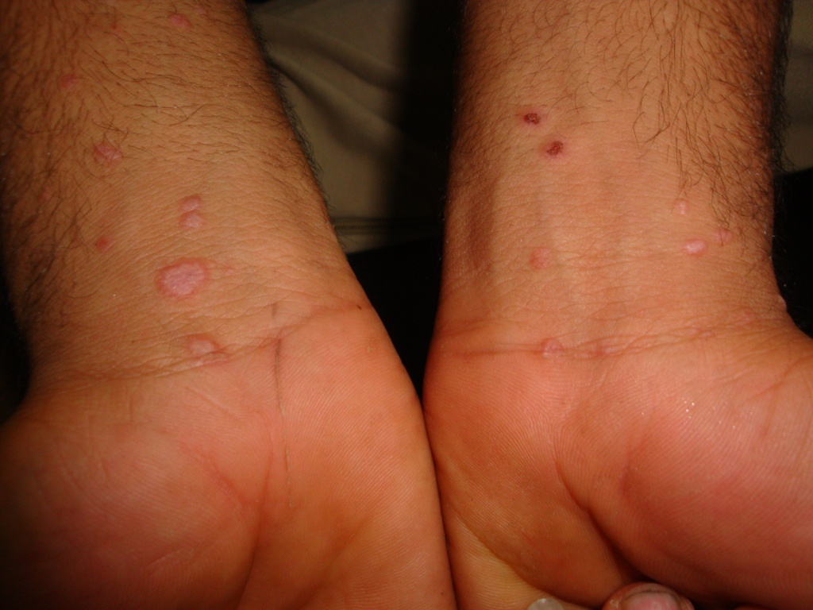

Slide 14
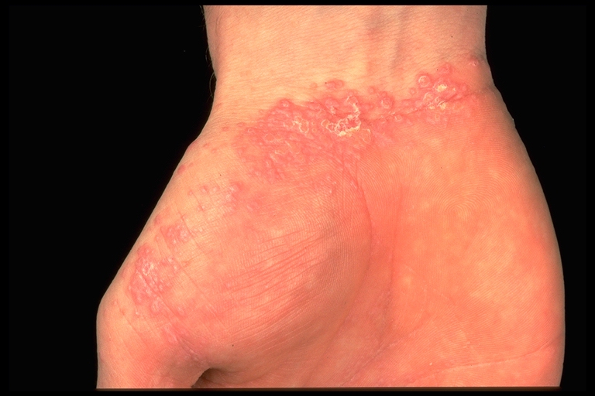
The white net patterning (Wickham's striae) is clearly visible on the surface of some of the papules on the wrist.

Slide 15
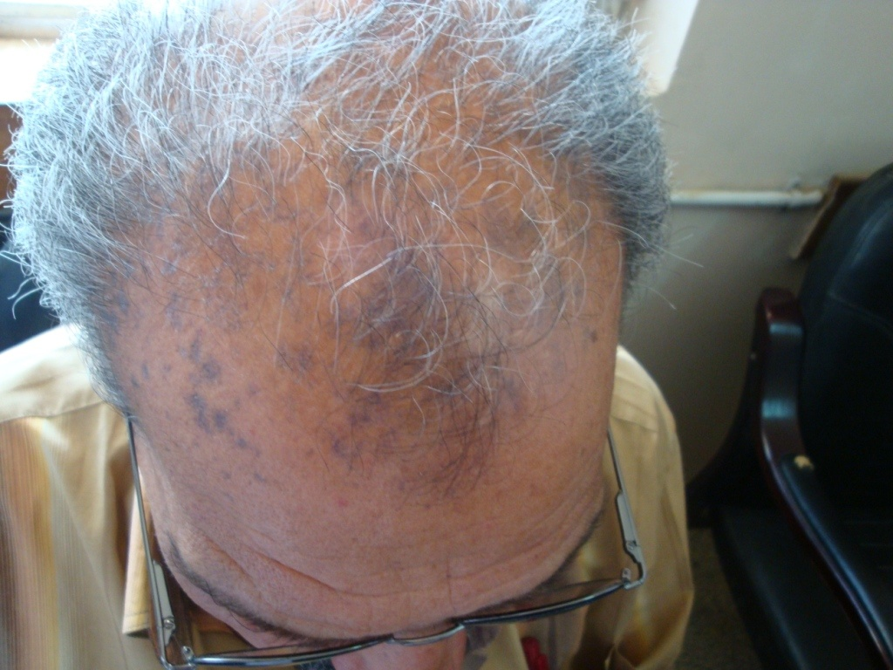

Slide 16
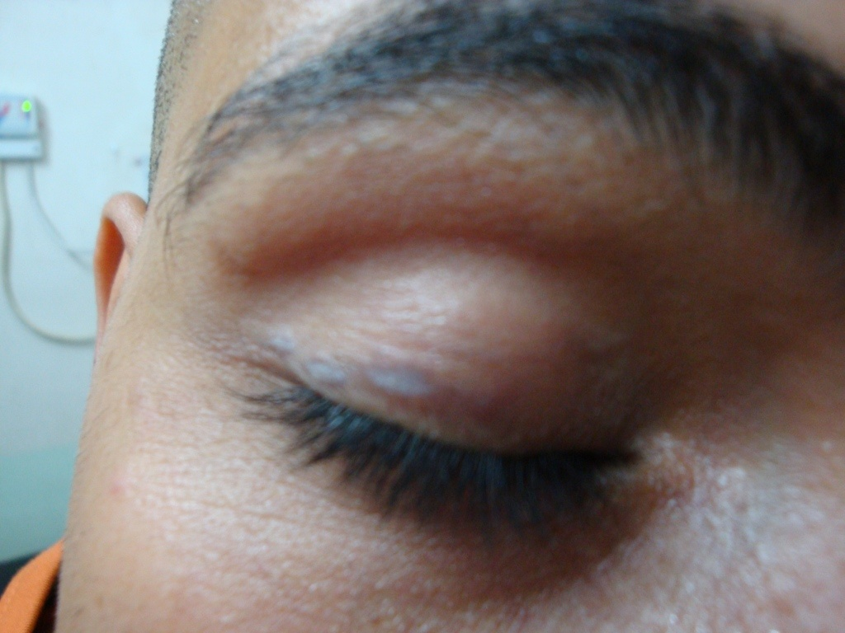

Slide 17
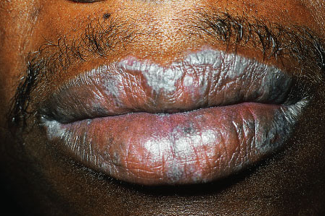

Slide 18
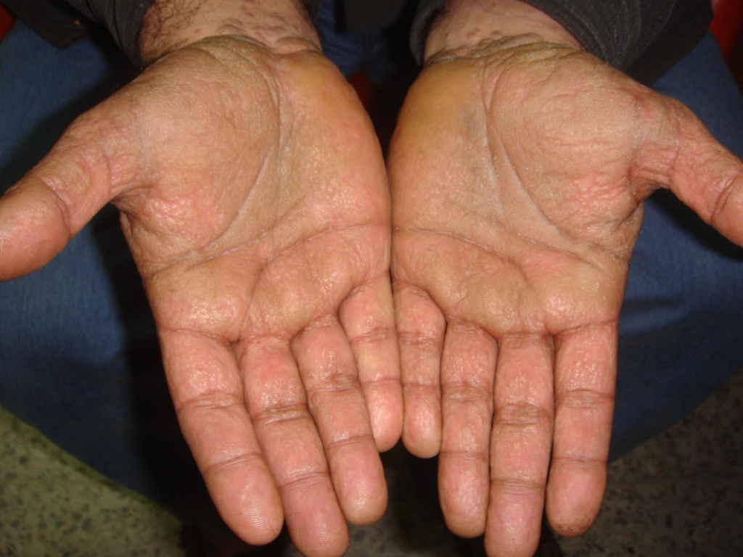
Yellowish papules involving both palms. Notice wrist involvement with violaceous papules.

Slide 19
Lichen planus
Configuration
Site of involvement
Morphology
1. Linear LP
2. Annular LP
LP of Scalp
Mucosal LP
LP of Nails
Palmoplanter LP
Inverse LP
Acute eruptive LP
Hypertrophic LP
Atrophic LP
Follicular LP
Ulcerative LP
Vesiculobullous LP
Actinic LP
LP pigmentosus

Slide 20
Variants of LP
Acute eruptive LP
Hypertrophic LP (LP hypertrophicus)
Atrophic LP (LP atrophicus)
Follicular LP (Lichen planopilaris)
Erosive-ulcerative LP
Vesiculobullous LP
LP pigmentosus
Actinic LP (LP actinicus)

Slide 21
Acute eruptive lichen planus
Mainly on the trunk
Multiple widely disseminated lesions.
Usually causes burning sensation more than itching.
Usually large in size and red rather than violaceous in color, so may be difficult to diagnose.
Linear lichen planus
Also known as zosteriform lichen planus.
Very occasionally lesions of lichen planus may take a linear form particularly along a limb. However, linear lesions may occur due to Koebner’s phenomenon.
The main differential diagnoses of linear lichen planus are:
Lichen striatus
Linear epidermal nevus

Slide 22
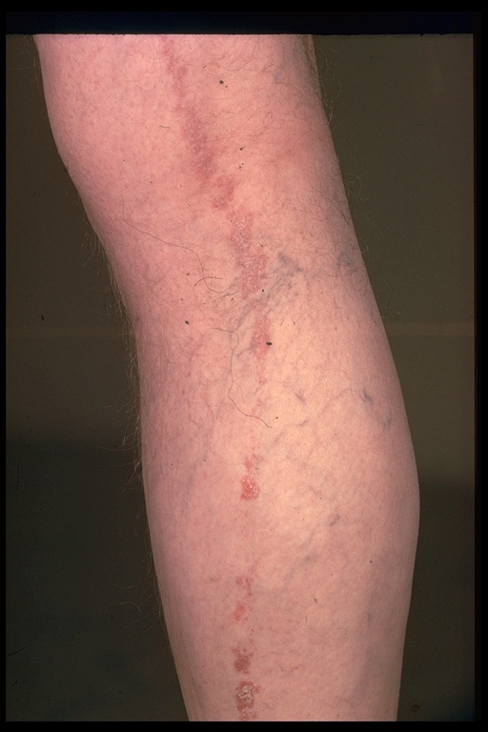
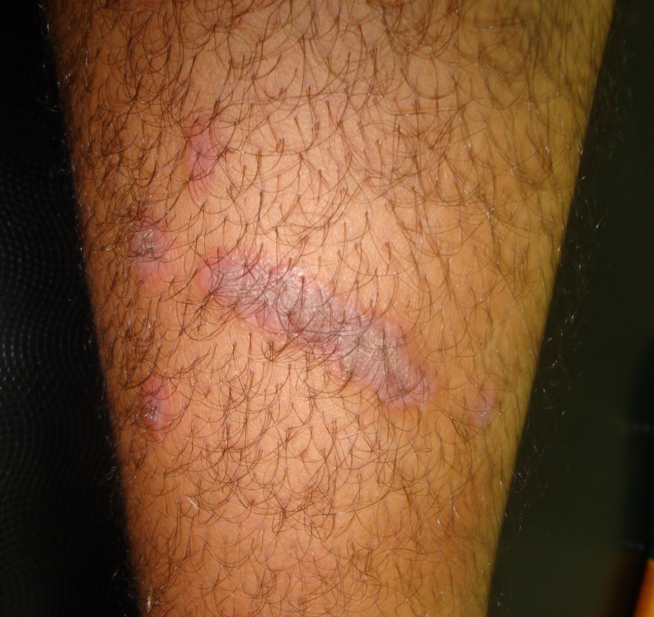
Leg
Linear lichen planus
Upper arm

Slide 23
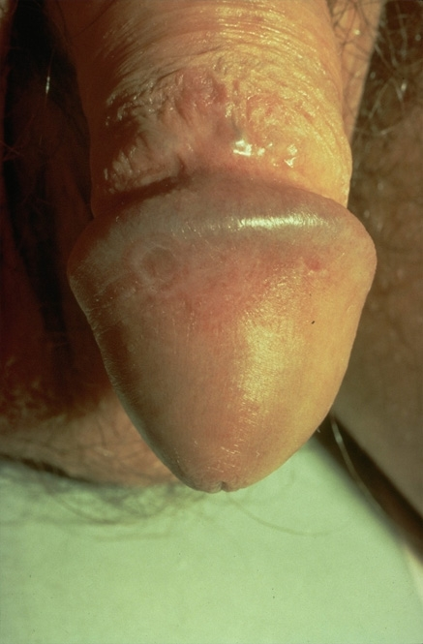
Annular lichen planus
About 10% of cases of LP.
Most commonly occurs on the glans penis or the lips.
Usually sparse ring-shaped lesions with elevated border composed of violaceous papules with usually hyperpigmented centers.
Coalescence of the annular plaques may produce polycyclic figures.
May occur in context of classical LP.
The main differential diagnoses are:
Granuloma annulare
Tinea (Dermatophytosis)
Sarcoidosis

Slide 24
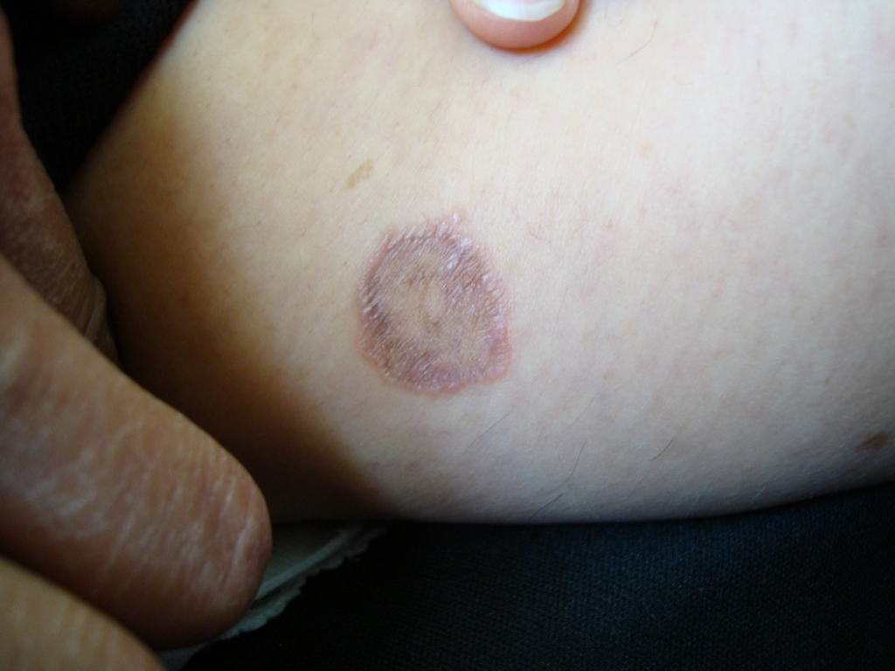
Annular LP
An annular plaque on the abdomen of a woman with hyperpigmented center and elevated violaceous border.

Slide 25
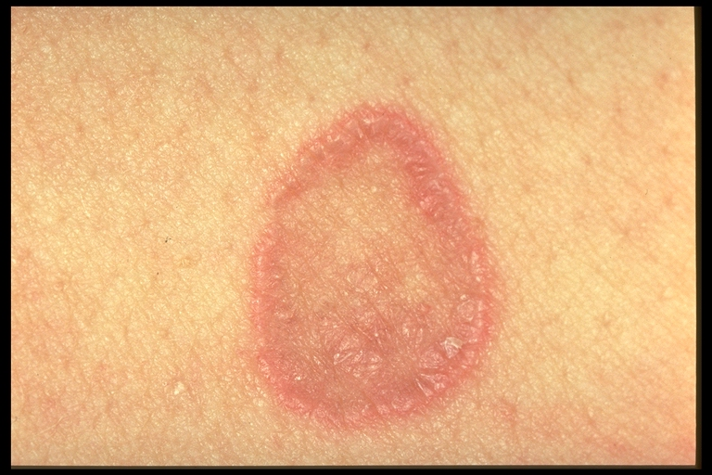
Annular LP
Ring-shaped lesion (annular plaque) made up of purple flat-topped papules particularly at the margin.

Slide 26
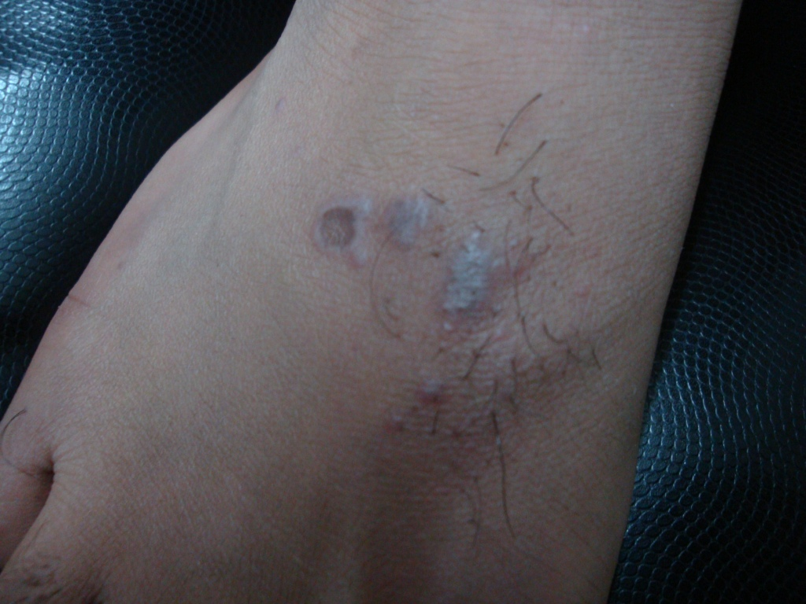
Annular lesions may occasionally be seen in the context of ordinary lichen planus.

Slide 27
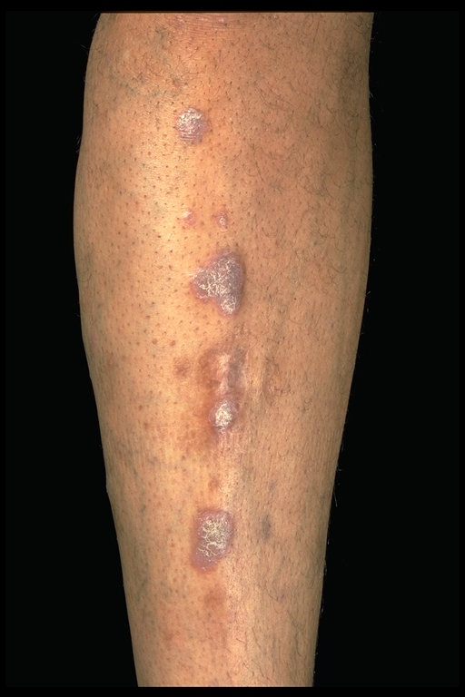
Hypertrophic lichen planus
Characterized by hypertrophic, scaly, large sized and intensely pruritic plaques.
Usually involves the shins.
At the edges of the plaques, classical violaceous papules may be seen on careful examination. This may aid in the diagnosis.
Main differential diagnoses are:
LSC
Plaque psoriasis
Prurigo nodularis
Kaposi sarcoma
Lichen amyloidosis
Lichen planus verroucosus

Slide 28
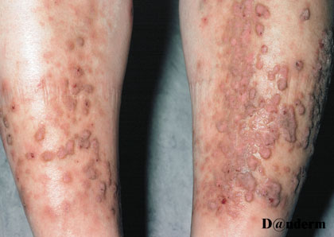
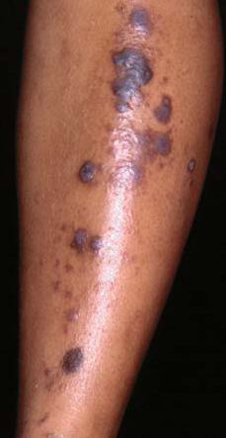
LP hypertrophicus commonly occurs on the shins (usually bilateral symmetrical).

Slide 29
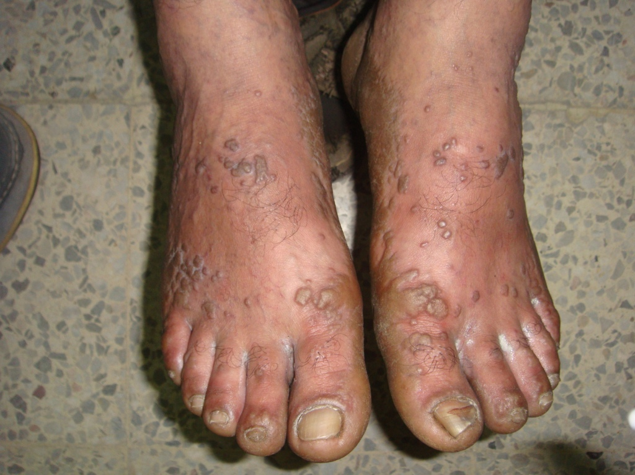
Hypertrophic LP on the feet having a verrucous appearance and may be difficult to be differentiated from verruca vulgaris.

Slide 30
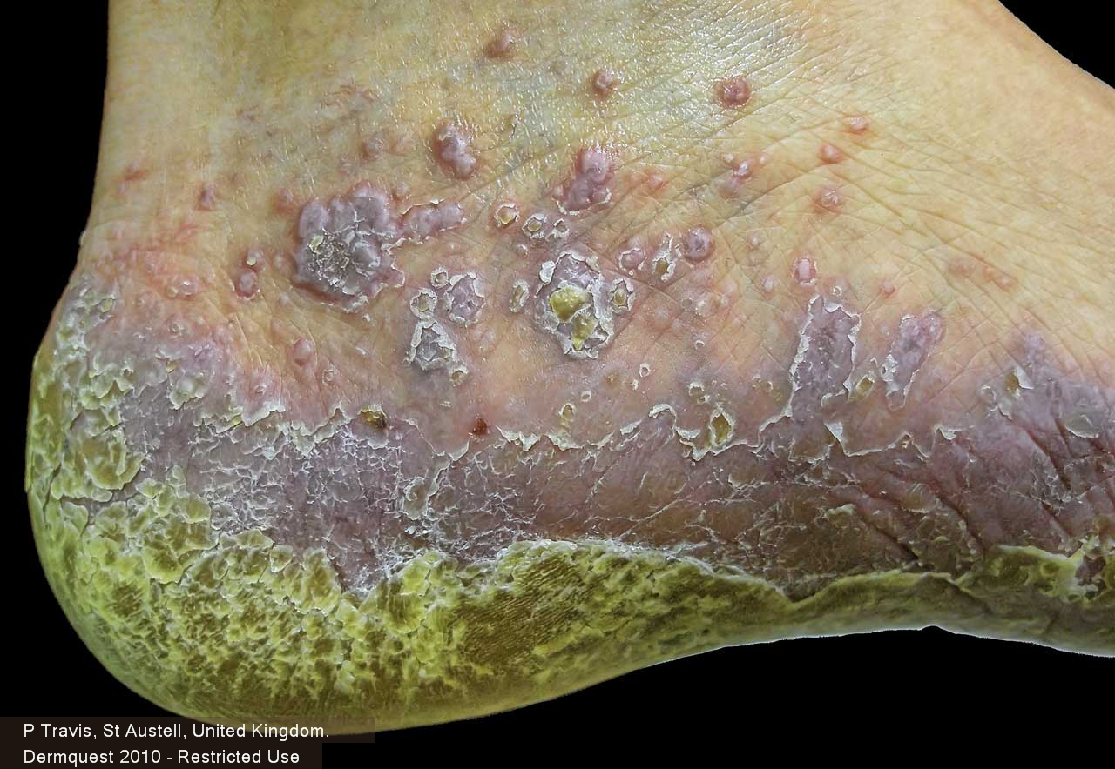
LP hypertrophicus with a characteristic violaceous color

Slide 31
Atrophic lichen planus
A rare variant of LP characterized by few, small, well-demarcated papules or plaques with central atrophy. Lesions may coalesce to form larger plaques.
Most commonly occurs on the lower extremities or the trunk.
The main differential diagnosis is lichen sclerosus.

Slide 32
Follicular lichen planus
A rare variant of LP (< 1%). It affects women > men.
Small, violaceous, follicular, hyperkeratotic papules centered around hair follicles.
May affect any hair-bearing area especially the scalp and usually causes gradual but permanent cicatricial alopecia with one or more residual tufts of normal appearing hairs within the scarred area is a characteristic feature.
The main differential diagnoses of follicular lichen planus are:
Lichen nitidus
Lichen spinulosus
Follicular psoriasis
Other causes of scarring alopecia especially DLE.

Slide 33
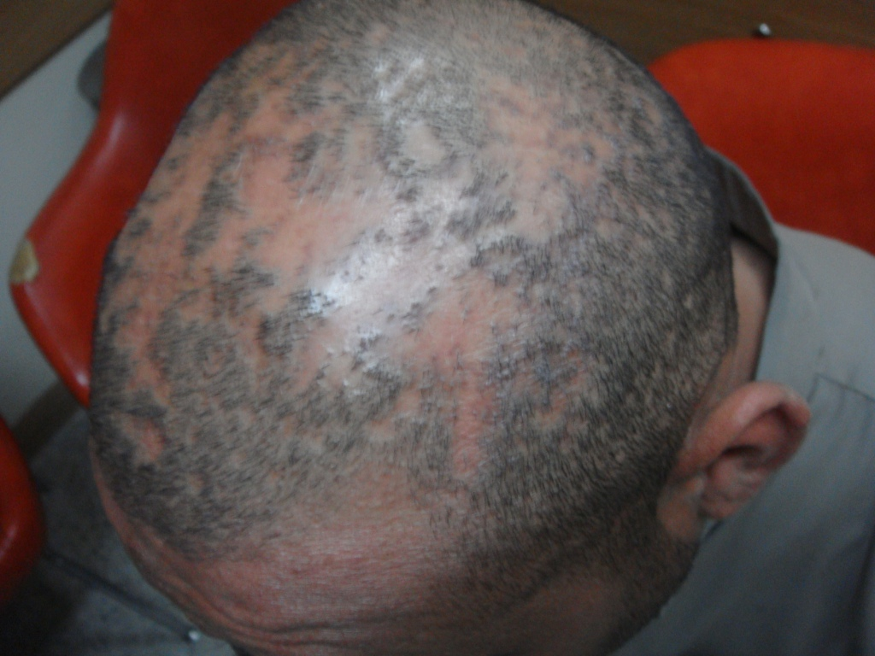
Cicatricial alopecia caused by lichen planopilaris. Notice small follicular purplish papules at the periphery of scarred areas

Slide 34
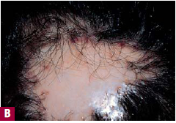
Lichen planopilaris resulting in atrophic, scarred, porcelain white area with bordering follicular involvement resulting in doll’s hair formation.

Slide 35
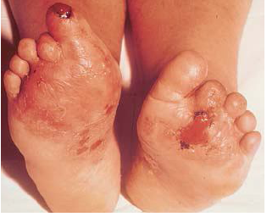
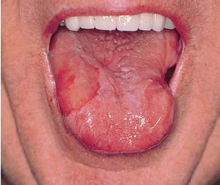
Erosive-ulcerative lichen planus
Commonly involves the mucous membranes especially of the mouth but rarely affects the skin.
Usually occurs on the feet and toes and produces painful ulceration and may cause permanent loss of the toes.
SCC may complicate lesions of ulcerative LP.
Erosive-ulcerative LP. Erosions, ulcers, and scarring of toes and sole.
Long standing oral LP. Erosion of right lateral tongue was biopsied and confirmed SCC

Slide 36
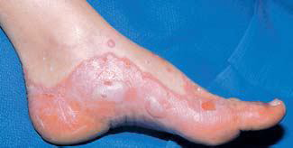
Vesiculobullous lichen planus
A rare variant of lichen planus.
Usually occurs on the lower extremities.
Vesicles and/or bullae occur atop classical lesions of LP or rarely on normal skin.
Vesiculobullous lichen planus

Slide 37
Lichen planus actinicus
Synonyms: Actinic LP and LP subtropicus.
Common in tropical and subtropical regions including Africa, Middle East and India. It is also common in Iraq.
Aetiology is presumed to be long exposure to sun light (may be regarded as one of photo-sensitive disorders).
Shows seasonal variation with the onset in spring and summer and may remit or be quiescent during winter.
Third decade of life (young adults) is the most common age of occurrence in both sexes.
Classical presentation of LPA is with annular plaques having hyperpigmented centers and violaceous borders.
Sites: usually sun-exposed parts like the face, neck, V-shaped area of the chest and the dorsa of the hands. The face is almost always most severely affected.
Itching is usually absent or mild.

Slide 38
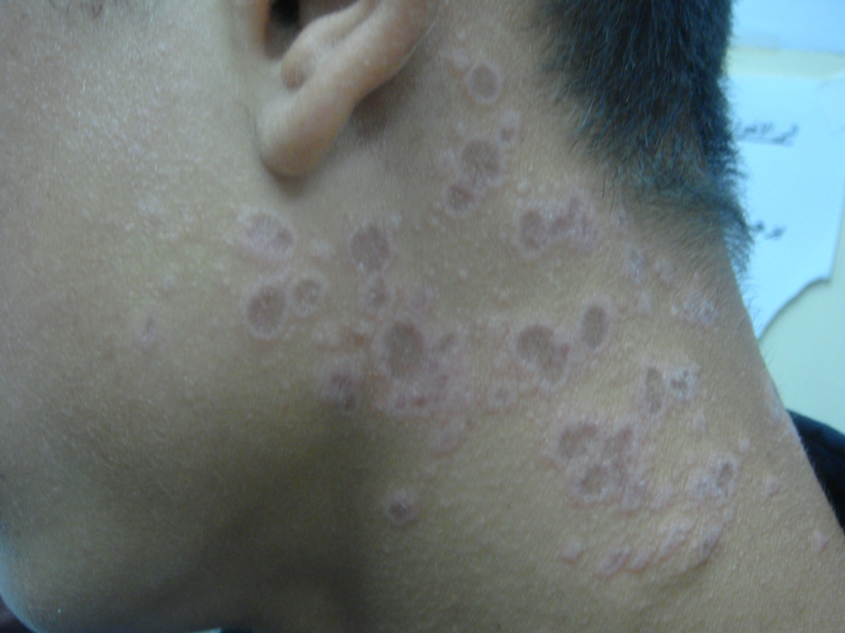
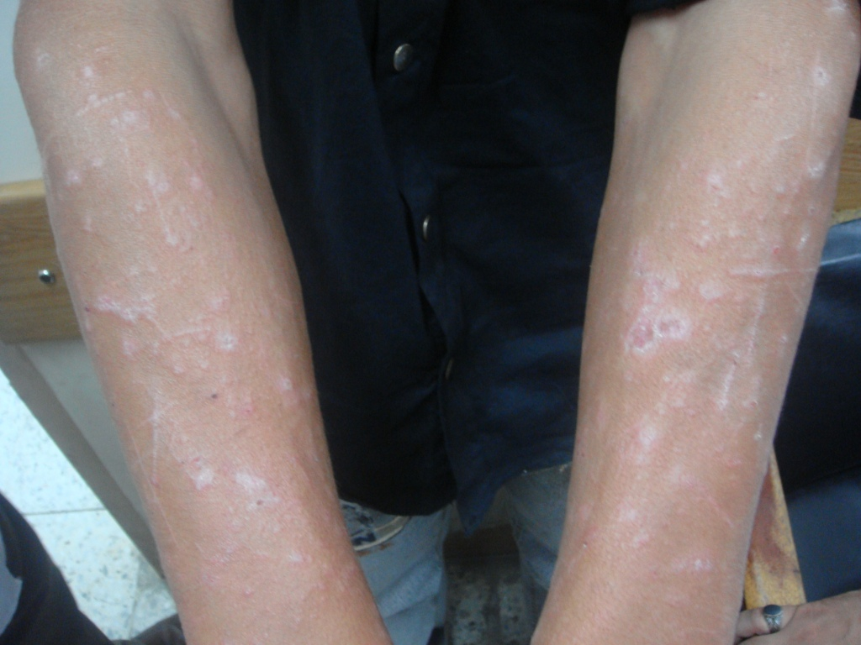
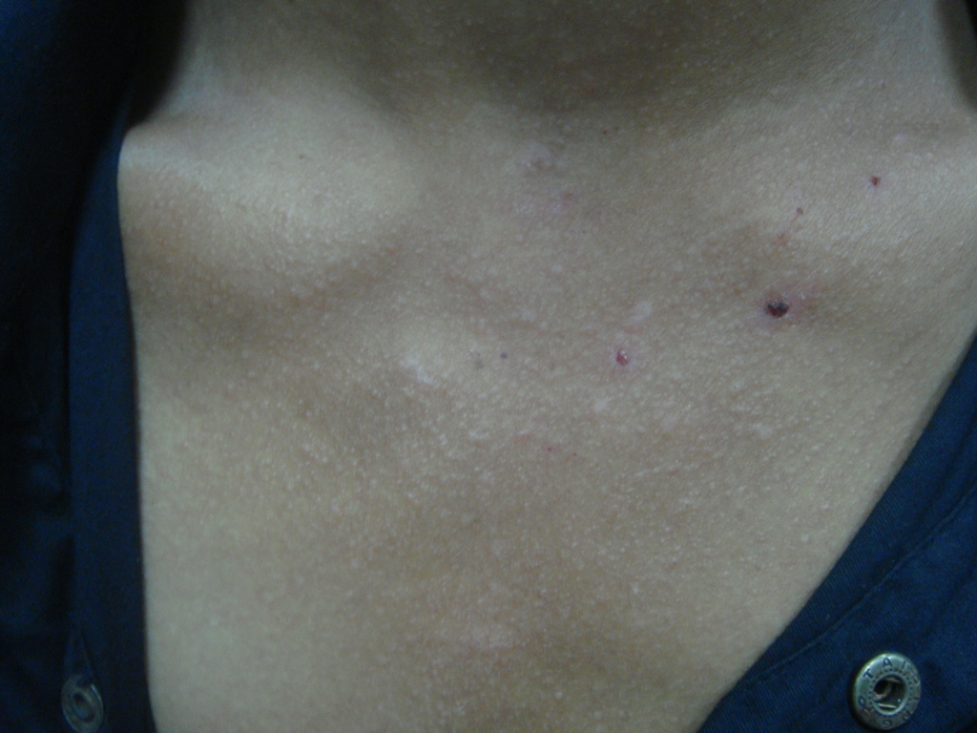
Lichen planus actinicus involving the sun exposed parts of the body with classical annular plaques

Slide 39
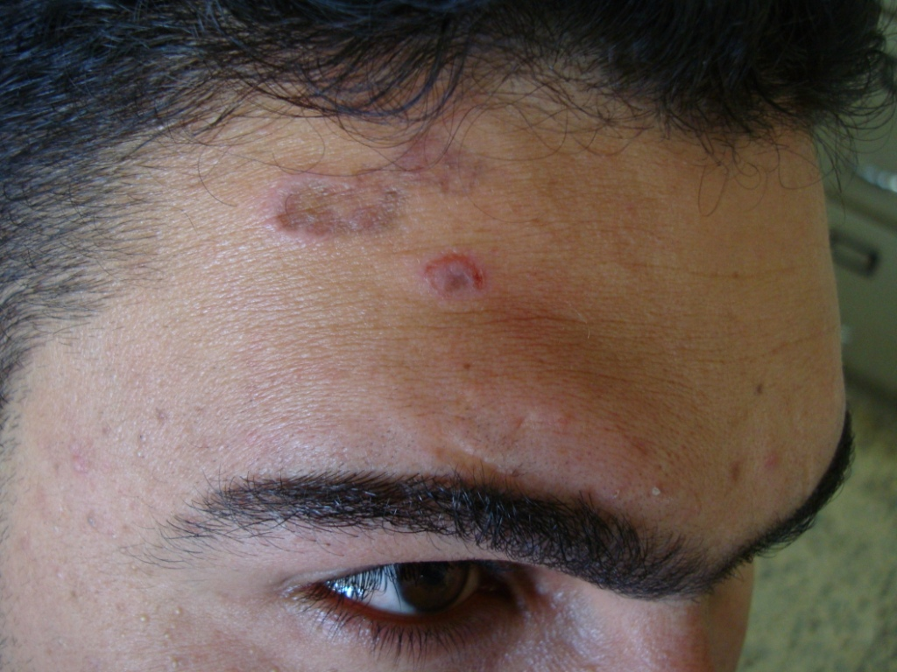
A young adult with classical annular plaques of LPA

Slide 40
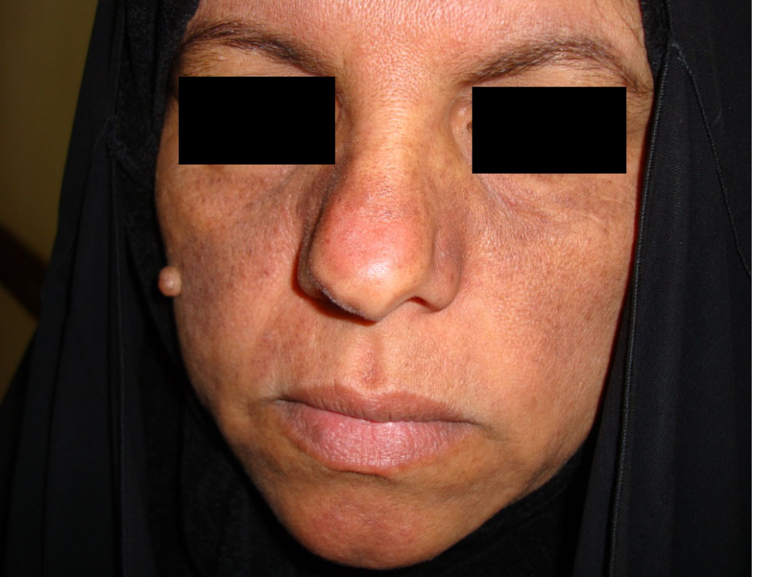
Melasma-like LPA

Slide 41
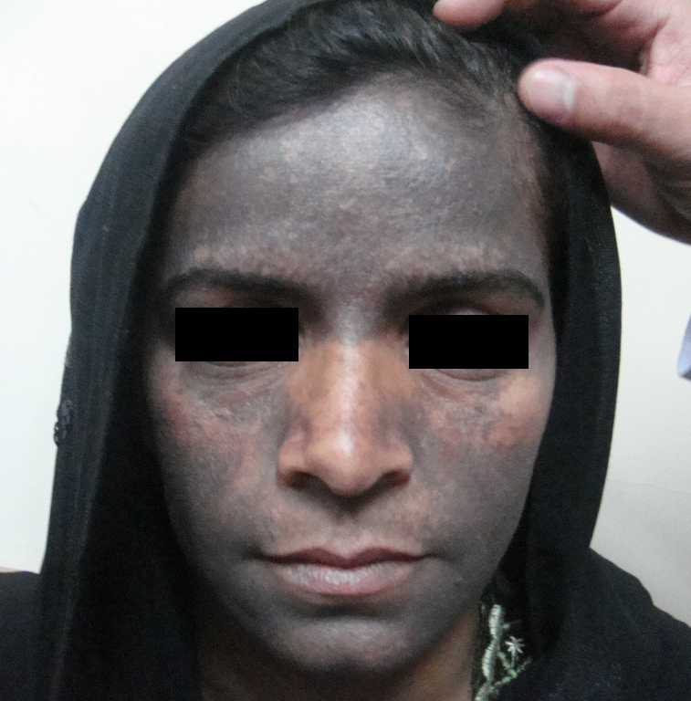
LP Pigmentosus
LP pigmentosus is a rare variant of lichen planus.
More common in Latin America and India.
Usually presents with hyperpigmented patches of the sun-exposed parts and body flexors.
Occurs more frequently in people with dark complexion.
LP pigmentosus
Diffuse hyperpigmentation of the face

Slide 42
Mucosal lichen planus
The mucous membranes of the mouth and/or genitalia are involved in about two-thirds of the cases of lichen planus.
LP may be confined only to the mucous membranes without skin involvement.
Commonest sites affected in the mouth are the inner side of the cheeks, tongue, palate, gums and lips.
The most common genital sites involved are the glans penis, vulva and the vagina.
Mucosal LP has more prolonged course than the cutaneous form of the disease.
There are 3 morphological patterns of mucosal lichen planus:
1. Reticulate pattern: asymptomatic, pinhead-sized, whitish papules in a lace-like pattern (whitish network-like lesions). Occasionally, the papules coalesce forming large, irregular, whitish patches mimicking leukoplakia.

Slide 43
2. Ulcerative (Erosive) pattern: common form of mucosal lichen planus. It presents as painful, superficial, erosions or ulcerations of the oral or genital mucosa. SCC may complicate longstanding cases of this form of mucosal lichen planus.
3. Atrophic pattern: is the rarest type and presents as annular atrophic whitish patches.
Sometimes lichen planus occurs exclusively in the mouth. Persistent ulceration may be the dominant physical sign although the white reticulate pattern is usually also present. Biopsy is usually necessary to establish the diagnosis.

Slide 44
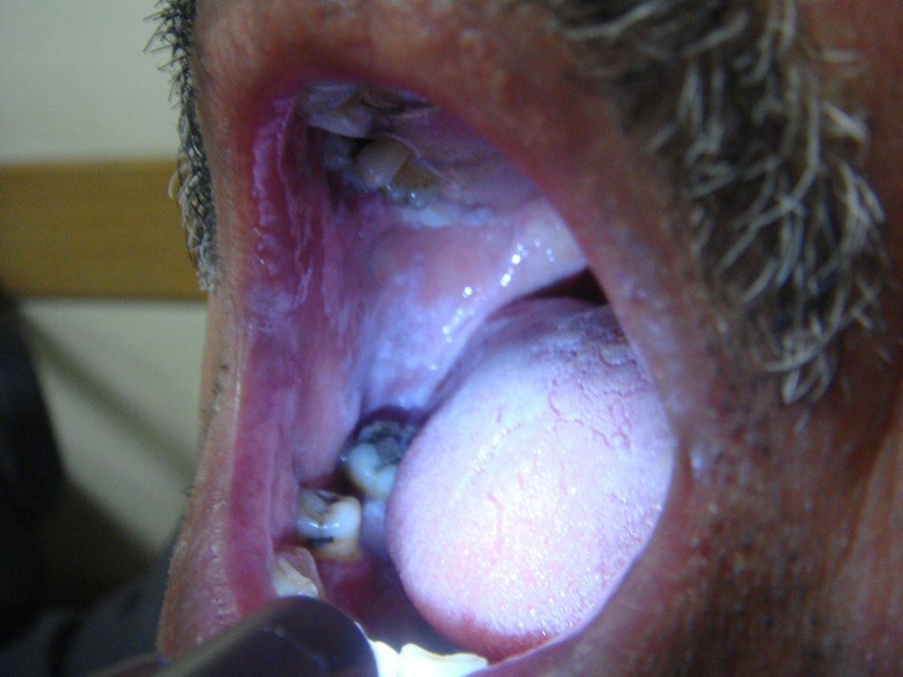
Oral lichen planus

Slide 45
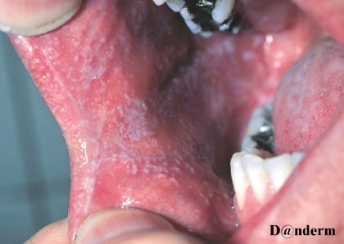
Reticulate pattern of oral LP

Slide 46
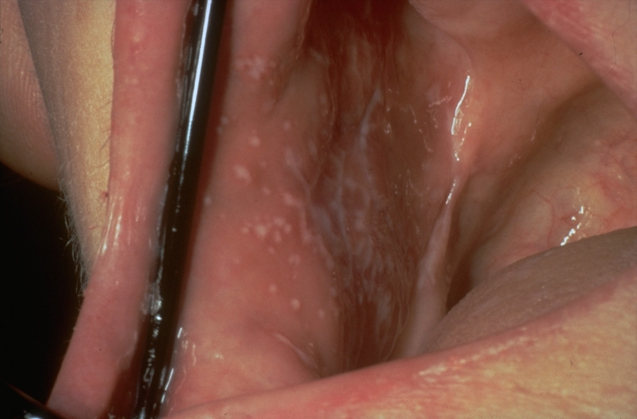
Lacy pattern on cheek mucosa

Slide 47
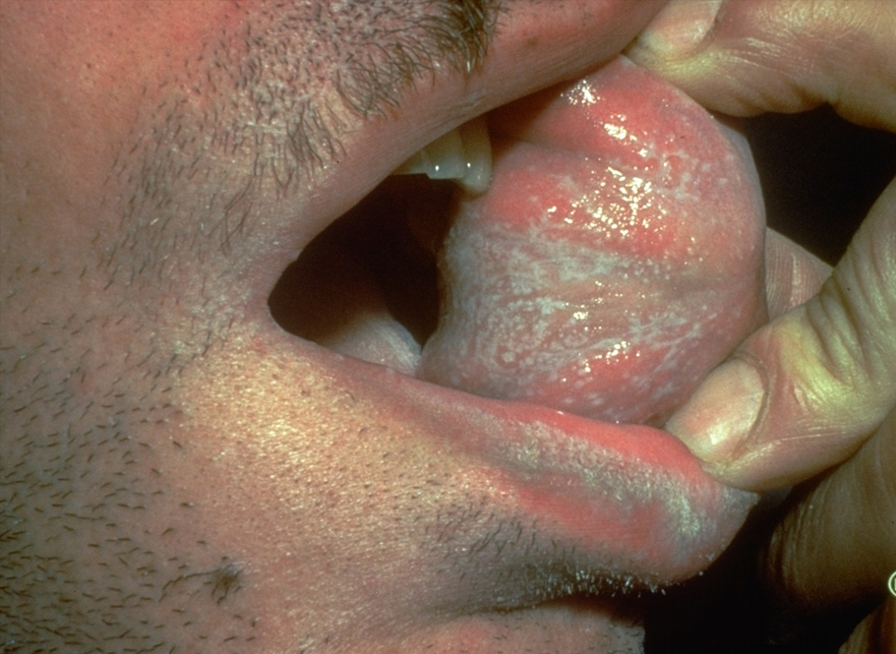

Slide 48
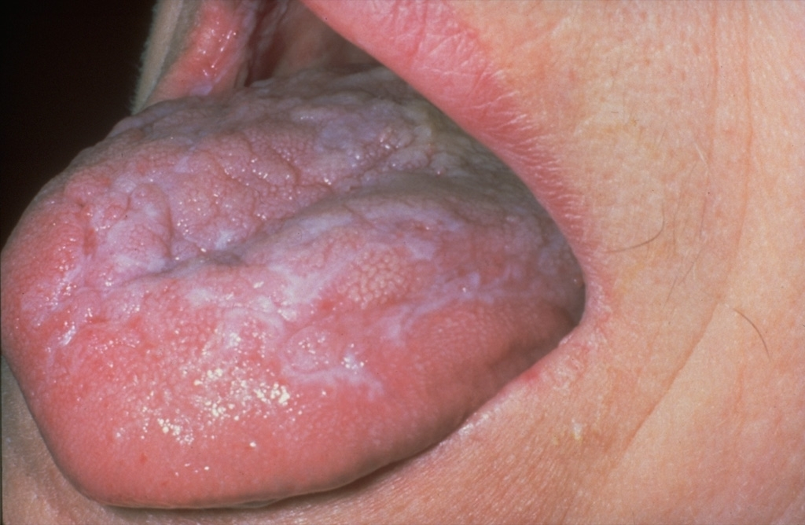
Atrophic lichen planus involving the tongue

Slide 49
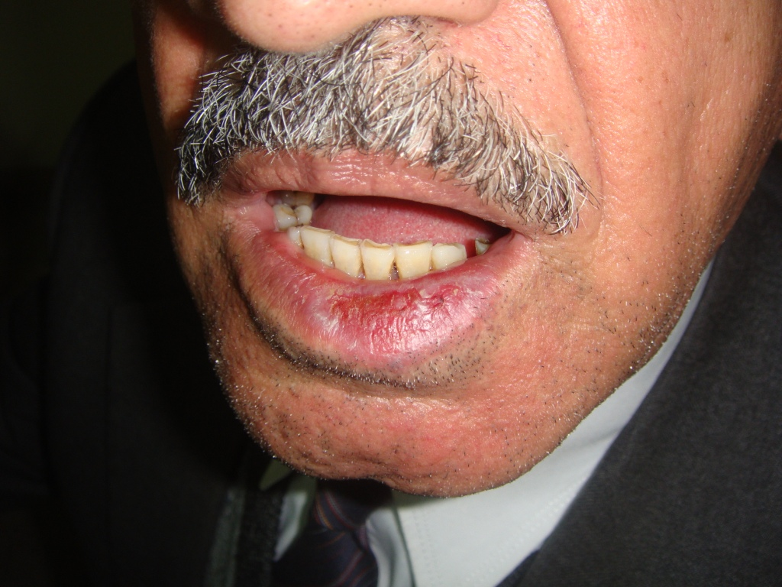
Erosive lichen planus on the lower lip

Slide 50
Lichen planus of the nails
Nail changes are rare in lichen planus (1-10% of cases).
Nail changes
Thinning of the nail plate (commonest change).
Thickening of the nail plate (due to subungual papules).
Nail splitting.
Longitudinal grooves or ridges in the nail plate.
Pterygium formation: the most specific nail change in lichen planus. It is due to inflammatory destruction of the nail matrix, which will be replaced by fibrosis that leads to fusion of the proximal nail fold with the proximal portion of the nail bed. It is seen as a triangular band in the middle of the proximal portion of the nail plate. It commonly involves the nail of the thumb.
Nail dystrophy: obliteration of the whole nail unit.

Slide 51
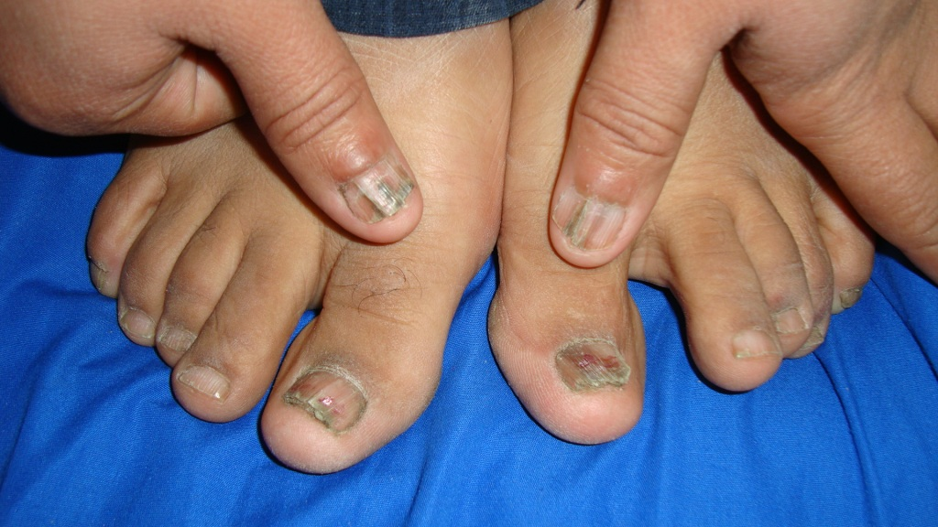
Partial nail dystrophy with pterygium formation specially of thumbs

Slide 52
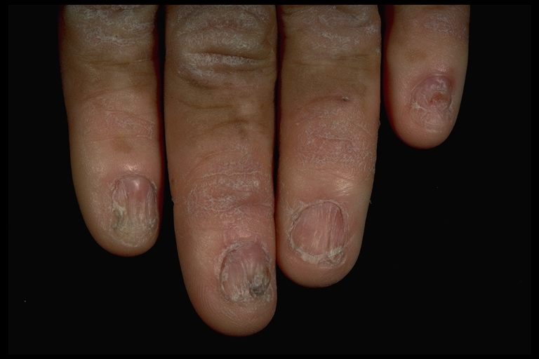
Destruction of the nail plate results in adhesion between the nail plate and bed producing an appearance known as pterygium.

Slide 53
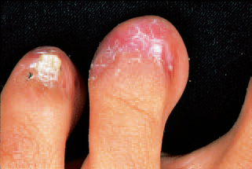
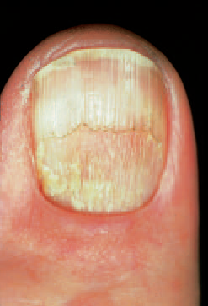
Total nail dystrophy with permanent scarring
The main differential diagnoses of lichen planus of the nails are:
Psoriasis
Onychomycosis
Alopecia areata
Thinning and longitudinal grooving of the nail plate

Slide 54
Complications of lichen planus
Scarring alopecia (permanent hair loss).
Nail loss or deformities.
SCC may complicate erosive lichen planus of the mucosa.
Post-inflammatory hyperpigmentation.
Management of lichen planus
Lichen planus is self-limiting disease but may take many months to few years to disappear. However, it is difficult to treat. For:
A. Widespread disease: may be treated with:
1. Systemic steroids ( the problem is relapse as dose reduced).
2. Systemic retinoids (Acetretin and Isotretinoin).
3. PUVA therapy.
4. Enoxaparin (low molecular weight heparin) given as 3 mg subcutaneous injection weekly. It is not effective for oral lesions.
5. Cyclosporine: for most severe cases. Main side effect is its potential toxicities.

Slide 55
B. Limited cutaneous lesions: can be managed with superpotent topical corticosteroids or intralesional steroid injections.
C. Oral lesions: you can prescribe:
Superpotent topical steroid in Orabase.
Topical steroid + topical Tretinoin.
Intralesional steroid (for unresponsive lesions).
Cyclosporine mouthwash (for refractory cases).
Hydroxychloroquine 200-400 mg orally per day for 6 months.
What are the indications of intralesional steroid in LP?
Hypertrophic LP.
Painful oral lesions.
Nail dystrophy.
Early scalp involvement.

Slide 56
الحمد لله رب العالمين
THANK YOU

