Slide 1
NAIL DISORDERS
Dr. Nameer Al-Sudany

Slide 2
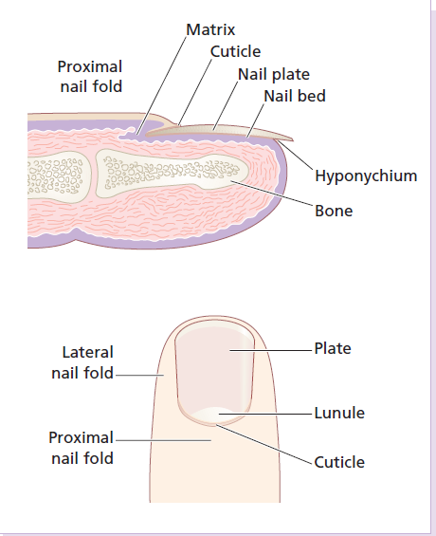
Anatomy of the nail
The nail unit consists of:
Nail matrix
Proximal nail fold
Cuticle
Nail plate
Nail bed
Hyponychium
Lunula
Lateral nail folds

Slide 3
The nail matrix is responsible for production of the hard keratin of the nail plate.
The nail bed is capable of producing small amounts of keratin which contribute to the nail and which are responsible for the ‘false nail’ formed when the nail matrix is obliterated by surgery or injury.
The cuticle acts as a seal to protect the potential space of the nail fold from chemicals and from infection.
Functions of the nails
The nails provide strength and protection for the terminal phalanx.
Nails help with fine touch and with the handling of small objects.
Cosmetic function.
Nail growth
Nail growth rate varies from person to person. Fingernails average between 0.5 and 1.2 mm per week, while toenails grow more slowly.
Nails grow faster during summer, if they are bitten and in youth.
They change with ageing from the thin, occasionally spooned nails of early childhood to the duller, paler and more opaque nails of the very old. Longitudinal ridging and beading are particularly common in the elderly.

Slide 4
Nail Disorders
Congenital nail abnormalities
Traumatic nail disorders
Nail infections
Nail tumors
Nail color changes
Nail in common dermatoses
Nail in systemic diseases

Slide 5
Congenital nail abnormalities
Anonychia: one or more nails are missed since birth. It is very rare condition.
Pachyonychia congenita:
Rare autosomal dominant condition.
Grossly thickened misshapen nails seen at early childhood.
May be ass. with alopecia, palmoplanter keratoderma and hyperkeratosis at frictional areas esp. on leg and feet.
Nail-patella syndrome:
Rare autosomal dominant syndrome.
Nails are smaller than normal (esp. thumbs) associated with rudimentary or absent patellae and iliac spines.
Epidermolysis bullosa dystrophica:
Autosomal dominant & autosomal recessive. There may be permanent loss of nails.

Slide 6
Congenital nail abnormalities
Nail “en racquette” :
May be autosomal dominant (1-2% of population).
Shortness of the terminal phalanx leads to short and broad nail of the thumb.
Yellow nail syndrome: rare condition characterized by:
The nails are very slow growing, thickened and have greenish yellow color with over-curvature from side to side. The changes usually start in adult life.
Non-pitting peripheral edema due to lymphatic hypoplasia.
Chronic pulmonary infections and chronic sinusitis and pleural effusions may occur.
AIDS may associate with yellow nail syndrome.

Slide 7
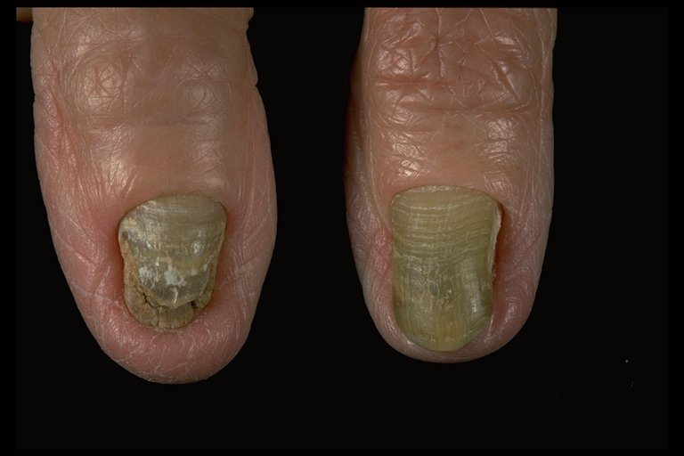
Yellow nail syndrome

Slide 8
Traumatic nail disorders
Nail matrix damage: may cause permanent nail ridges or splits in the nail plate.
Onychogryphosis: malalignment (curved) and thickening of the nails due to chronic trauma caused by sport or ill-fitting footwear.
Ingrowing nails: usually affects big toe resulting from ill-fitting shoes i.e. chronic trauma. Treatment is surgical (nail avulsion).
Subungual hematoma: presents acutely with severe pain due to accumulation of blood under the nail plate with a blackish or purplish discoloration of the nail plate. It affects the big toe more than other digits. Treatment: evacuate the blood by piercing the nail plate at time of trauma. If it is untreated the pain will subside spontaneously after a time.

Slide 9
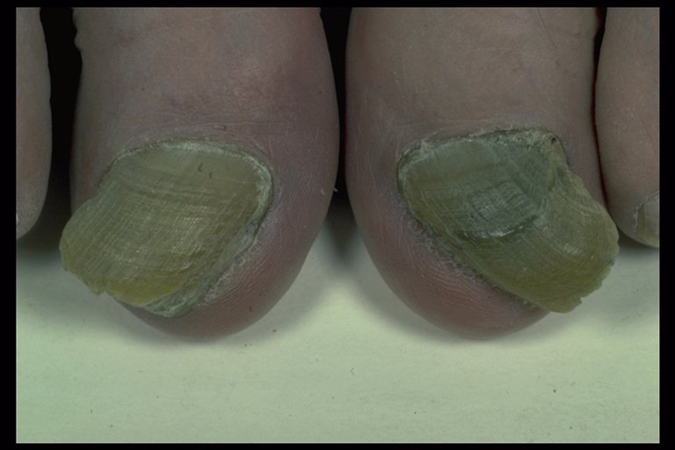
Onychogryphosis

Slide 10
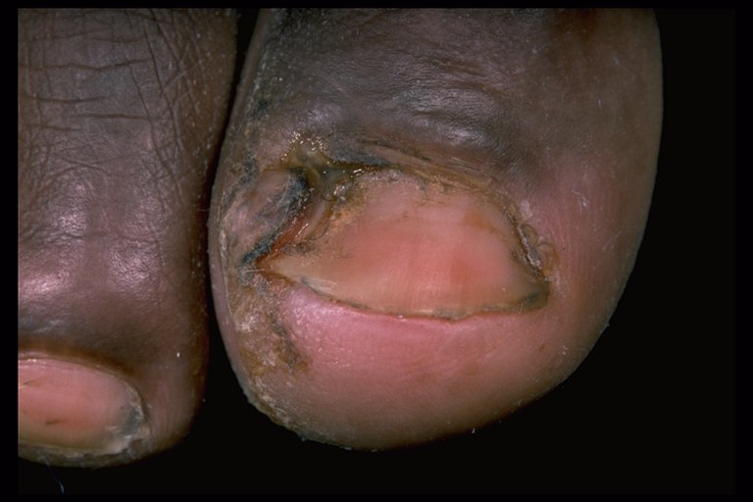
Ingrowing toenail

Slide 11
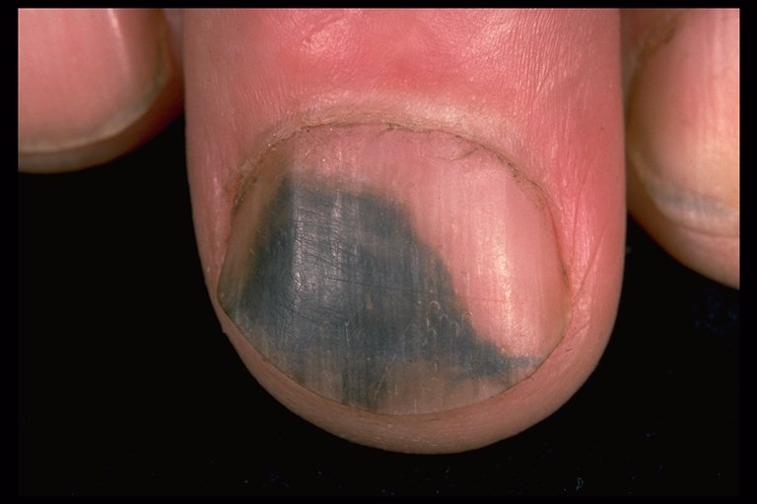
Black nail: Subungual hematoma

Slide 12
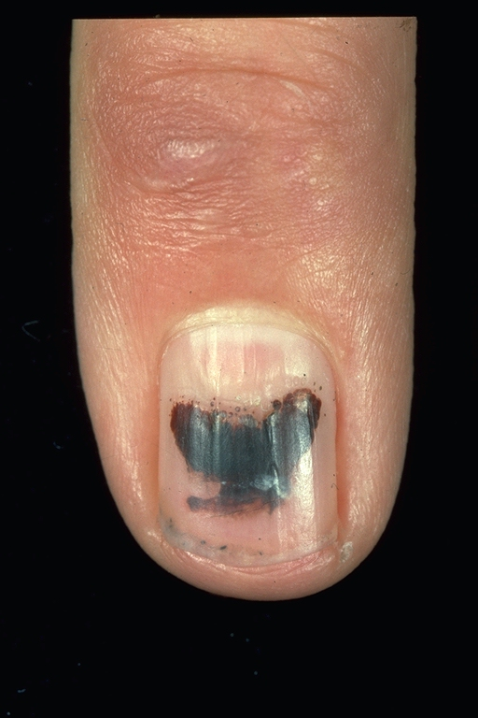
Red-brown nail
Subungual H. (trauma)

Slide 13
Splinter hemorrhage: fine longitudinal dark brown lines under the nail plate (in the nail bed).
Causes: minor traumas (manual workers ), SBE, psoriasis or can be idiopathic.
Onycholysis: separation of the nail plate from the nail bed. Causes:
Trauma (commonest cause)
Psoriasis
Onychomycosis
Erythroderma
Photo-onycholysis: due to tetracyclines, chloramphenicol, psoralens and fluroquinolones.
Raynaud’s phenomenon.
Hypochromic anemia (poor oxygenation).
Thyrotoxicosis.
Idiopathic.

Slide 14
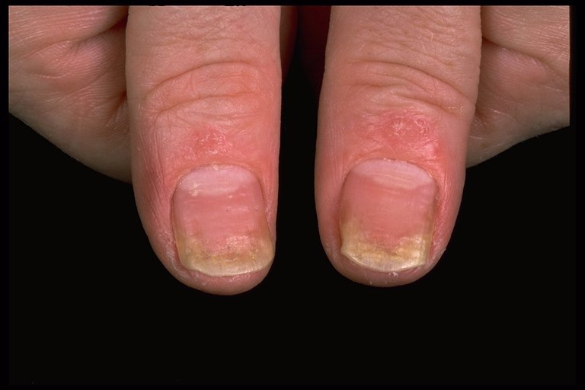
Bilateral onycholysis due to psoriasis

Slide 15
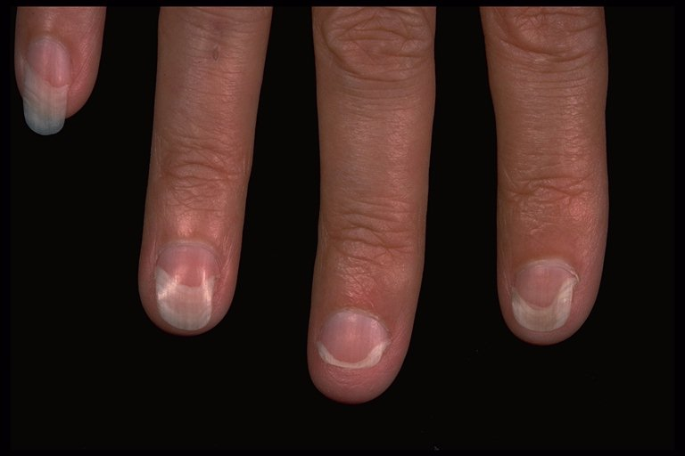
Photo-onycholysis due to tetracycline

Slide 16
Lamellar splitting of the nail plate: repeated wetting and drying of hands in housewives may cause splitting of the distal parts of the nail plates.
Median canal dystrophy: this condition affects the thumb nails only. The cause is possibly trauma to the nail matrix. There are small lines extending outward from the central ridge or split giving the impression of an inverted fir tree. The condition recovers after months or years but relapse is not uncommon.

Slide 17
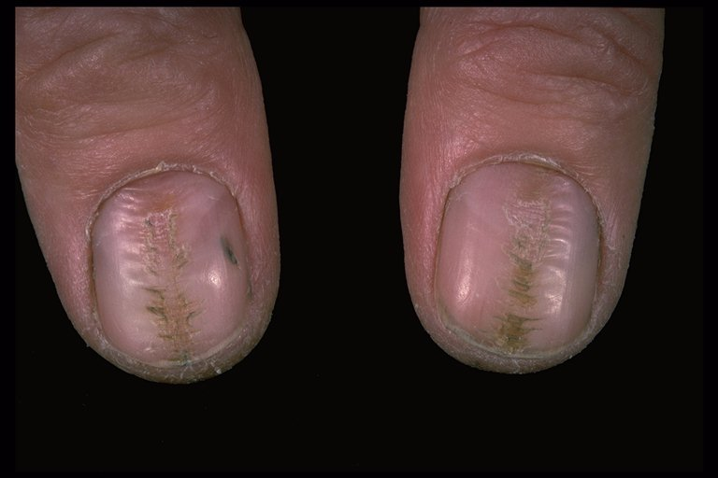
Median canal dystrophy

Slide 18
Nervous habits
Onychophagia (Bitten nails): seen both in children and adults. The nails are short and irregular. Some individuals may also bite the cuticles of the nails and even the skin around the nails.
Habit tic nail dystrophy: a common problem due to the habit of picking or rubbing of the cuticle or the proximal nail fold (repetitive traumas) especially of the thumb or index which produces a ladder pattern of transverse ridges and grooves up to the center of nail plate.

Slide 19
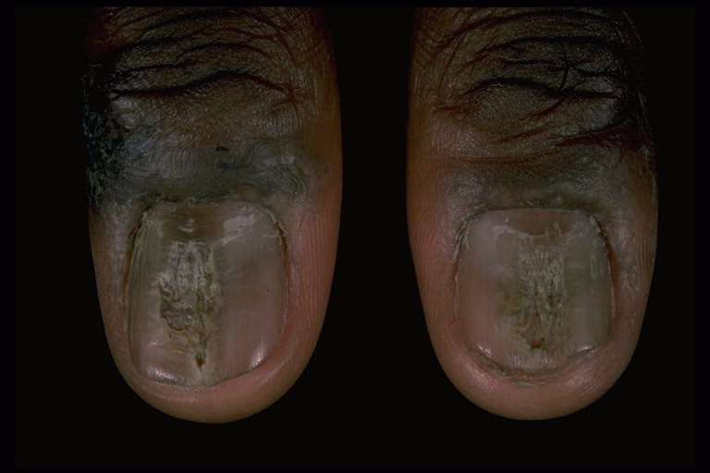
Habit-tic nail dystrophy

Slide 20
Nail infections
The nail unit may be involved with bacterial infections like paronychia or pseudomonas infection or fungal infections (onychomycosis).
Paronychia
Paronychia is an inflammation of the nail fold. There are two types: acute paronychia which is purely bacterial in origin and chronic paronychia which is usually mixed infection due to a mixture of opportunistic pathogens. The main differences between the two types are shown below:
See table

Slide 21
Differences between acute and chronic paronychias
Features | Acute paronychia | Chronic paronychia
Onset | Acute | Gradual (Insidious)
Cause | S. aureus | C. albicans + G+ve and –ve cocci
Predisposing factor | Usually traumatic (Cuticular seal damage) | Moisture (housewives, bar tenders, fishermen…)/ DM
Symptoms (Pain) | +++ | +
Signs | Tender red swelling and pus collection | Less tender, red diffusely swollen nail fold (Pillow-like) + little pus
Nail plate | Normal | May be ridged & discolored
No. of nails affected | Usually one | Usually more than one
Course | Short | Long (may last for years)
Treatment | Drainage + anti-S. aureus antibiotics | Topical and systemic antifungal (anti-candidal) and antibiotics

Slide 22
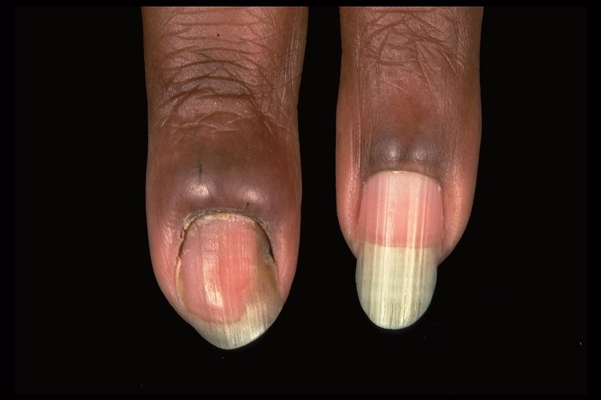
Chronic paronychia due to Candida albicans

Slide 23
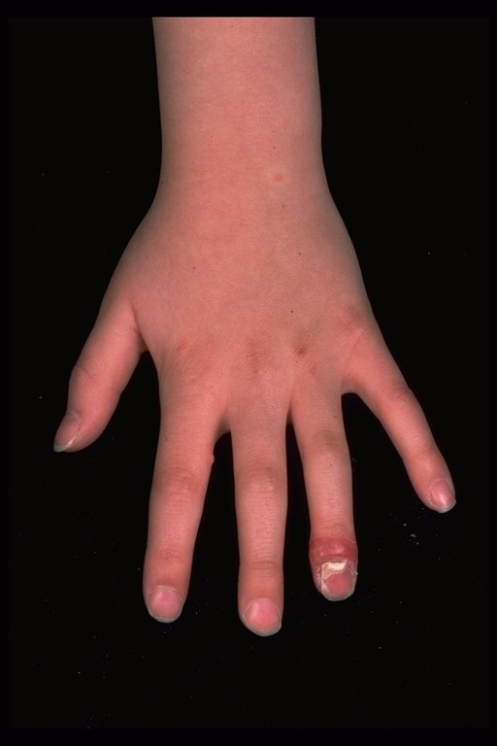
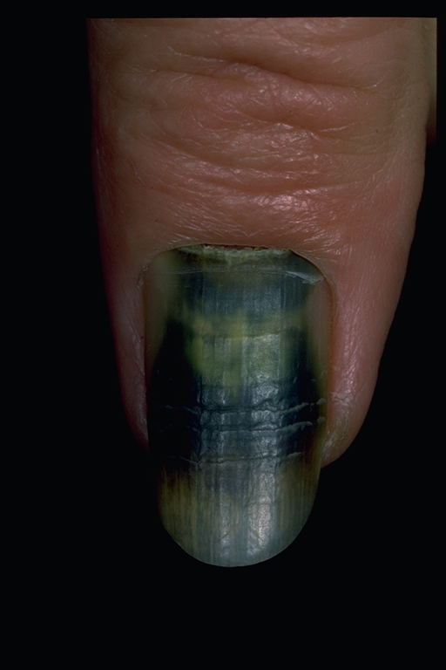
Acute paronychia due to Staphylococcus aureus
Nail infection due to Pseudomonas

Slide 24
Tinea unguium (Onychomycosis)
It usually occurs in adults (rare in children). It may associate with tinea pedis (foot infection) or tinea mannum (hand infection). The causative fungal species are similar to those of tinea pedis especially Trichophyton rubrum.
Predisposing factors:
Old age (diminished blood supply).
Moisture exposure.
Antecedent nail disorders e.g. nail trauma, nail psoriasis and hand eczema.
Clinically, the infection starts in one finger and then spread to involve other nails with yellow brown discoloration of the nail plate. Later on subungual hyperkeratosis or even onycholysis may occur. Advanced cases may result in nail dystrophy .

Slide 25
Differential diagnosis of tinea unguium:
Psoriasis of the nails
Lichen planus of the nails
Candidal onychomycosis (rare)
Idiopathic nail dystrophy
Treatment
Fungal infection of the nail is one of the indications of systemic anti-fungal therapy which include:
Griseofulvin
Azole anti-fungals (Itraconazole or Fluconazole)
Terbinafine (Lamisil®).
Terbinafine is a fungicidal agent with a broad spectrum activity. It is the drug of choice in the treatment of tinea unguium and given in a dose of 250 mg once daily for 6 weeks in fingernail infection and for 12 weeks in toenail infection.

Slide 26
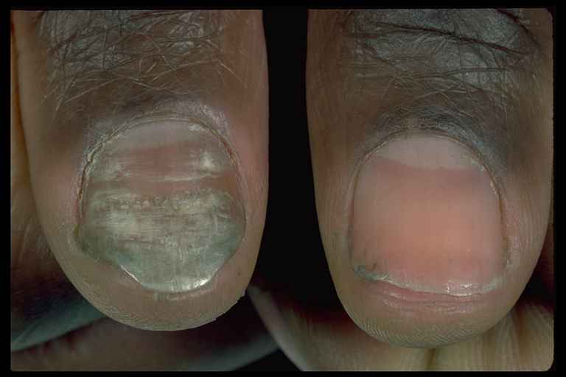
Nail discoloration –Tinea unguium

Slide 27
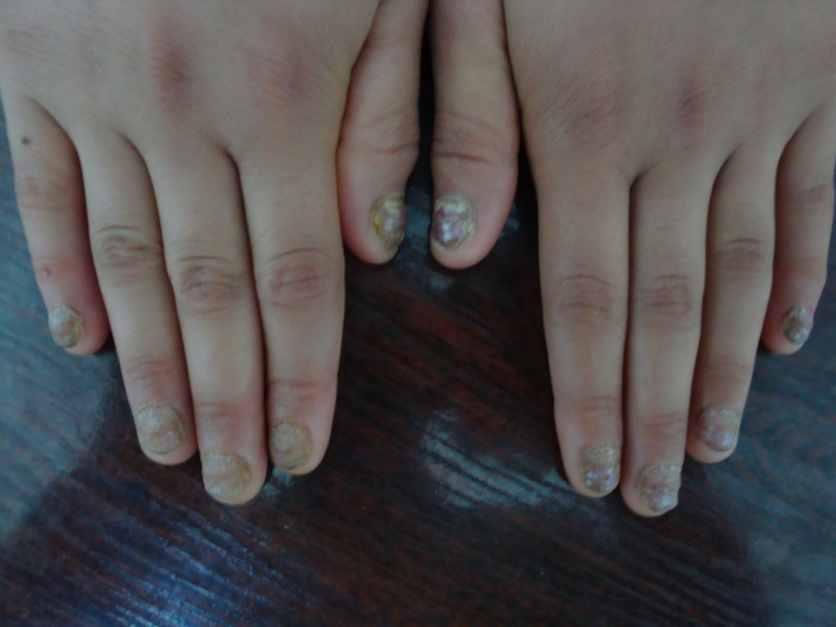
Nail dystrophy – Tinea unguium

Slide 28
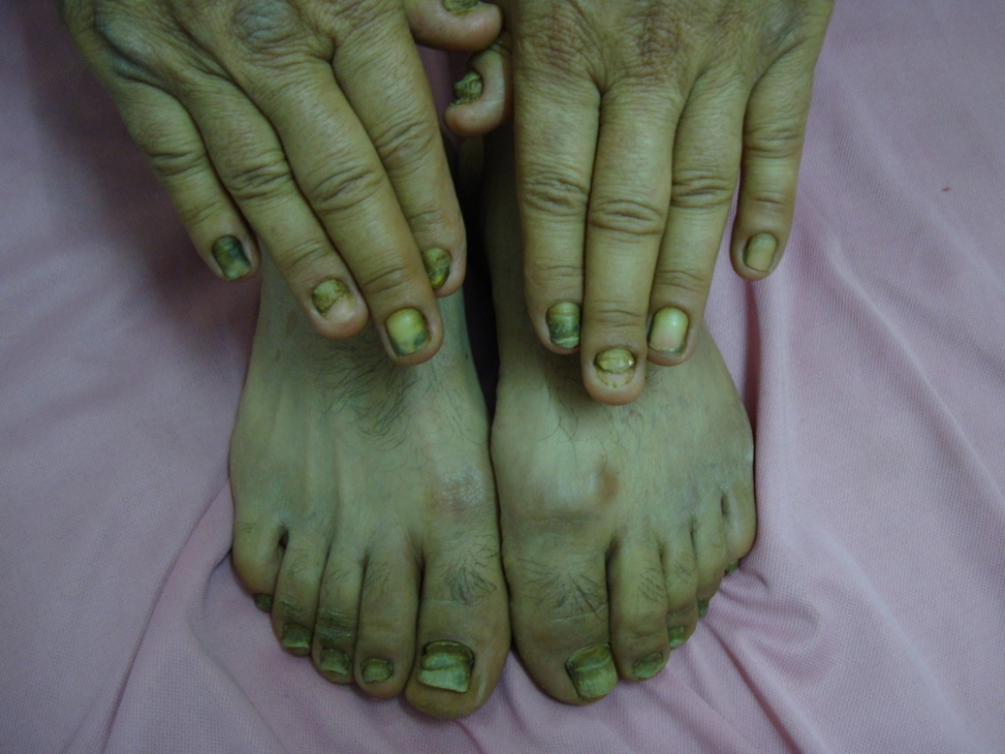
Nail dystrophy – Tinea unguium

Slide 29
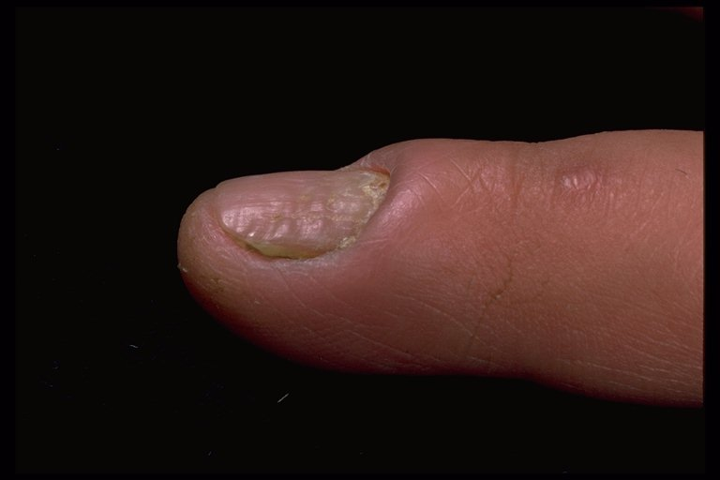
Onychomycosis: chronic paronychia, nail thickening & ridging due to C. albicans

Slide 30
Nail tumors
The nails and their surrounding areas may be involved with a number of benign and malignant tumors:
Peri-ungual wart
Koenen’s tumor (peri-ungual fibromas): usually seen in late childhood in 50% of patients with tuberous sclerosis.
Sub-ungual exostoses: painful bony protrusions under the nail plate. Usually occur secondary to trauma to the terminal phalanx. Diagnosis by X-rays and treatment is surgical removal.
Myxoid cyst: Smooth dome-shaped swelling contains a clear jelly-like material. It usually involves the proximal nail fold of fingers and may have connection to the DIP joint. Treatment: Surgery, cryosurgery or intralesional triamcenolone injection.

Slide 31
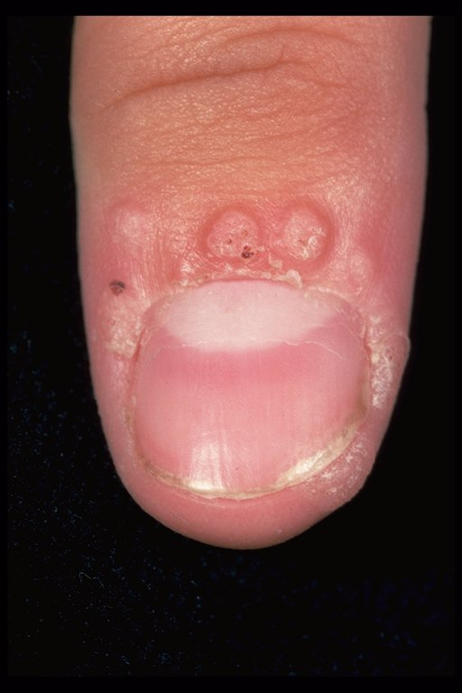
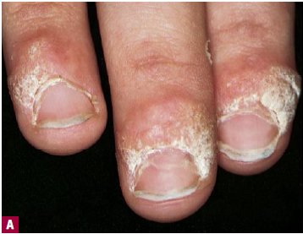
Periungual warts
Periungual warts

Slide 32
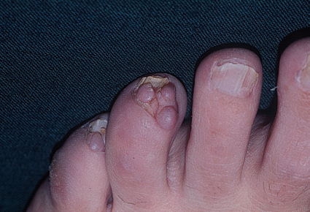
Periungual fibromas develop in adult life as small pink sausage-like lesions emerging from the nail folds

Slide 33
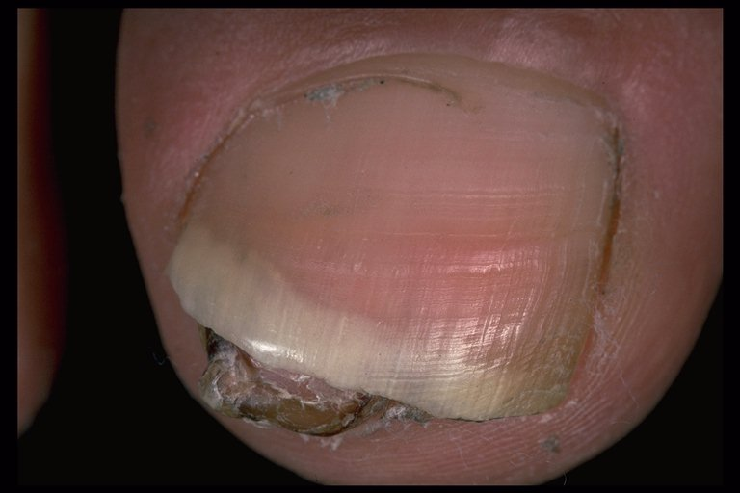
Subungual exostoses
The distal edge of the nail is lifted up by a discrete firm swelling. X-ray reveals an area of calcification.

Slide 34
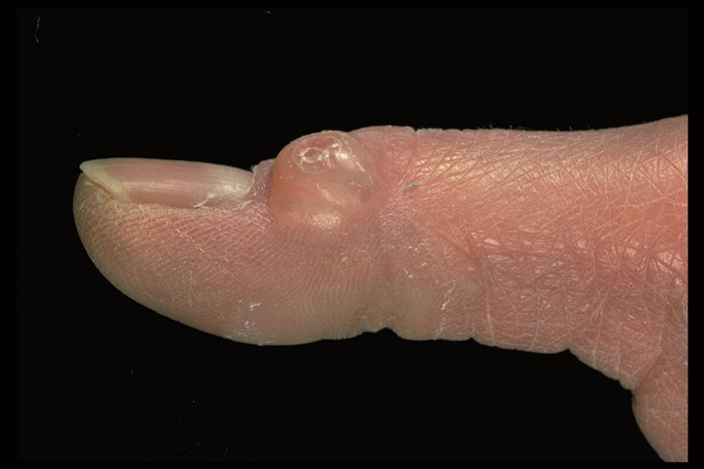
Myxoid cyst

Slide 35
Pyogenic granuloma (PG): is a benign vascular tumor. It may occur in the nail folds and either follows a trauma or occurs spontaneously. PG usually presents as an asymptomatic bright red or purplish nodule that usually bleeds easily on minor touch. Treatment is by curettage + cautery, or surgical excision.
Glomus tumor: a very tender small red or bluish lesion under the nail plate (sub-ungual). It causes pain with change in temperature. Treatment is surgical.
Malignant melanoma: presents as painless pigmented area under the nail plate (subungual). If the nail matrix is involved it may produce melanonychia striata which is a band or strand-like pigmentation of the nail plate. It is known as Hutchinson’s sign. Treatment is surgery.
SCC and Keratoacanthoma rarely involve the subungual region. Treatment is surgical excision.

Slide 36
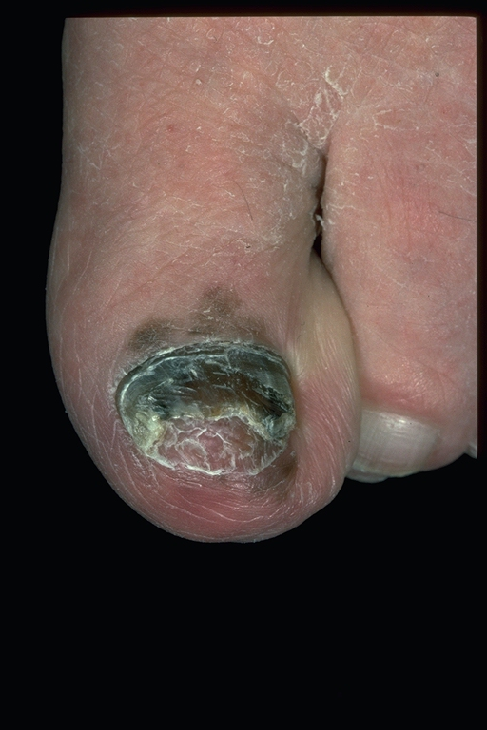
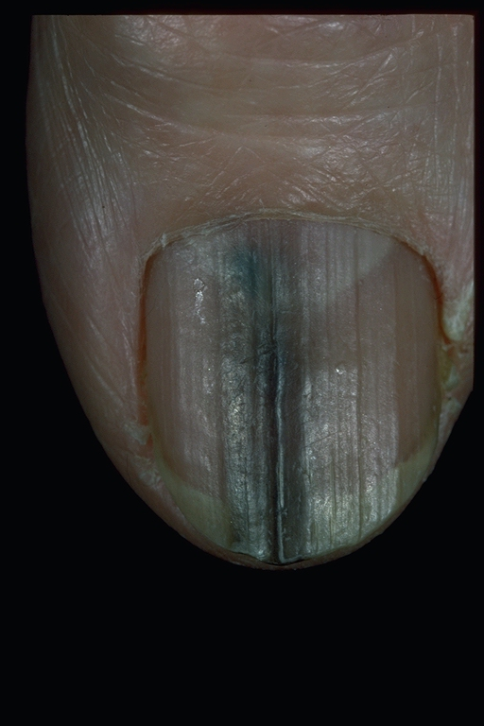
Malignant melanoma
Melanonychia striata

Slide 37
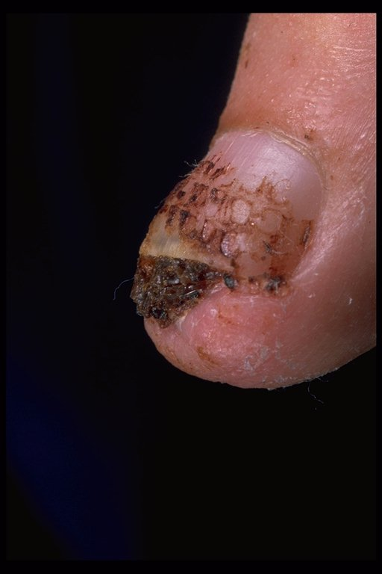
A friable lesion underneath the proximal nail which has bled and caused the nail to separate away. The nail needs to be removed so that a biopsy can be performed to elucidate the nature of the tumour, before proceeding to amputation.
Squamous cell carcinoma

Slide 38
Nail color changes
Half-and-half nails: with a white proximal and red or brown distal half, is seen in a minority of patients with chronic renal failure.
White nails: rare sign of liver cirrhosis (hypoalbuminemia).
Brown pigmentation of nail plate: Addison’s disease.
Green discoloration of nail plate: Pseudomonas infection.
Blackish discoloration of nail plate: may be seen in subungual hematoma, Proteus infection, subungual melanoma and with antimalarial drugs (rare).
Yellow discoloration of nail plate: is encountered in yellow nail syndrome and with long term tetracycline usage.
Terry’s nails: The whole nail plate is white except the distal 1-2 mm is pink. It may be seen in elderly, IDDM, chronic congestive heart failure and liver cirrhosis.

Slide 39
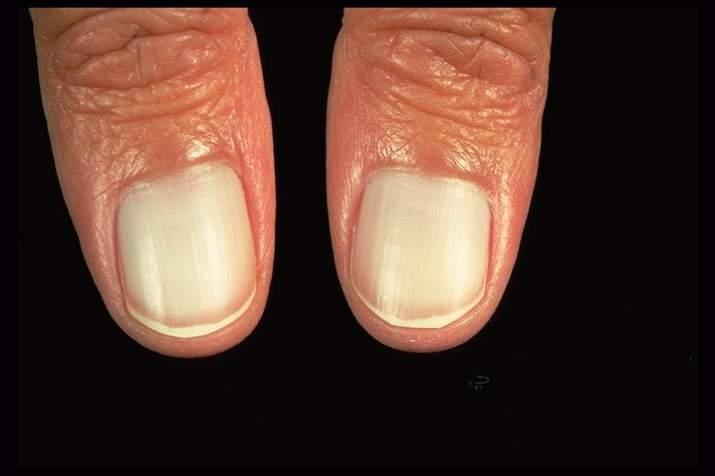
White nails (hypoalbuminaemia- Liver disease)

Slide 40
Leukonychia: The mechanism is still unknown. They may be due to minor trauma, systemic disease or familial tendency. They represent air spaces within the nail plates. They have no relation to calcium insufficiency. Clinically there are four patterns : Punctate leukonychia, Striate (transverse) leukonychia, Partial leukonychia and Total leukonychia
Melanonychia: band-like brownish-black discoloration of the nail plate that may be found in:
Negros (up to 80% as normal variant).
Malignant melanoma involving the nail matrix.
Melanocytic nevus of the nail matrix.
Melanonychia appears late in life in a white person should raise suspicion of acral lentiginous melanoma, therefore nail matrix biopsy is a must.

Slide 41
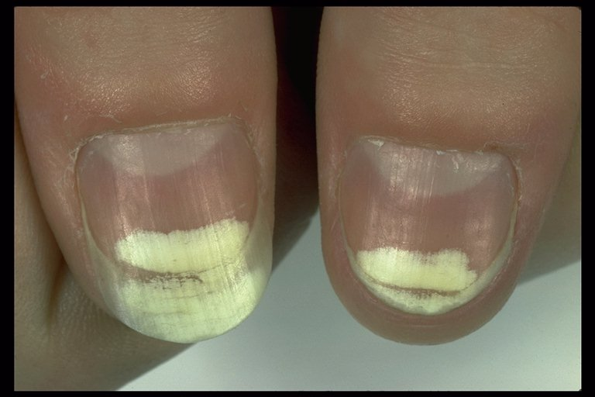
White nail- Trauma
Small white punctate areas in the nails are very common and are probably secondary to trauma. Striate (as here), partial or total forms are uncommon and may be congenital or acquired but the cause is unknown.

Slide 42
Nail in common dermatoses
[Psoriasis/ Lichen planus/ Eczema/ Alopecia areata]
Psoriasis: Nails involvement (symmetrical) is up to 50 %.
Nail pitting: is the commonest nail finding in psoriasis. It appears as coarse, rounded depressions in the nail plate. Nail pitting may be seen in alopecia areata, eczema and as a normal variant.
Onycholysis: separation of the nail plate from underlying nail bed. If the separation is localized to well defined area of the nail plate (usually central) it results in grey-brown discoloration mimicking an oil drop appearance and so called oily spot discoloration. It is the most specific nail change in psoriasis.
Subungual debris (Subungual hyperkeratosis).
Nail dystrophy: the nails become very thick and rough. It occurs in severe cases of psoriasis.

Slide 43
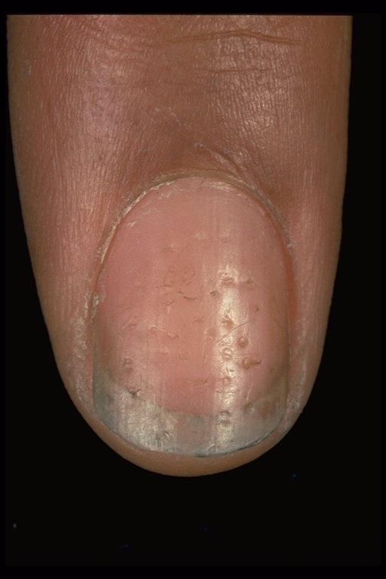
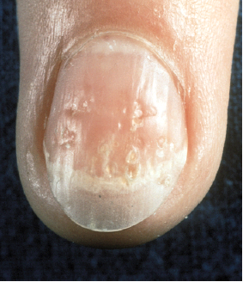
Nail pitting: Psoriasis
Nail pitting: Alopecia areata

Slide 44
Lichen planus: Nail involvement is up to 10% of cases.
Longitudinal ridges and grooves of the nail plate.
Thinning of the nail plate (reversible).
Pterigium: the cuticle becomes adherent to the nail plate and grows outward and distally from the proximal nail fold as a triangular fibrous band-like. It is the most specific nail change in lichen planus and results in permanent damage. Pterigium usually occurs in cases with severe nail involvement.
Total nail dystrophy.

Slide 45
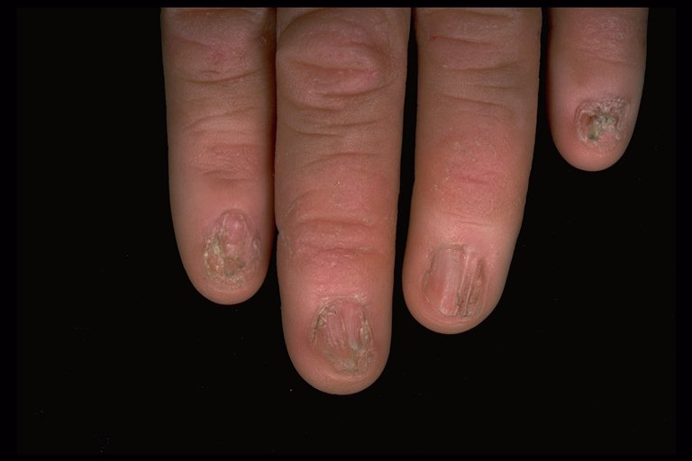
Nail dystrophy and Pterygium formation (LP)

Slide 46
Nail in systemic diseases
Nail clubbing: bulbous enlargement of the finger pulps due to soft tissue hypertrophy and increased vasculature by unknown mechanism. It is associated with an increased nail curvature in both vertical and horizontal directions. The main causes of nail clubbing are:
Chronic lung disease e.g. bronchogenic Ca & suppurative lung diseases such as bronchiectasis, empyema and cystic fibrosis.
Cyanotic heart disease and infective endocarditis
Biliary cirrhosis
Inflammatory bowel disease (Crohn’s & Ulcerative colitis)
Thyrotoxicosis
Familial (rare)

Slide 47
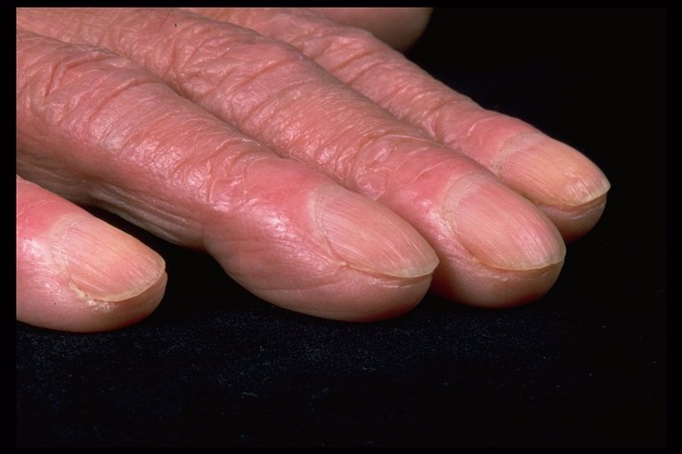
Nail clubbing
The angle between the nail and the posterior nail fold should be less than 180º. The nail is described as clubbed when the angle is equal to or greater than 180º. Subsequently the distal phalanx becomes enlarged and with it the nail.

Slide 48
Koilonychia: spooning and thinning of the nail plate. It is a sign of iron deficiency anemia.
Beau’s line: transverse grooves appear synchronously on all nails a few weeks after an acute illness due to temporary arrest of the nail matrix growth. The growth returns to normal when the insult subsides so Beau’s line develops. The line progresses steadily out to the free margin of the nail. The causes of Beau’s line are:
Febrile illness e.g. typhoid fever, malaria, scarlet fever and mycoplasma pneumonia.
Severe skin disease such as erythroderma, pustular psoriasis and pemphigus vulgaris.
Severe psychological trauma.

Slide 49
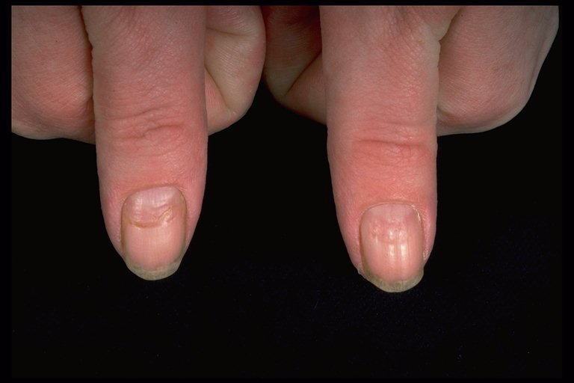
Beau’s lines due to severe viral infection 3 months ago

Slide 50
Nail and connective tissue disorders:
Erythema and telangiectasia of the nail folds with dilated or thrombosed capillaries in the proximal nail fold indicates presence of CTD such as SLE, dermatomyositis or systemic sclerosis.
Shaggy cuticle is seen in dermatomyositis.
Loss of finger pulps (vasculitic infarctions) with over curvature of the nail plate occurs in systemic sclerosis.
Thinning of nail plate, longitudinal ridging & sometimes with partial onycholysis is found in Raynaud’s phenomenon.

Slide 51
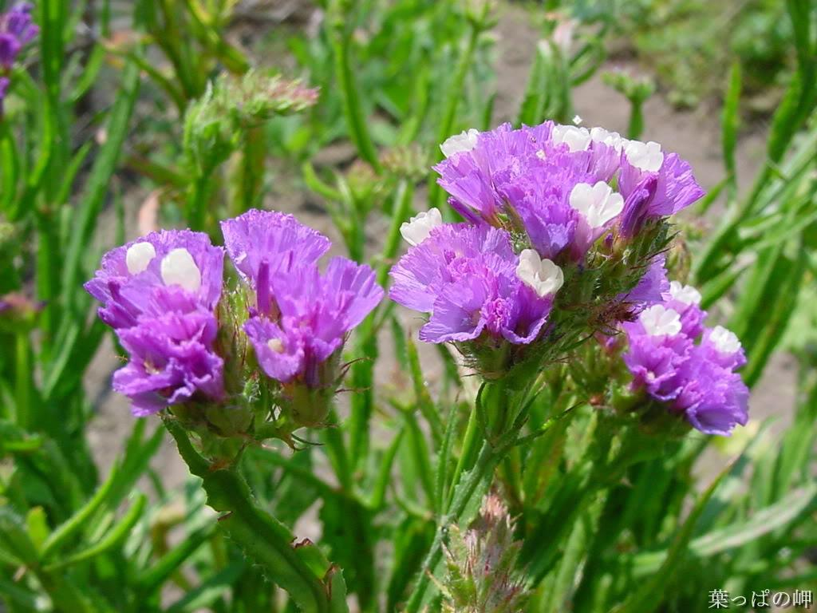
الحمد لله رب العالمين

