Slide 1
Psoriasis
داء الصدف

Slide 2
Psoriasis
Psoriasis is a chronic, non-infectious, inflammatory skin disorder, characterized by well-defined salmon pink plaques covered with large centrally attached white-scales.
1-2 % of the general population.
Any race can be affected.
Equal sex ratio.
Any age involved (mostly 15-45 years).
Unpredictable course: Usually chronic course with exacerbations and remissions.

Slide 3
Aetiology
The exact cause is still unknown.
Multifactorial disease: Genetic predisposition + Environmental factors.
The basic two key defects are: Hyperproliferation of keratinocytes & Inflammation.
Both these abnormalities can induce each other leading to a vicious cycle.

Slide 4
Genetics in psoriasis
Polygenic inheritance: not follow a simple Mendelian pattern of inheritance with 2 modes of inheritance:
Early onset with positive family history.
Late adulthood onset without obvious F. history.
A child has chance 16% to be affected if one parent is psoriatic and 50% if both parents have psoriasis.
Twin concordance rate:
Monozygotic twins 70% Vs. Dizygotic twins 20%

Slide 5
Genetic linkage
Individuals with HLA-Cw6 genotype have 20 times risk more than those who are HLA-Cw6 negative and 10% of HLA-Cw6 individuals will develop psoriasis.
Other HLA loci associated with psoriasis are: HLA-B13, B17 and B57.
Family history is 30% positive in psoriasis.

Slide 6
Epidermal cells kinetics
Keratinocytes proliferate “out of control” in psoriasis . So in psoriasis there is an accelerated epidermopoiesis .
The epidermal turn-over rate is shortened to <10 days in psoriatics compared to 30-60 days in non-psoriatics.

Slide 7
Inflammation
Psoriasis may represent an immunological response to as yet unknown antigen. Types of cells that are involved in keratinocyte hyperproliferation and inflammatory reaction include:
T-lymphocytes (T-helper cells)
Keratinocytes
Neutrophils (Polymorphs)
Epidermal antigen-presenting cells
Dermal fibroblasts

Slide 8
These cells produce variety of immunological and biochemical substances that induce and perpetuate psoriatic plaques . Examples are:
Cytokines
Interleukins
Chemokines
Leukotriens
TNF-alpha
INF-gamma

Slide 9
Provoking & predisposing factors
Trauma (Scratches, surgical wounds, burns …..).
Kobner (Isomorphic)phenomenon
2. Infections
Beta- hemolytic Streptococci → Guttate Psoriasis.
HCV
HIV
3. Sunlight: 90% improved: 10% worsened
4. Hormonal factor
Pregnancy: improves psoriasis but it may relapse postpartum.
Hypocalcaemia (hypoparathyroidism) is a rare precipitating cause of psoriasis.

Slide 10
Provoking & predisposing factors
5. Drugs: Antimalarials/ Beta-blockers/ IFN-α &
Lithium (may exacerbate psoriasis).
Systemic or potent topical CS and Efalizumab may result in rebound psoriasis on their withdrawal.
NSAIDs exacerbate psoriasis (unproven).
6. Smoking: Psoriasis is more common in smokers and x-smokers.
7. Emotion: Emotional upsets seem to cause some exacerbations.

Slide 11
Histopathology
Parakeratosis
Absent granular cell layer
3. Acanthosis: irregular thickening of the epidermis over the rete ridges (test tube-like rete ridges), but thinning over dermal papillae (suprapapillary thinning). Bleeding may occur when scale is scratched off (Auspitz’s sign).
4. Epidermal polymorphonuclear leucocyte infiltrates
and micro-abscesses (Munro microabscesses).
4. Dilated & tortuous capillary loops in the dermal papillae.
5. T-lymphocyte infiltrate in upper dermis.

Slide 12
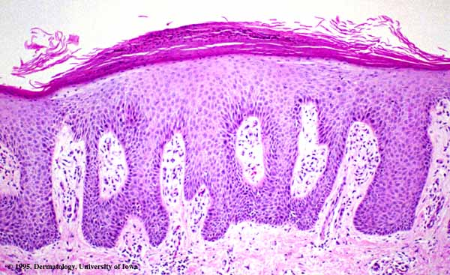
Parakeratosis
No granular layer
Acanthosis
Dilated tortuous
capillaries

Slide 13
Presentation of Psoriasis
Clinical forms:
1. Plaque psoriasis (Psoriasis vulgaris)
Commonest form
Bilateral symmetrical involvement.
Size: Few millimeters to several centimeters
Shape: Well-defined round, oval or geographic plaques.
Color: Salmon pink to fiery red
Large silvery-white scales
Auspitz's sign is characteristic but not pathognomonic. It is pinpoint bleeding spots that appeared on gentle scratching of psoriatic scales by a blunt object.

Slide 14
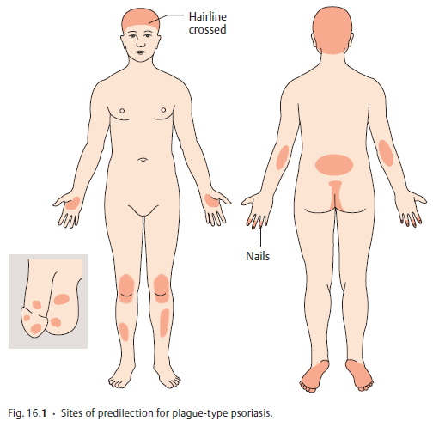
Predilection sites
Limbs’ extensors: (elbows and knees)
Sacral region
Umbilicus
Scalp
Genital region (specially glans penis)
Face is uncommonly involved.
Sites of predilection of plaque-type psoriasis

Slide 15
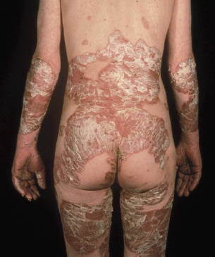
Widespread plaque-type psoriasis

Slide 16
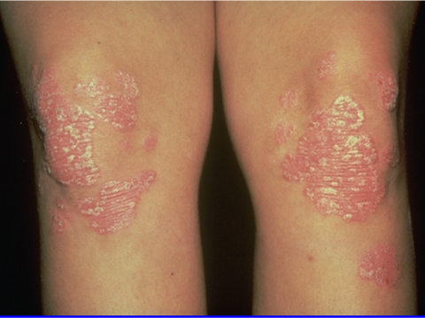
Localized plaque-psoriasis

Slide 17
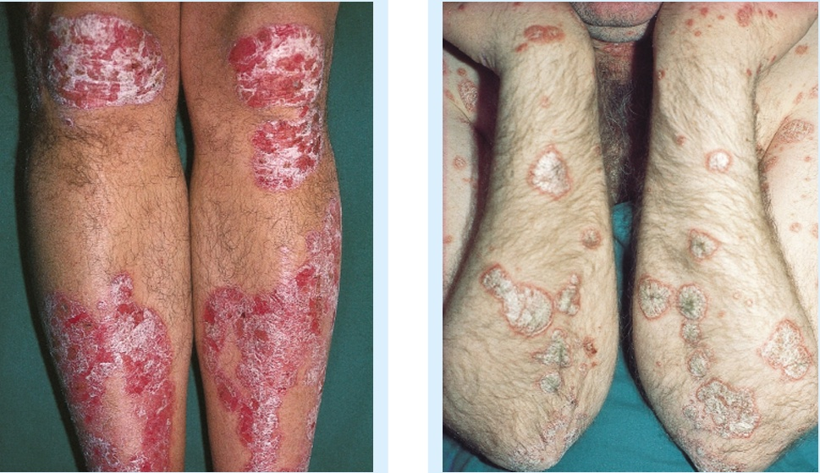
Well-demarcated plaque-psoriasis with thick white-silvery scales on the extensor surfaces of the limbs

Slide 18
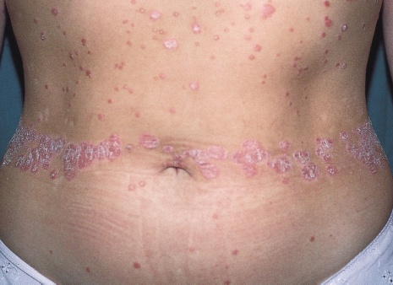
Koebner phenomenon
Linear psoriasis on the waist from tight clothing

Slide 19
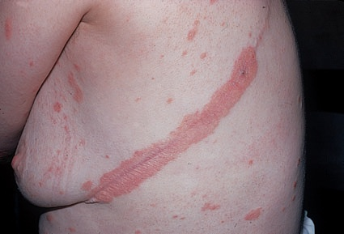
Koebner phenomenon
Psoriatic plaque along a thoracotomy scar

Slide 20
Variants of plaque psoriasis
A. Scalp psoriasis
The scalp is often involved by psoriasis.
Localized areas of scaliness are interspersed with normal skin.
Lumpiness is sometimes more easily felt than seen.
Scalp lesions may be itchy.
Frequently, the psoriasis overflows just beyond the scalp margin (Corona psoriatica).
Significant hair loss is rare.
The most important differential diagnosis is seborrhoeic dermatitis.

Slide 21
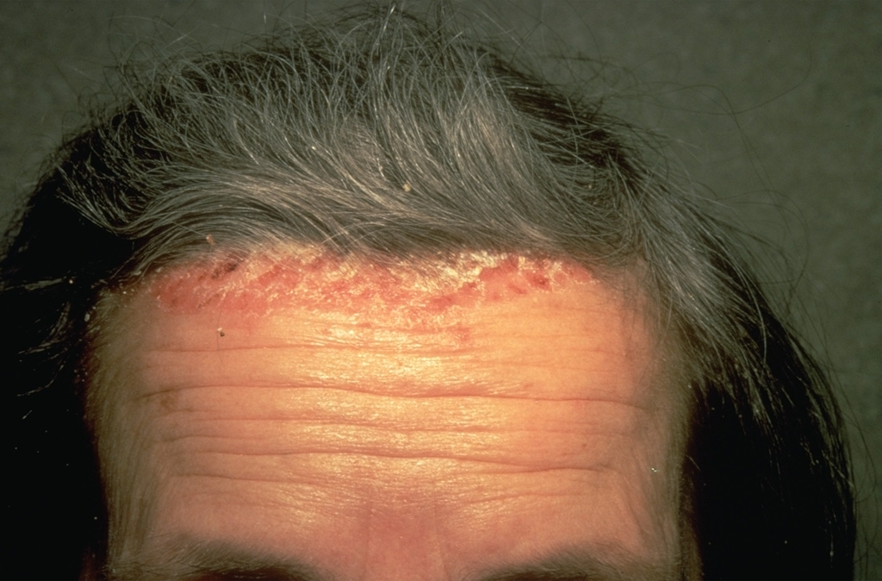
Scalp psoriasis with characteristic corona psoriatica

Slide 22
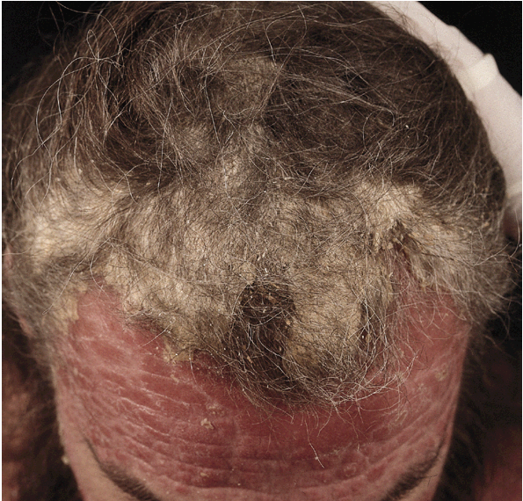
Diffuse Scalp psoriasis

Slide 23
Variants of plaque psoriasis
B. Flexural psoriasis (Inverse psoriasis)
It involves body flexures ( Axillae, groins, submammary folds, umbilicus and anogenital “natal cleft”).
Moist, red, glistening sharply demarcated plaques often with fissuring in the depth of the folds.
Lack of scales.
Bilateral symmetrical involvement.
The most important differential diagnoses:
Seborrhoeic dermatitis
Tinea cruris
Candidiasis
Erythrasma
Napkin dermatitis (Infants)

Slide 24
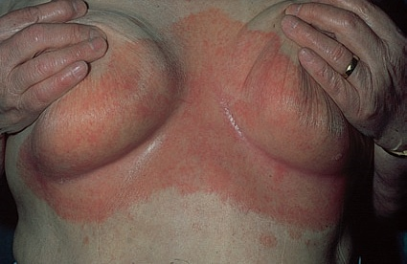
Flexural psoriasis (lacking of scales)

Slide 25
Variants of plaque psoriasis
C. Palmoplanter psoriasis
Often poorly demarcated, faintly erythematous lesions that may associate with fissuring, inflammation or itching.
Sometimes difficult to be diagnosed.
Psoriasis is one of the common causes of acquired palmoplanter keratoderma (thick palms and soles).
Maximum involvement: Thenar and hypothenar eminences of the hands and over the metatarsal bones and heels of the feet.
Differential diagnosis: Hyperkeratotic eczema, tinea manuum and other causes of keratoderma.

Slide 26
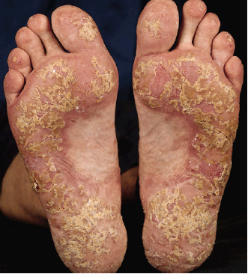
Planter plaque psoriasis with characteristic large whitish scales

Slide 27
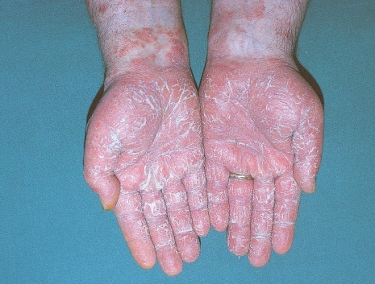
Bilateral symmetrical plaque-type psoriasis of the palms

Slide 28
Variants of plaque psoriasis
D. Nail psoriasis
Nail involvement: 10-50%
All nail changes are not pathognomonic.
Nail pitting: Thimble nails with tiny, punched-out pits is the most common nail change in psoriasis.
Onycholysis: Separation of the nail plate from the nail bed. The nail plate turns yellow (the main differential diagnosis is tinea unguium).
Subungual hyperkeratosis: Retention of scales below the nail plates.
Nail discoloration: spotty brownish or yellowish discoloration of the nail plate (Oily spot discoloration). This is the most specific nail change in psoriasis.
Nail dystrophy: Partial or complete nail destruction.

Slide 29
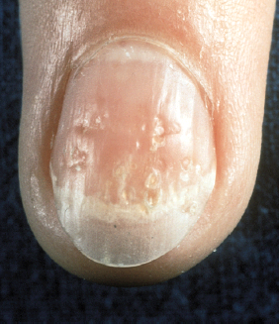
Causes of Nail pitting
Psoriasis
Alopecia areata (Hammered brass nails)
Active hand eczema
Idiopathic (Few nail pits may be found in about 4% of general population)
Nail pitting with distal onycholysis

Slide 30
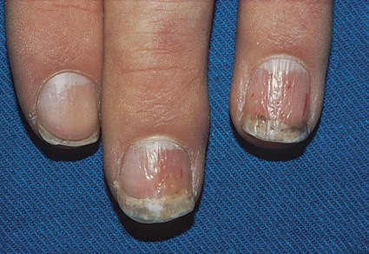
Thimble-like pitting of nails with onycholysis

Slide 31
2. Guttate psoriasis
Usually seen in children and adolescent.
Often triggered by streptococcal tonsillitis.
“Guttate” means drop-shaped. The size of lesions rarely more > 1 centimeter.
Numerous small round red macules that erupt suddenly on the trunk and soon become scaly.
The rash often clears in a few months but plaque psoriasis may develop later.

Slide 32
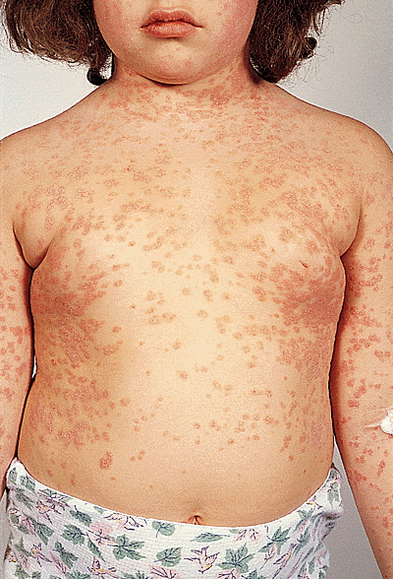
Guttate Psoriasis

Slide 33
3. Pustular psoriasis
A. Generalized (von Zumbsch) Psoriasis
Rare but serious variant of psoriasis.
Usually starts in flexures.
Sudden onset of myriads of small sterile pustules on red bases. The patient is usually ill with swinging pyrexia.
Impetigo herpetiformis is acute generalized pustular psoriasis of pregnancy.
Leukocytosis.
Prognosis may be serious (may threaten life).

Slide 34
B. Localized palmoplanter pustular psoriasis
Also known as Palmoplanter pustulosis.
Better prognosis than the generalized form.
Involves the middle portion of the palms and soles.
On resolution, it leaves brownish spots.

Slide 35
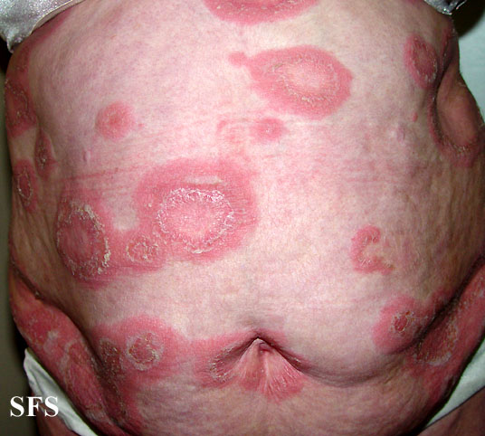
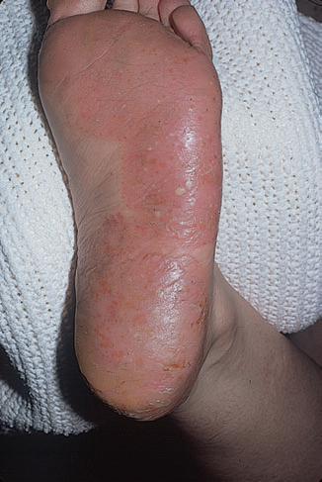
Pustular psoriasis involving the trunk
Pustular psoriasis of the sole

Slide 36
3. Erythrodermic psoriasis
Also rare and may be serious variant of psoriasis.
Occur de novo or more often complicate chronic plaque psoriasis (stable plaque ps. → unstable erythrodermic ps.).
Might be sparked by:
Irritant treatment like tar, dithranol, phototherapy and corticosteroids (specially on withdrawal).
Severe emotional trauma.
Intercurrent infections.
The entire body becomes red with variable scaling.
Malaise is accompanied by shivering (heat loss due to generalized vasodilatation).
The skin feels hot and uncomfortable.
Prognosis: guarding (complications may ensue).

Slide 37
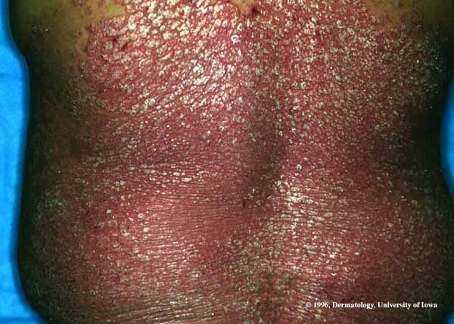
Erythrodermic psoriasis

Slide 38
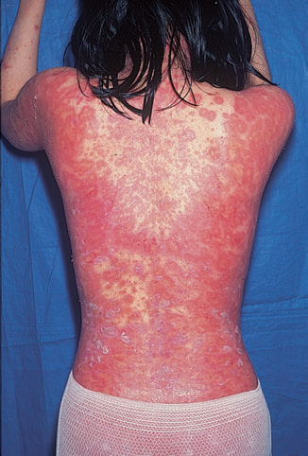
Unstable psoriasis following long-term use of a potent topical steroid.

Slide 39
Complications of erythrodermic psoriasis
Hypothermia
Hypovolemic shock
High out-put heart failure
Hypoalbuminemia
Sepsis
5. Psoriatic arthropathy (Arthropathic psoriasis)
May be considered as a complication rather than a variant of psoriasis.
Arthritis occurs in 5-20% of psoriatics + skin lesions.
Nail involvement is common (up to 80%).
50% of the cases associated with HLA-B27.
-

Slide 40
5. Psoriatic arthropathy (Arthropathic psoriasis)
Clinical patterns of arthritis
Oligoarthritis involving one large joint (70% of cases).
Distal arthritis involves the distal interphalangeal joints of the toes and fingers.
Symmetrical poly-arthritis (Rheumatoid arthritis-like) involves the small joints of the hands and feet. However, it is seronegative (negative rheumatoid factor) and absent rheumatoid nodules.
Psoriatic spondylitis involves the sacroiliac joints and spines i.e. ankylosing spondylitis-like. It strongly correlates with the presence of HLA-B27 (90% of cases).
Arthritis mutilans: Destruction of the small joints of the hands and feet.

Slide 41
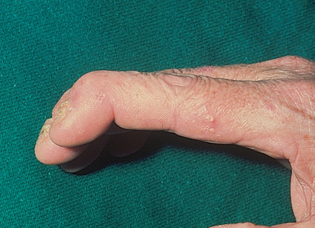
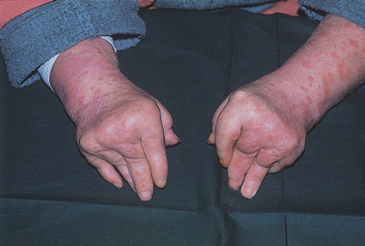
Fixed flexion deformity of distal interphalangeal joints following arthropathy.
Rheumatoid-like changes associated with severe psoriasis of hands.

Slide 42
Differential Diagnosis
Plaque psoriasis
Discoid eczema
Seborrhoeic eczema
Pityriasis rosea (PR)
Secondary syphilis
Tinea corporis
Psoriasiform drug eruption
Discoid lupus erythematosus (DLE)
Lichen planus

Slide 43
Investigations
1. Biopsy is seldom necessary. Usually, the diagnosis of common plaque psoriasis is obvious from its clinical appearance.
2. Throat swabbing for β-hemolytic streptococci is needed in guttate psoriasis.
3. Skin scrapings and nail clippings may be required to exclude tinea.
4 Radiology and tests for rheumatoid factor are
helpful in assessing arthritis.

Slide 44
Management of psoriasis
Explanation and reassurance
Not contagious
Spontaneous remission may occur.
No treatment, at present, alters the overall course of the disease.
Type of therapy depends on patient’s age, sex, type and severity of psoriasis, site of lesions, marital status and presence of co-morbidities.
Types of treatment: topical or systemic

Slide 45
Management of psoriasis
Topical therapy: for limited plaque psoriasis involving < 20% of the body surface area.
Topical corticosteroids + Salicylic acid
Tar preparations: Crude tar better than refined tar. It is used as ointment or solution or shampoo in 2-10% concentrations and may be mixed with other preparations like corticosteroids.
Vitamin D analogues: e.g. Calcipotriol (Cacipotriene, USA). Also it can be combined with corticosteroids to increase its efficacy and decreases its irritation.
Anathralin (Dithranol): Used in concentrations 0.1-2%. It is used alone or in combination with corticosteroids. The main disadvantages are irritation, staining and costly. To decrease irritation it can be used as short contact therapy i.e. applied for only 30 minutes and washed off.
Local retinoids e.g. Tazarotene gel.

Slide 46
Management of psoriasis
7. Calcineurin inhibitors e.g. Tacrolimus ointment.
8. Salicylic acid (2-6%): Usually combined with corticosteroids. It is useful in decreasing the scaliness and so increasing penetration of corticosteroids.
9. Phototherapy (Ultraviolet therapy): Narrowband UVB (311nm) radiation is effective in many cases of plaque psoriasis.

Slide 47
Systemic therapy
Indications
Plaque psoriasis > 20% of body surface area.
Erythrodermic psoriasis.
Pustular psoriasis.
Arthropathic psoriasis.
Nail psoriasis.

Slide 48
Management of psoriasis
Systemic therapies
Retinoids e.g. Acitretin 10-50 mg per day. The most frequent and important side effects are dryness of skin and mucous membranes, increased plasma lipids and liver enzymes and teratogenicity.
Methotrexate 0.2-0.4 mg per day, the main S/E is hepatotoxicity.
Cyclosporine 2-5 mg per day, the main S/E is nephrotoxicity.
Photochemotherapy (PUVA = Psoralen + UVA). Psoralen 0.6-0.8 mg per kg per dose followed 2 hours later by UVA exposure.

Slide 49
5. Biologics: are monoclonal antibodies act as either inhibitors of TNF-alpha or prevent T-cell activation.
Very expensive, not free of side effects and given through injections.
Reserved for very severe or refractory cases.
Examples of biologics:
Etanercept
Infliximab
Adalimumab
Alefacept
Efalizumab

Slide 50
الحمد لله رب العالمين

