Slide 1
Syphilis
Dr. Nameer Al-Sudany
"He who knows syphilis, knows medicine"
Sir William Osler

Slide 2
SYPHILIS
Syphilis is an infectious and contagious venereal disease caused by a spirochete called Treponema pallidum. If it is untreated, it progresses through 4 stages: primary, secondary, latent and tertiary.
Transmission of T. pallidum predominantly occurs via penetration of the spirochetes through mucosal membranes and abrasions on epithelial surfaces. This occurs through sexual contact with an infectious lesion (major route). Other occasional ways of transmission are:
From mother to fetus in utero (Transplacental).
Via blood products transfusion.
Breaks in skin and mucous membranes that come into direct contact with an infectious lesion.

Slide 3
The major risk factors of syphilis include: unprotected sex, promiscuous sex and intravenous drug use. Health care workers are at occupational risk.
Spirochetes: Three genera cause human infection:
1. Treponema syphilis, yaws and pinta
2. Borrelia Lyme disease and relapsing fever
3. Leptospira leptospirosis
Treponema pallidum:
A fragile motile spiral bacterium.
Number of spirals varies from 4 to 14 coil.
Length 5 to 20 microns X 0.25 microns in diameter.

Slide 4
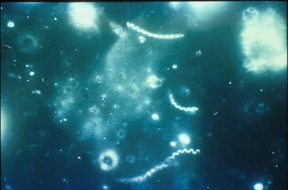
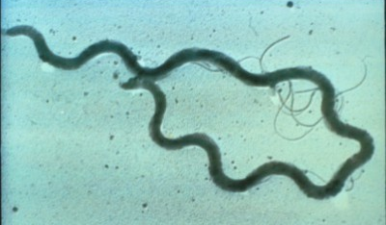
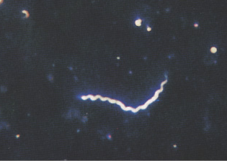
Spirochetes Treponema pallidum

Slide 5
Treponema pallidum
Pathogenic in apes, humans, and rabbits.
Three movements: projection and rotation in the direction of the long axis. Bending or twisting from side to side.
It is too small to be seen under LM. However, it can be identified by its distinctive undulating movements on dark-field microscopy. It can survive only briefly outside of the body; thus, transmission almost always requires direct contact with the infectious lesion.

Slide 6
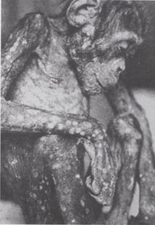
Syphilis in an ape

Slide 7
Classification
Syphilis
Congenital
Early
Late
Acquired
Primary
Secondary
Latent
Tertiary
Syphilis has a myriad of presentations and can mimic many other diseases. Hence, it has earned the nickname “ the great impostor.”
The complex and variable manifestations of the disease prompted Sir William Osler to remark, “ The physician who knows syphilis knows medicine.”

Slide 8
Histopathology
Regardless the stage of disease and location of lesions, the main histopathologic hallmarks of syphilis are:
Endarteritis (obliterative in nature in some instances).
A plasma-rich infiltrate.
Immunity
Cell-mediated immunity: Syphilitic infiltrate reflects a delayed-HSR to T. pallidum (lymphohistiocytic infiltrate).
Humoral immunity: Antigens to T. pallidum induce host production of treponemal specific antibodies and non-specific reagin antibodies.
Immunity to syphilis is incomplete i.e. cellular and humoral immunity may prevent the formation of a primary lesion on subsequent infections, but they are insufficient to clear the organism. Why??

Slide 9
Epidemiology of Syphilis
1950s, the incidence of primary and secondary syphilis has decreased following the introduction of penicillin.
1980s, the incidence has increased due to increased use of intravenous drugs and crack cocaine, the exchange of sex for drugs, the indiscriminate or anonymous sex and the number of people with multiple sexual partners.
Many famous personages are thought to have suffered from syphilis, including Bram Stoker, Henry VIII and Vincent Van Gogh.
Periods of decreasing incidence of syphilis may be attributed to increased awareness to syphilis and other STDs, aggressive screening and emphasis on primary prevention of these diseases.
Trends for congenital syphilis cases closely parallel those for acquired cases in women, namely, a decreased incidence over the past decade.

Slide 10
Epidemiology of Syphilis
Age Distribution of Syphilis
Syphilis is most common during the years of peak sexual activity (15-45 years).
Sex Distribution of Syphilis
Males are affected more frequently with primary and secondary syphilis than females with variable sex ratios.
Since 2002, syphilis was much more prevalent among males largely due to the increased rate of disease among MSM (Men who have sex with men).

Slide 11
Prognosis of syphilis
The overall prognosis in syphilis depends upon the stage, extent and duration of the disease in addition to prior attempts to treat the diseases as T. Pallidum remains highly responsive to penicillins, and cure is likely.
The prognosis is usually good for primary stages (primary and secondary syphilis) if the there is no auditory, ocular or other neurologic involvement.
Latent syphilis can persist for years or decades.
Tertiary syphilis may have significant neurologic and cardiovascular consequences especially if it occurs after long latent period i.e. with advancing age.
Primary complications of syphilis are rare since the introduction of penicillin in 1950s. If syphilis is left untreated, about 1/3 of the patients develop complications, these are mainly:

Slide 12
Complications of untreated syphilis

Slide 13
Congenital syphilis is the most serious outcome of syphilis in women. A higher proportion of infants are affected if the mother has untreated secondary syphilis, compared to untreated early latent syphilis.
T. pallidum does not invade the placental tissue or the fetus until the fifth month of gestation, syphilis causes late abortion, still birth, or death soon after delivery in more than 40% of untreated maternal infections.
Pregnant women having early syphilis, it is likely that the mother will deliver a child not infected by syphilis if the mother was treated properly.

Slide 14
Clinical presentation of syphilis
Syphilis in its all stages has a broad and nonspecific manifestations and may masquerade as many other diseases (‘great imitator/impostor”) that necessitates a high index of suspicion to reach the proper diagnosis.
During history taking of suspected syphilis case it is important to enquire about sexual and social history (sex practicing, no. of sexual partners, use of condom, history of other STDs in the patient and his partners, i.v drug use and exposure to blood products).
For children and infants suspected to be syphilitics seek maternal history (exposure to infected individuals or blood products) and history of sexual abuse.

Slide 15
Primary syphilis (Chancre)
The incubation period averages 3 weeks (range 9-90 days).
The chancre develops at the site of primary inoculation is usually painless, solitary, raised, firm, red papule that may erode to create an ulcerative crater within the papule.
The chancre has a punched-out base and rolled edges and is highly infectious (spirochetes can be isolated from the ulcer’s surface or the overlying exudate).
Most chancres (90%) are genital (mainly on the glans penis and the vulva or cervix), whereas about 10% of chancres are extragenital (anus, oropharynx, tongue, nipples, fingers & other extragenital sites).

Slide 16
Primary syphilis
Multiple genital chancres may occur in some patients and sometimes they appear as “kissing ulcers” on opposing skin surfaces like on the labia.
Occasionally, the chancre may be hidden like intra-urethral or intra-anal and the patient may present with secondary syphilis for the first time.
Regional nontender lymphadenopathy usually follow the appearance of the chancre by 1-2 weeks.
The chancre usually heals within 3-12 weeks with residual scar formation.

Slide 17
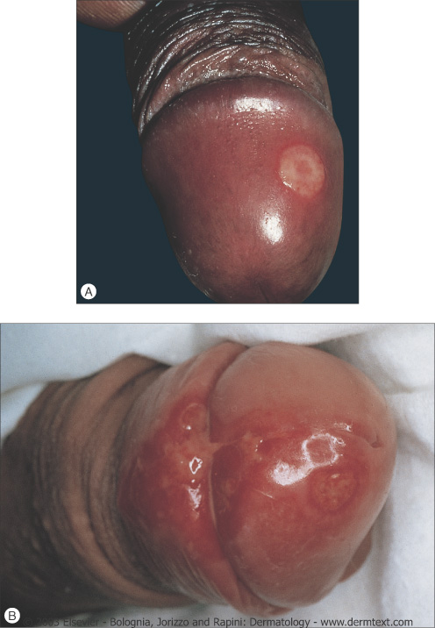
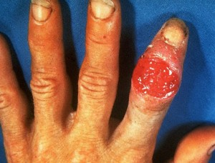
Syphilitic Chancre

Slide 18
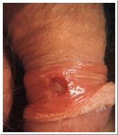
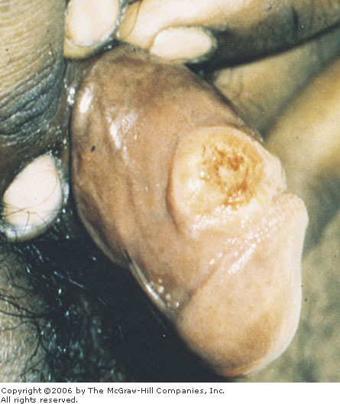

Slide 19
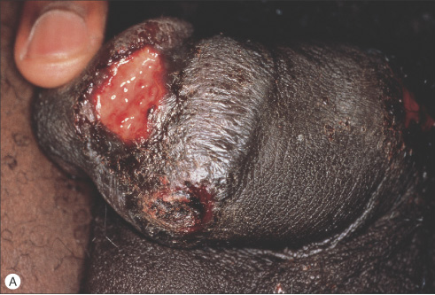
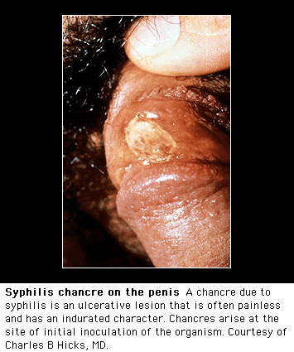

Slide 20
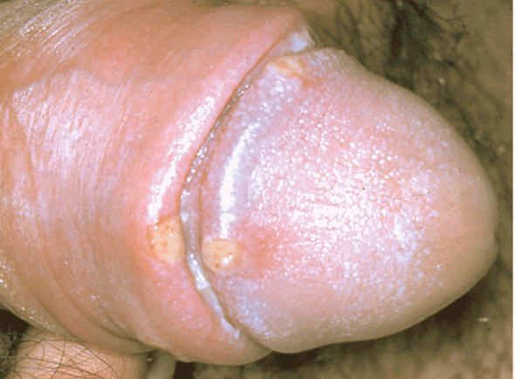
“Kissing chancres”

Slide 21
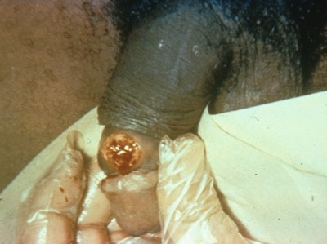
Primary syphilis-chancre

Slide 22
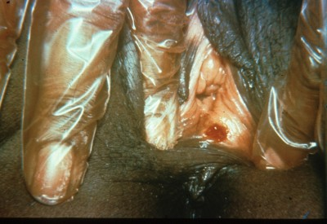
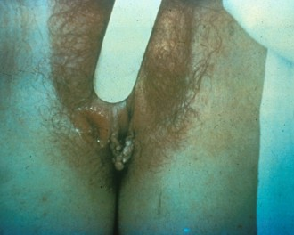
Chancre on the vulva

Slide 23
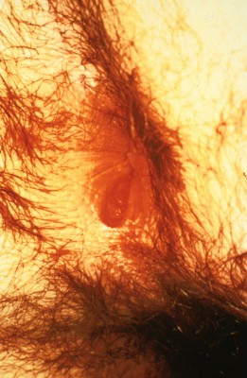
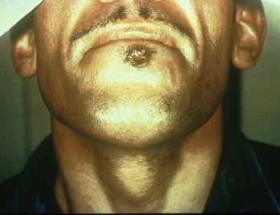
Extragenital chancre
Anal chancre

Slide 24
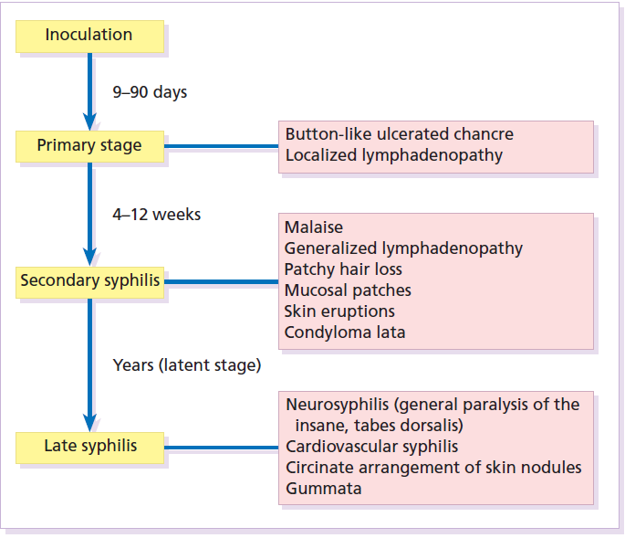
Stages of Syphilis

Slide 25
Secondary syphilis
The spirochetes multiply and spread throughout the body during this stage.
The CNS may be invaded early in the secondary stage as >30% have abnormal findings in CSF examination. A small number of patients develop acute syphilitic meningitis and present with headache, neck stiffness, facial numbness or weakness and deafness.
Secondary syphilis lesions are quite variable in their manifestations. Systemic manifestations include malaise, fever, headache, neck stiffness, anorexia, nausea, myalgias and arthralgias often are present in addition to lymphadenopathy and mucocutaneous rash.

Slide 26
Secondary syphilis
Secondary syphilis usually presents with:
1. Cutaneous eruption within 2-10 weeks after the primary chancre and is most florid 3-4 months after infection. About 25% of patients may be unaware of skin changes. A diffuse mucocutaneous rash over the entire body and characteristically may involve the palms, soles and oral mucosa is typical. It is seen in about 75% of the patients. Most often, the lesions are macular, discrete and reddish brown or coppery ham color; however, the lesions can be papular, pustular, annular or scaling. All such lesions contain treponemes. Of these, wet mucous patches are the most contagious. The rash is usually nonpruritic and bilaterally symmetrical.
The immune reaction during secondary stage of syphilis is at its peak and antibody titers are high.

Slide 27
Generalized non-tender lymphadenopathy.
Condylomata lata are painless, highly infectious (swarmed with treponemes), gray-white, slightly elevated, flat topped papules and plaques in warm, moist areas (characteristically around the anus).
Patchy alopecia is non-scarring hair loss of the scalp and facial hair, including the eyebrows. It usually has irregular outline and mostly involves the sides and occipital regions of the scalp. It has been referred to as “moth-eaten appearance”.
Other less common manifestations include GI involvement, hepatitis, nephropathy, proctitis, arthritis and optic neuritis.

Slide 28
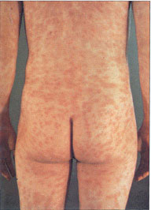
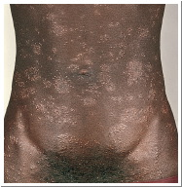
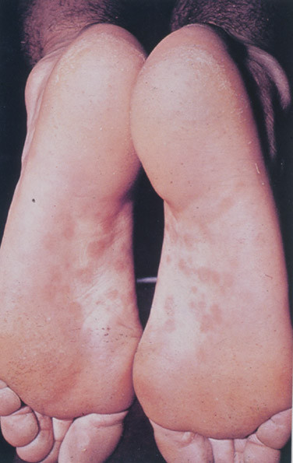
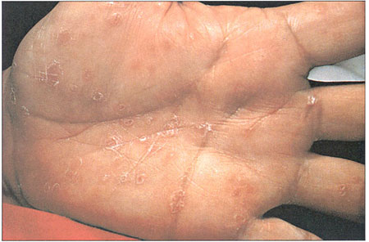

Slide 29
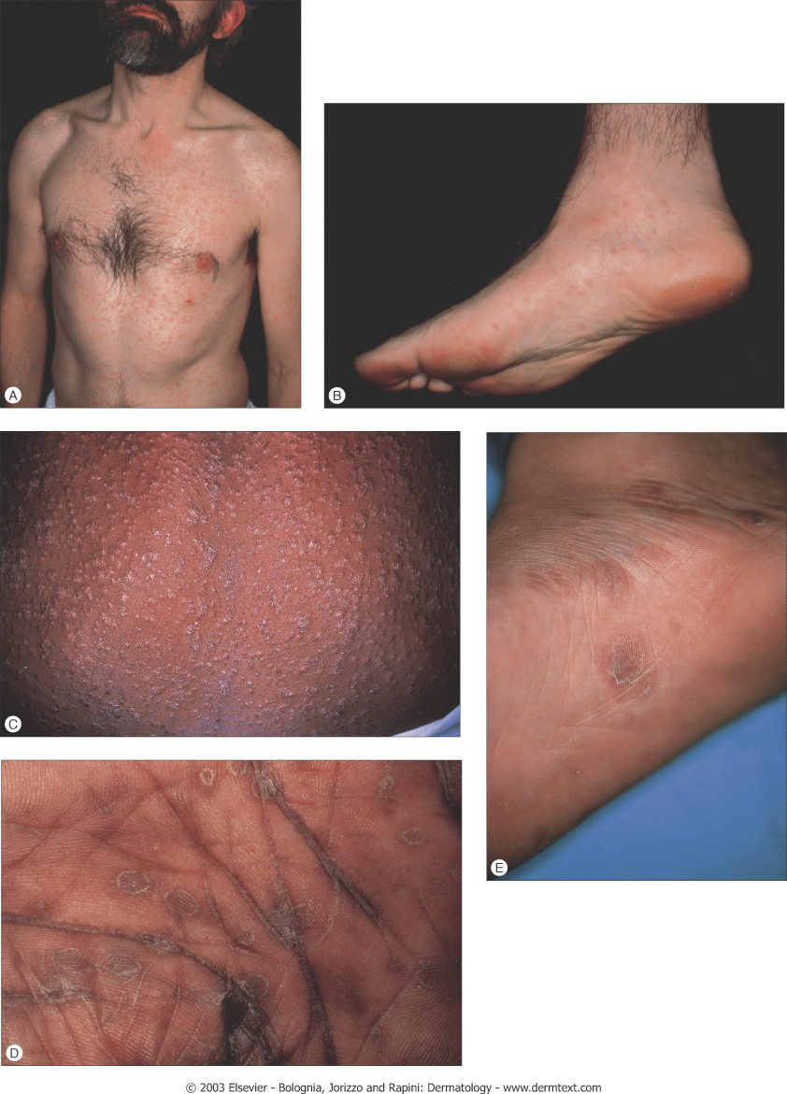
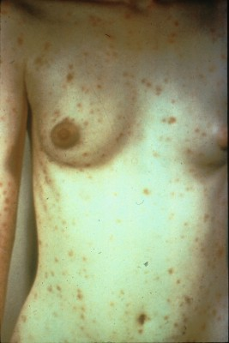
Rash of secondary syphilis

Slide 30
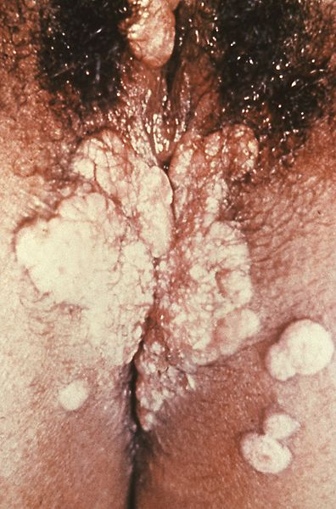
Secondary S.: Codylomata lata

Slide 31
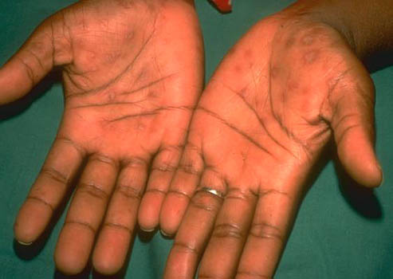

Slide 32
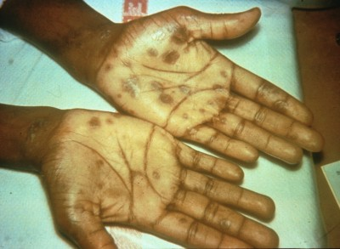
Secondary syphilis

Slide 33
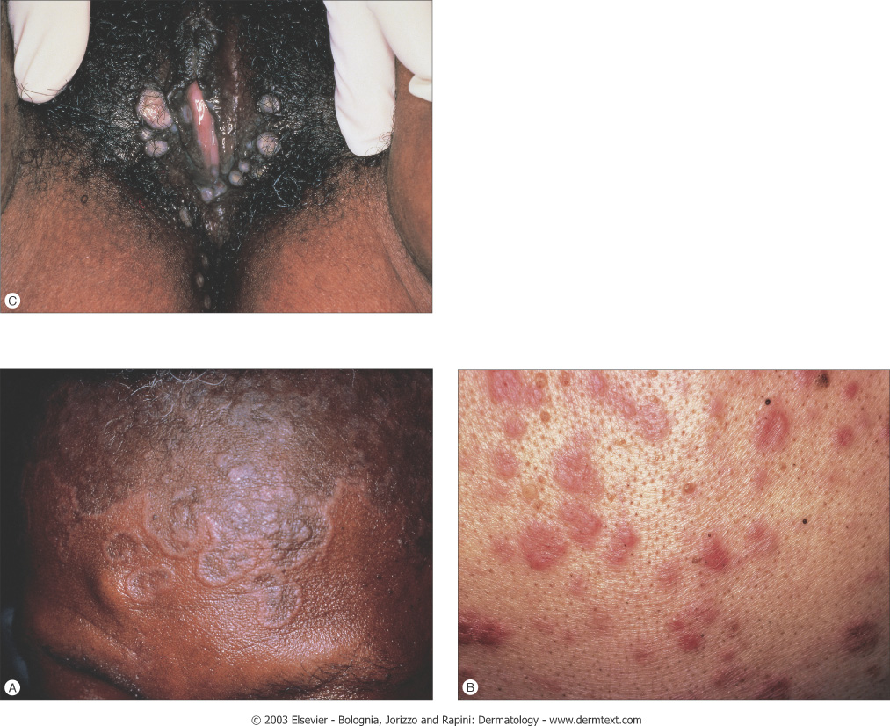
Secondary syphilis

Slide 34
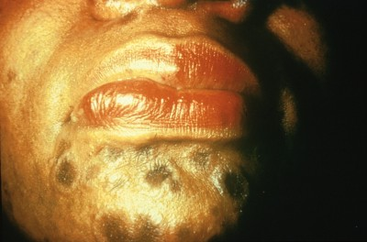
Secondary syphilis: Annular lesions on the face

Slide 35
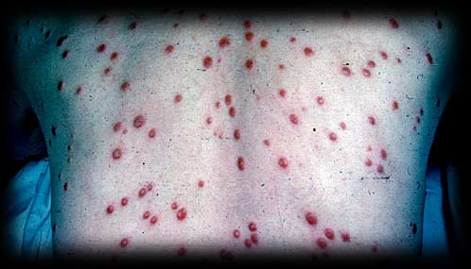
Secondary syphilis

Slide 36
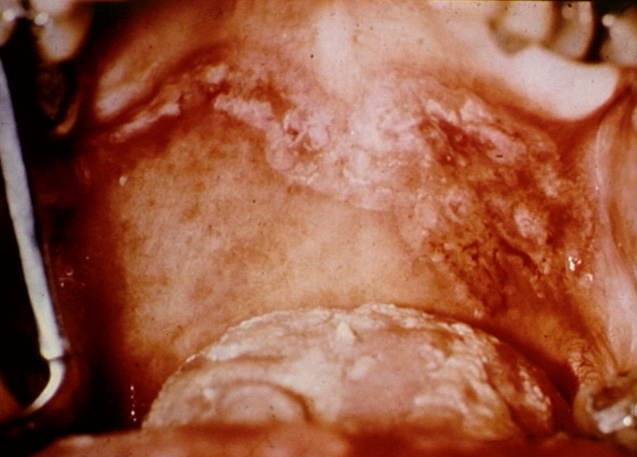
Mucous patch of secondary syphilis

Slide 37
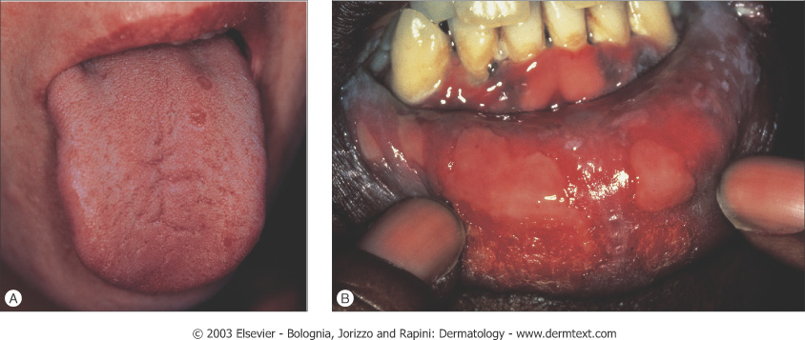
Mucosal lesions (erosions) of secondary syphilis

Slide 38
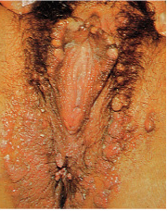
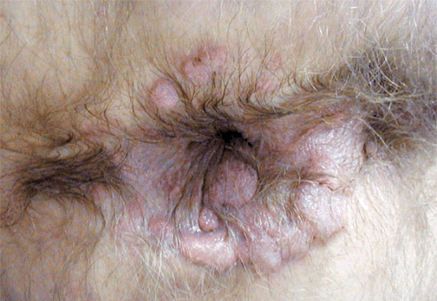
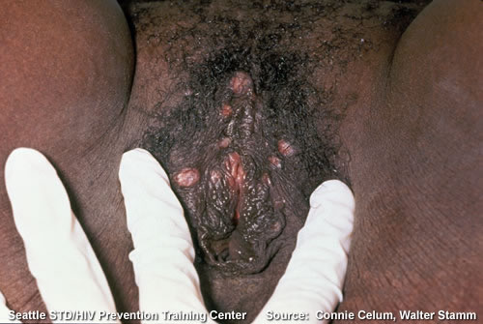
Condylomata lata

Slide 39
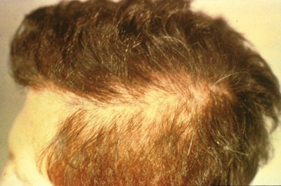
Secondary syphilis: “Moth-eaten alopecia”

Slide 40
Latent syphilis
Latent syphilis is a stage at which the features of secondary syphilis have resolved, though patients remain seroreactive i.e. asymptomatic period and the disease is detected only by serological tests).
Latency: few years - 25 years before the destructive lesions of tertiary syphilis manifest.
Latent syphilis is divided into early latent and late latent. The distinction is important because treatment for each is different.
About 1/3 of untreated latent syphilis patients go on to develop tertiary syphilis.

Slide 41
Latent syphilis
Early latent syphilis: first year after resolution of primary or secondary syphilis.
Late latent syphilis (>1 year after resolution of secondary syphilis) is not infectious; however, woman in this stage can spread the disease in utero.
A small percentage of infants infected in utero may have a latent form of infection that becomes apparent during childhood and, in some cases, during adult life.

Slide 42
Tertiary syphilis (Late syphilis)
Gummatous syphilis (benign late syphilis)
Cardiovascular syphilis
Neurosyphilis
Tertiary syphilis is rare nowadays.
Slow inflammatory damage to tissues.
Generally not thought to be infectious.
Late syphilis is a slowly progressive disease and characterized by granulomatous lesions called gummas. Presentation
1. Gummas: nodules with rubbery texture which may quickly break down to leave punched-out ulcers that heal poorly, leaving papery atrophic white scars.

Slide 43
Gummas principally form in the liver, bones and testes but may affect any organ.
Treponemes rarely visualized or recovered from gummas.
Gummas develop within 3-10 years of infection. There is deep boring bone pain characteristically worse at night. Trauma may predispose a specific site to gamma involvement.
2. Unilateral papulosquamous plaques that extend peripherally and clear centrally to leave serpiginous outline specially on the limbs and forehead.

Slide 44
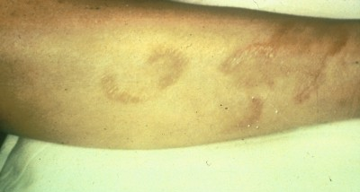
Late syphilis: serpiginous gummata of forearm

Slide 45
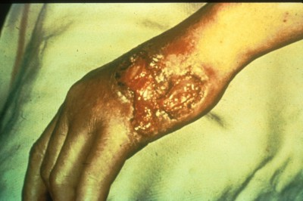
Late syphilis: Ulcerating gumma

Slide 46
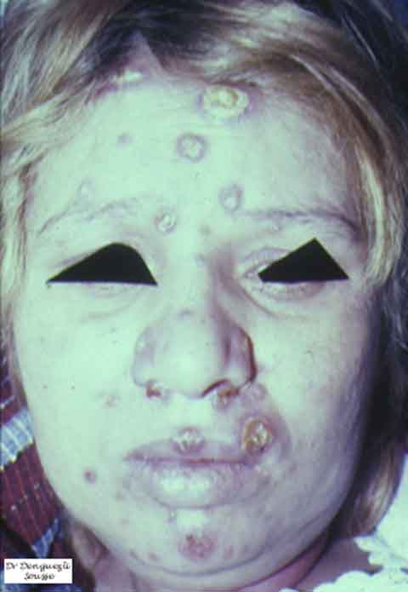
Tertiary gummatous syphilis

Slide 47
Congenital syphilis
Early congenital syphilis occurs within the first 2 years of life while late congenital syphilis is seen those older than 2 years.
The placental tissue is immune to invasion by treponemes until the fourth month of gestation and later is readily crossed to infect the fetus causing a high rate of spontaneous abortion and still birth.
Early congenital syphilis presents with symptoms similar to severe adult secondary syphilis with widespread condylomata lata and rash. Snuffles describes the mucopurulent rhinitis caused by involvement of the nasal mucosae. It is the earliest symptom and soon followed by cutaneous lesions.

Slide 48
Manifestations of the late congenital syphilis include bone and teeth abnormalities, such as:
Saddle nose (due to destruction of the nasal septum).
Saber shins (due to inflammation and bowing of the tibia).
Clutton’s joints (due to inflammation of the knee joints).
Hutchinson’s teeth (the upper incisors are widely spaced and notched).
Mulberry molars (Molar teeth have too many cusps).
After the age of 2 years, many neurological abnormalities may occur (hearing, language and visual defects).
Tabes dorsalis and general paresis may develop as in adults.

Slide 49
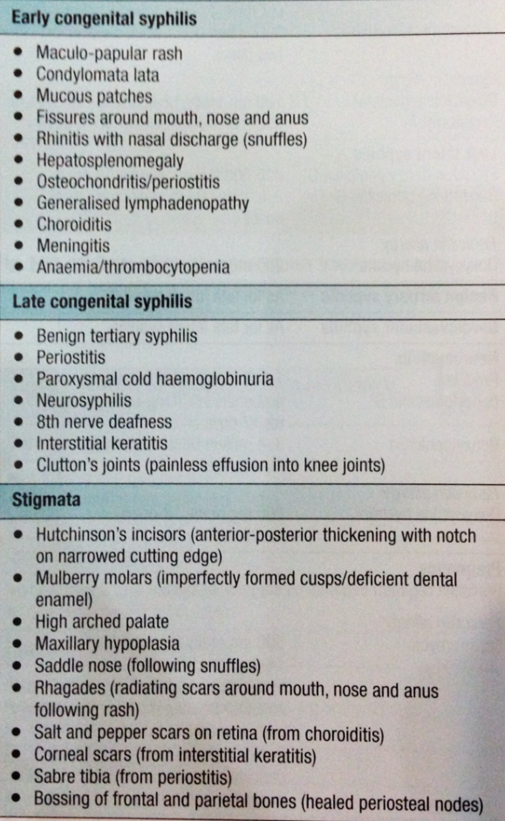
Summary
clinical manifestations of congenital syphilis
*
* Stigmata: permanent tissue damage of fetus or baby after birth in both early and late congenital syphilis.

Slide 50
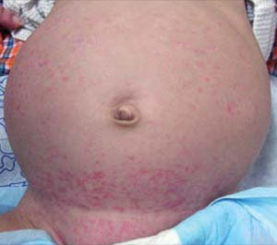
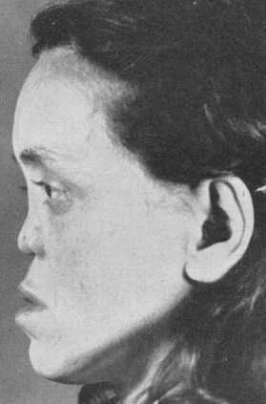
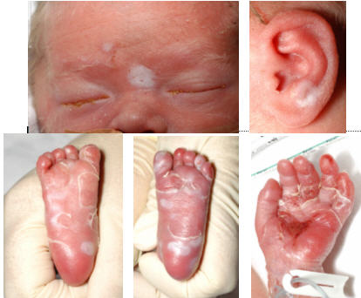
Congenital syphilis

Slide 51
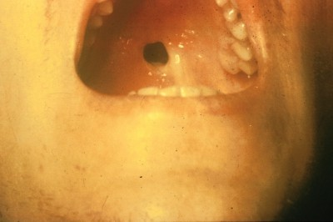
Congenital syphilis - perforation of palate

Slide 52
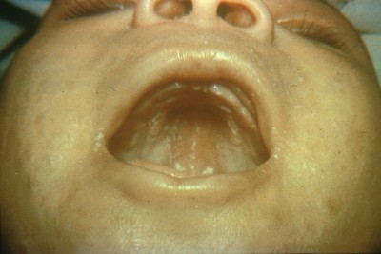
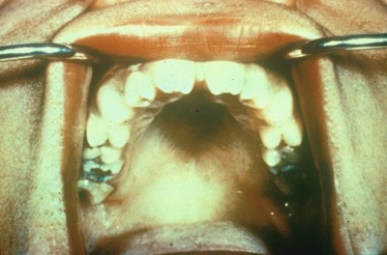
Congenital syphilis mucous patches
Congenital syphilis Hutchinson’s teeth

Slide 53
Differential diagnosis of syphilis
Primary chancre
Chancroid
Herpes genitalis
Granuloma inguinale (Donovanosis)
Lymphogranuloma venerium
Behcet’s disease
Trauma
Scabies
SCC
Male urethritis (Intra-urethral chancre)
2. Secondary syphilis
Generalized rash:
Psoriasis, Pityriasis rosea, Drug eruption, Tinea corporis, Discoid eczema, Lichen planus, Yaws and HIV disease.
B. Mucous Patch:
Lichen planus, Candidiasis and Leukoplakia.
C. Conylomata lata:
Condylomata accuminata

Slide 54
Investigations
T. pallidum cannot be cultivated in vitro and is too small to be seen under the light microscope.
Dark-field microscopy is essential in evaluating moist lesions such as the chancre or the condylomata lata.
When dark-field microscopy is not available, direct immunofluorescence staining of fixed smears (direct fluorescent antibody T pallidum [DFA-TP]) is an option.
Serological testing is considered the standard method of detection for all stages of syphilis.
Serologic test cannot be used to differentiate different species of treponemes, for e.g. yaws, pinta and syphilis.

Slide 55
Serological Tests for Syphilis [STS]
Non specific tests: examples of these tests:
VDRL (Venereal Disease Research Laboratory) test
RPR (Rapid Plasma Reagin) test
Detect non-treponemal antibodies (Anticardiolipin Abs).
Used as screening tests.
Turn positive 1-2 weeks after chancre formation.
Usually become nonreactive with time after treatment. However, in some patients, non-treponemal antibodies can persist, sometimes for life.
Sensitivity: Primary syphilis 78-86% - Secondary syphilis 100%
Specificity: 85-99% . Reduced specificity i.e. false +ve tests may be faced in patients who have coexisting conditions like:

Slide 56
Causes Of False Positive VDRL Test*
Collagen vascular disease
Pregnancy
Intravenous drug use
Advanced malignancy
Tuberculosis
Malaria
Viral and rickettsial diseases
* False-positives usually have a titer of < 1:8.

Slide 57
2. Specific treponemal tests: must be performed to confirm the diagnosis of syphilis because there is possibility of false +ve results with non-treponemal tests. Examples of the tests are:
FTA-ABS (Fluorescent treponemal antibody-absorption)
TPHA (Treponema pallidum hemagglutination)
TPPA (Treponema pallidum particle agglutination)
MHA-TP (Microhemagglutination assay T pallidum)
Specific anti-treponemal antibodies may remain positive for life even after successful treatment.
FTA-ABS is commonly used as a confirmatory test following positive VDRL or RPR test findings. It has a sensitivity of 84% for detecting primary syphilis and almost 100% sensitivity for detecting other stages of syphilis. Its specificity is 96%.

Slide 58
Infants with suspected congenital syphilis with positive VDRL or FTA-ABS test should be tested for IgM-ABS test as maternal IgM does not pass to the fetus in utero.
Management of syphilis
The goal of therapy is to eradicate the causative organism.
Penicillin is the mainstay of treatment for all stages of syphilis. Patients with penicillin allergies should undergo penicillin allergy skin testing and penicillin desensitization, if necessary. Penicillin is also the drug of choice in pregnant women, congenital syphilis and neurosyphilis. Some specialists recommend pregnant women with syphilis who are allergic to penicillin to undergo penicillin desensitization.
A diagnosis of congenital syphilis requires that mother, partner and siblings are investigated.

Slide 59
Clinical and serological conversions are the endpoints of medical treatment of syphilis (Follow-up of all patients to ensure clinical and serological cure i.e., resolution of clinical signs and declining titers of nontreponemal tests to undetectable levels within 6 months of primary syphilis and 12-18 months for secondary syphilis).
VDRL test titers should be measured during follow up to document treatment efficacy.
Patients with confirmed syphilis infections should be tested for other STDs, including HIV.
Parenteral penicillin G is the drug of choice for all stages of syphilis. Alternatives to penicillin are:
Ceftriaxone
Azithromycin
Erythromycin
Doxycycline
Since T pallidum resistance to penicillin has not emerged, the primary need for alternative drugs is reserved for penicillin allergic patients.

Slide 60
The efficacy of these drugs in treating syphilis is questionable and limited clinical data are available at the present time.
Erythromycin has been associated with high failure rates and doxycycline may be an option for patients who refuse parenteral therapy or in patients with penicillin allergy, except in pregnancy when erythromycin is given.
Erythromycin crosses the placenta poorly so the newborn baby must be treated with a course of penicillin and consideration to retreating the mother.
Penicillin Dosage
I. Early Syphilis (Primary/ Secondary/ Early latent)
Procaine benzyl penicillin G 600000 U i.m daily for 10 days (17 days if there is neurological involvement).
Benzathine penicillin G 2.4 million once a week for 2 doses.

Slide 61
Penicillin allergy
Doxycycline 100mg orally 12-hourly for 14 days OR
Erythromycin 500 mg orally 6-hourly for 14 days.
II. Late Syphilis (Late latent/ Benign tertiary):
Procaine benzyl penicillin G 600000 U i.m daily for 17 days
Benzathine penicillin G 2.4 U i.m weekly for 3 weeks.
III. Syphilis in Pregnancy:
Penicillin, the dose and duration depend on the stage of syphilis. If penicillin allergy give erythromycin stearate 500 mg orally 6-hourly for 14 days and doxycycline after delivery.
IV. Congenital Syphilis:
Early Cong. Syphilis: Benzyl penicillin 50000 U/Kg i.v 12-hourly for first 17 days of life then 50000 U/Kg i.v 8-hourly for 3 days OR
Procaine benzyl penicillin G 50000 U/Kg i.m daily for 10 days.

Slide 62
Late Congenital Syphilis: the dose depends on the weight and age of the child.
Adult regimen from age of 15 years.
Jarisch-Herxheimer Reaction
Acute febrile reaction following initiation of treatment, characterized by headache, malaise and myalgia and resolving within 24 hours. It is common in early syphilis and may cause worsening of neurological or ophthalmic disease (uveitis, optic neuritis). Fetal distress or premature labour may be consequences in pregnancy. The reaction is rare in late syphilis.
Treatment: Oral prednisolone 10-20 mg 8-hourly for 3 days on an in-patient basis.

Slide 63
THANK YOU
الحمد لله رب العالمين

