Slide 1
Malignant Epidermal Tumors
Dr. Nameer Al-Sudany

Slide 2
Basal cell carcinoma (rodent ulcer)
The most common form of skin cancer. It occurs most commonly on the face but may affect other parts of the body. It usually affects the middle-aged or elderly. The lesions invade locally and very rarely metastasize.
Cause
1. Prolonged sun exposure is the main factor: BCCs are most common in white people who have lived in sunny areas, high latitudes, or near the equator.
2. Scars caused by X-rays, vaccination or trauma.
3. Photosensitizing agents: pitch, tar and oils can act as cocarcinogens with ultraviolet radiation.
4. Previous treatment with arsenic, once present in many ‘tonics’, predisposes to multiple basal cell carcinomas, often after a lag of many years.
5. Multiple basal cell carcinomas are found in the nevoid basal cell carcinoma syndrome (Gorlin’s syndrome).
6. Rare genetic disorders e.g. xeroderma pigmentosum.

Slide 3
Clinical Types of BCC (Presentation)
Nodulo-ulcerative BCC
This is the most common type of BCC. An early lesion is a small translucent, sometimes umbilicated, skin-colored papule that slowly enlarges. Then central necrosis (ulceration) develops with an adherent crust and a rolled pearly edge. Coarse telangiectatic vessels often run across the tumor’s surface. Without treatment such lesions may reach 1–2 cm in diameter in 5–10 years.
2. Cystic BCC: The lesion is at first like the nodular type, but later cystic changes predominate and the nodule becomes tense and more translucent, with marked telangiectasia.

Slide 4
3. Cicatricial (morphoeic) BCC
A slowly expanding yellow or white waxy plaque with an ill-defined edge. Ulceration and crusting, followed by fibrosis, are common, and the lesion may look like an enlarging scar.
4. Superficial (multicentric) BCC
It arises most often on the trunk. Several lesions may be present, each expanding slowly as a red, pink or brown scaly irregular thin plaque with a fine thread-like edge. Such lesions can grow to more than 10 cm in diameter.
5. Pigmented BCC
Pigment may be present in all types of BCC, causing all or part of the tumor to be brown or have specks of brown or black within it.

Slide 5
Clinical course
The slow but relentless growth destroys tissue locally. Untreated, a basal cell carcinoma can invade underlying cartilage or bone or damage important structures such as the tear ducts.
Histology
Small, darkly blue staining basal cells with numerous mitoses grow in well-defined aggregates which invade the dermis. The outer layer of cells is arranged in a palisade. In the cicatricial type, the islands of tumor cells are surrounded by fibrous tissue.

Slide 6
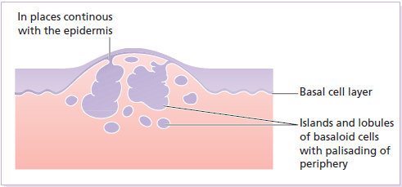
Histology of nodular basal cell carcinoma

Slide 7
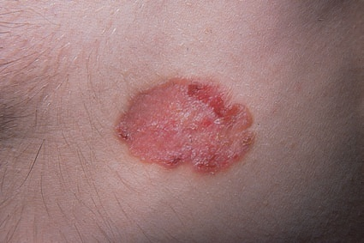
Superficial BCC presents as persistent scaly plaque with a thread-like edge on the trunk

Slide 8
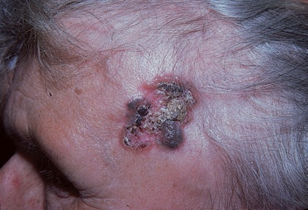
Pigmented BCC on the temple. The opalescent pearl-like rim is a characteristic of basal cell carcinoma.

Slide 9
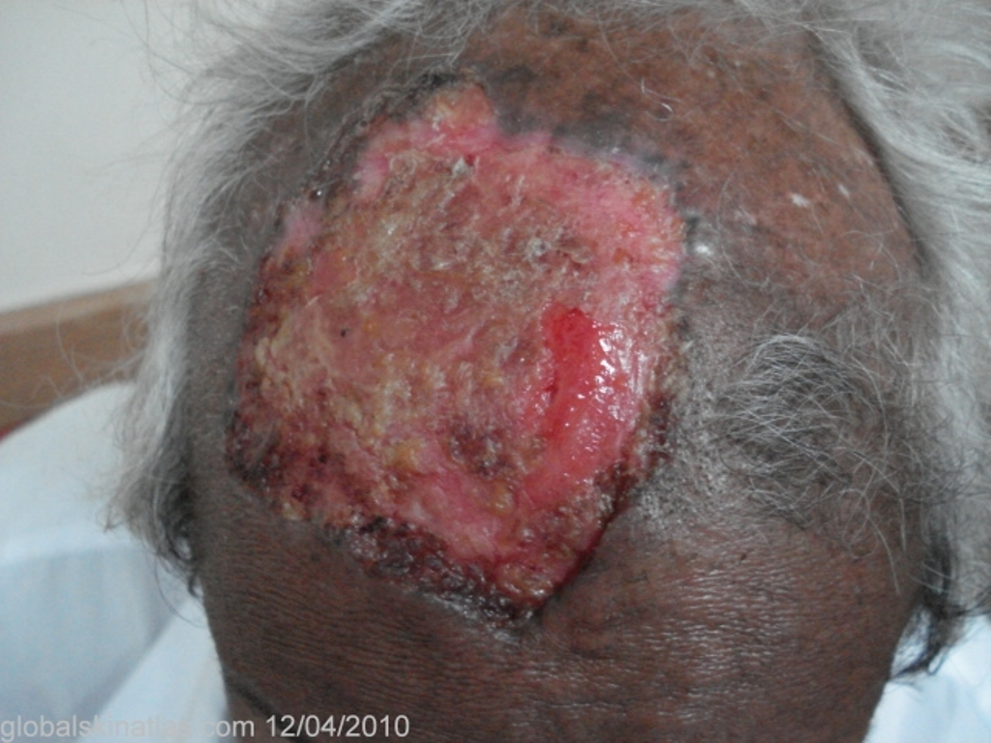
A huge ulcerative BCC on the scalp of > 5 years duration

Slide 10
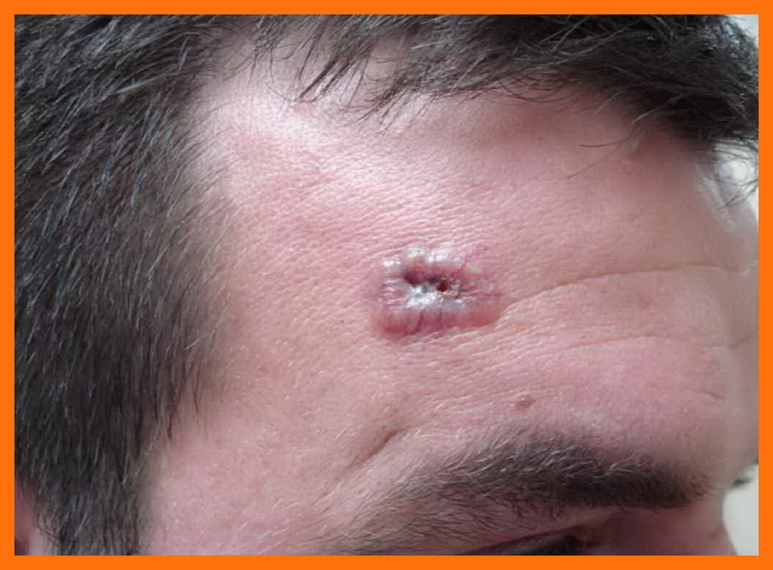
Noduloulcerative BCC with rolled edge and prominent surface telangiectasia

Slide 11
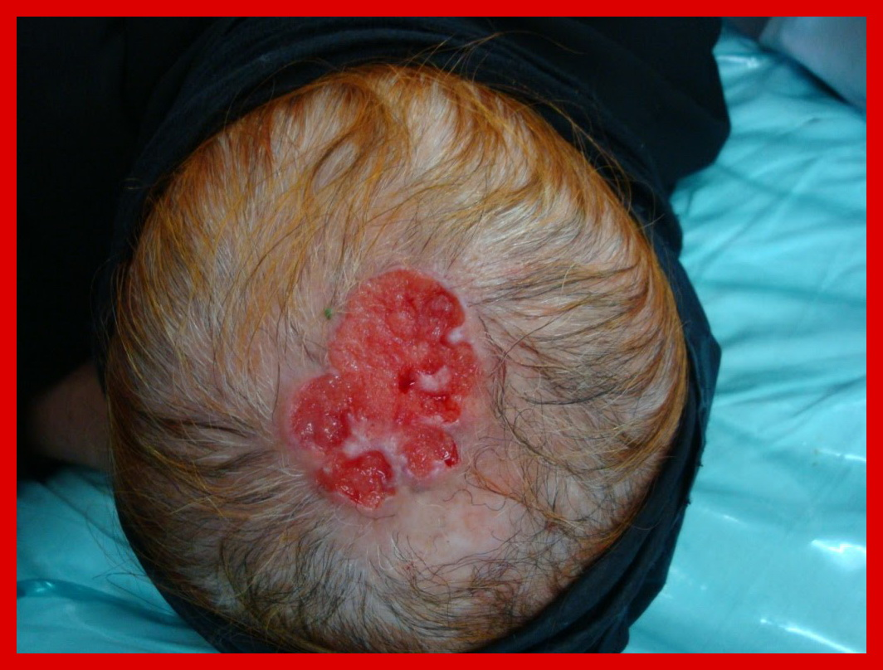
Recurrent BCC on the scalp

Slide 12
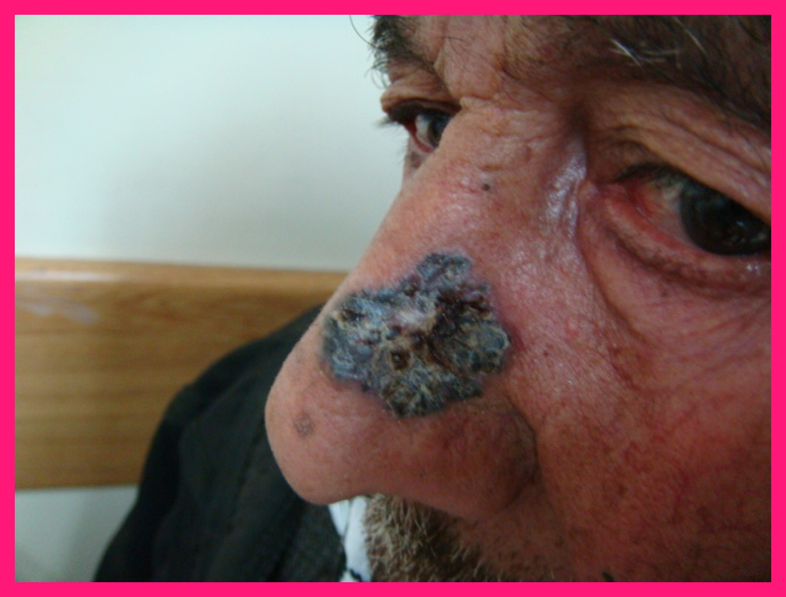
Pigmented BCC on the nose

Slide 13
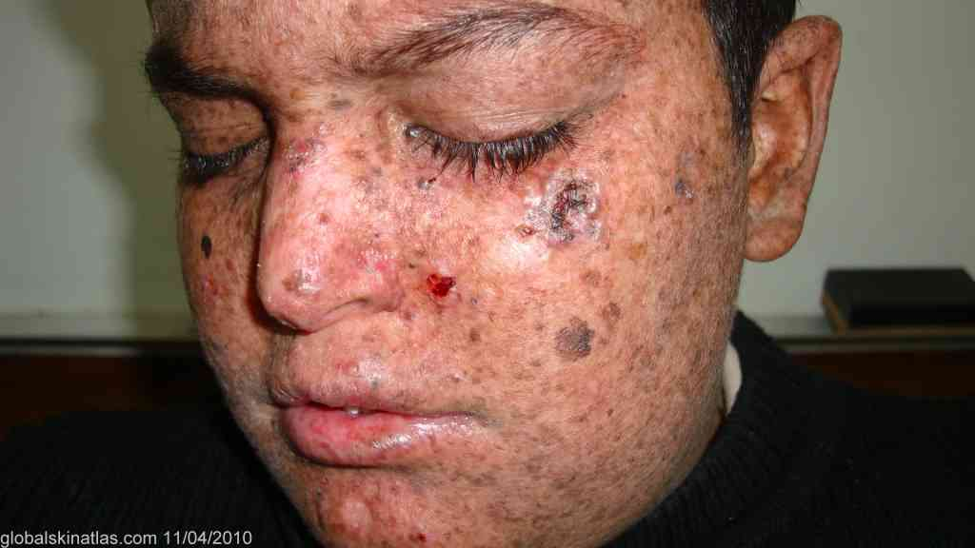
Multiple BCCs in a young boy with XP

Slide 14
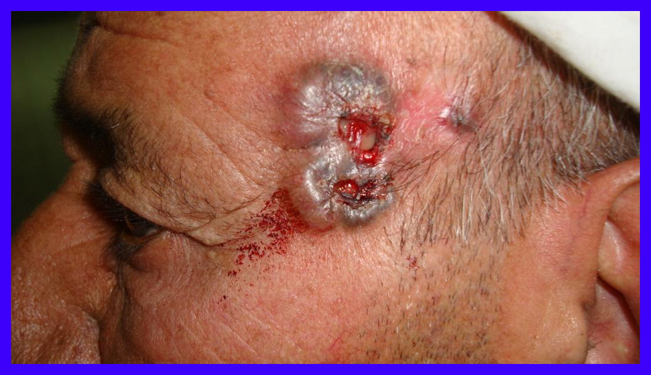
Recurrent Noduloulcerative BCC. Notice the scar of previous treatment (arrow).

Slide 15
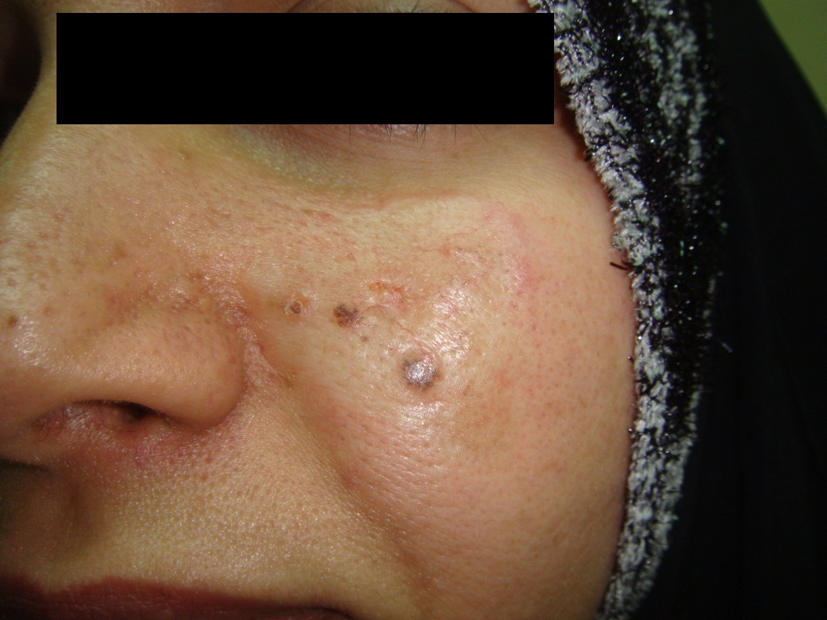
Morpheic BCC (Scar-like appearance)
Ulcer

Slide 16
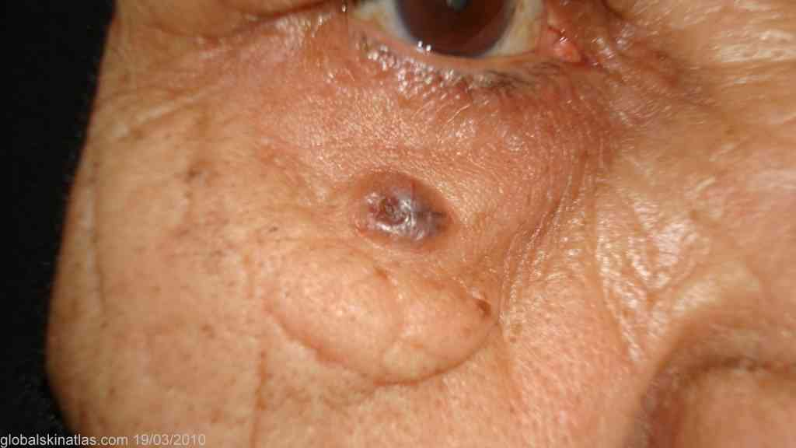
Pigmented basal cell carcinoma

Slide 17
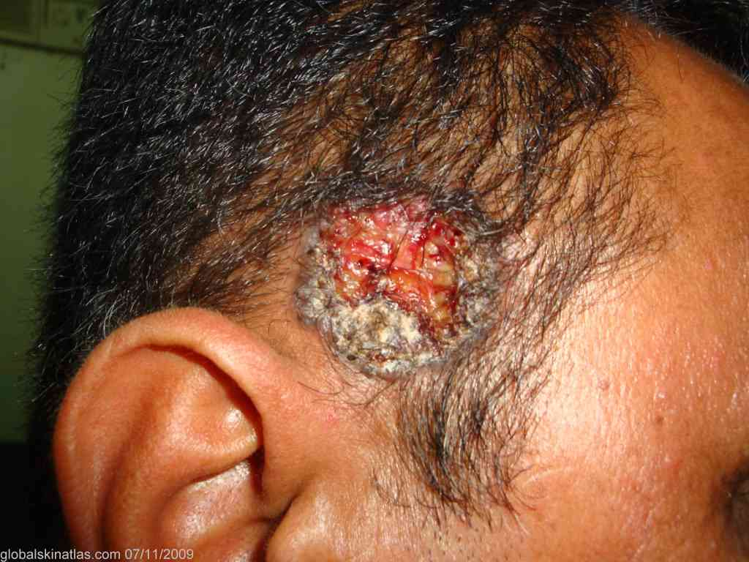
Ulcerative BCC with a granular base

Slide 18
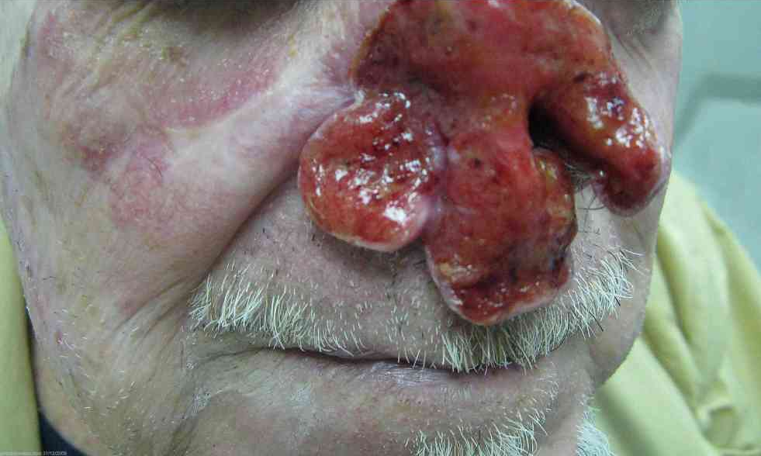
A grossly neglected basal cell carcinoma invading underlying nasal bones and cartilages

Slide 19
Differential diagnosis of BCC
Nodular basal cell carcinoma may be confused with:
Intradermal melanocytic nevus
Squamous cell carcinoma
Giant molluscum contagiosum
Keratoacanthoma
Pigmented basal cell carcinomas should be distinguished from:
Seborrhoeic keratosis
Malignant melanomas
Cicatricial basal cell carcinoma may mimic:
Morphea
Scar.
Superficial basal cell carcinoma may be confused with:
1. Bowen’s disease (Intra-epidermal carcinoma)
2. Psoriasis
3. Nummular eczema

Slide 20
Treatment of BCCs
There is no single treatment of choice for all BCCs. Treatment should be tailored to the type of tumor, its site and the age and general health of the patient.
1. Surgical excision: wounds closed with sutures generally heal with less apparent scar than those left to heal by secondary intention. It is particularly indicated for tumors on the face and keloid-prone areas.
Excision with 0.5 cm of surrounding normal skin, is the treatment of choice for discrete nodular and cystic tumours in patients under 60 years. This can be performed by excising an ellipse of skin containing the tumour and normal margins.

Slide 21
Cicatricial tumours, with their ill-defined edges, and lesions near vital structures should be excised by specialist surgeons. Mohs’ micrographic surgery (microscopically-controlled surgery) is highly effective; it includes careful histological checks in all planes of tissue excised during the operation. Mohs’ surgery is also becoming the treatment of choice for large (greater than 1 cm) tumors, and for tumors on important sites such as the nose, inner canthus or nasolabial folds.
2. Radiotherapy is also effective; it is seldom used now for biopsy-proven lesions in patients under 70 years, but is helpful when surgery is contraindicated.

Slide 22
3. Cryotherapy
4. Curettage and Cautery
5. Photodynamic therapy
The above three modalities are sometimes useful for superficial lesions. Sometimes treatment with curettage and cautery may be preferable to aggressive treatment for selected tumors and for elderly patients.
6. 5-FU (5% cream or intralesional): 5-Fluorouracil may be useful for superficial BCC.
7. Imiquimod (5% cream): for superficial BCC.
The 5-year cure rate for all types of BCCs is >95% but regular follow-up is advisable to detect local recurrences when they are small and remediable.

Slide 23
Keratoacanthoma (KA)
KAs are rapidly growing tumors that usually do not invade and may resolve spontaneously. Many believe that KA is a variant of regressing SCC and may name it keratoacanthomatous SCC.
Aetiology: the main predisposing factors are:
Sun light (UVR) plays an important role in the etiology of KA.
Light-skinned persons more apt to develop KA than dark-skinned people.
Photosensitizing chemicals such as tar and mineral oils. They can act as cocarcinogens with UVR.
Immunosuppressive states
Xeroderma pigmentosum.

Slide 24
Clinical features of KA
Keratoacanthoma is characterized by rapidly growing papule that enlarges from 1 mm to as much as 25 mm in 3 to 8 weeks. A fully developed KA is a sharply demarcated, dome-shaped, skin-colored to pinkish nodule with a central crater filled with a keratin plug. If left, the lesion may resolve spontaneously over 6–12 months leaving an ugly depressed scar. Most cases of KA present with a solitary nodule, however multiple lesions may be seen in some patients.
Giant KA is defined as a lesion > 2 cm in diameter. It may attain a diameter of 25 cm.

Slide 25
KAs may develop at sites of skin injury or previous skin disease. This is known as Kobner phenomenon or Isomorphic phenomenon which is positive in up to 10% of cases of KAs.
Sites: KAs usually occur on sun exposed skin especially the face (> 2/3 of cases) and most of the rest on the backs of the hands and arms.
Less frequent sites: buttocks, thighs, penis, ears and scalp.
Rare sites: oral mucosa and subungual region.
KA usually is seen in middle-aged to elderly individuals and more in men than in women.

Slide 26
The most interesting feature of KA is its rapid growth, followed by a stationary period and finally a spontaneous involution to leave a slightly depressed scar.
Phases of evolution of KA
Growth phase (2-6 weeks)
Stationary phase (2-6 weeks)
Involution phase (2-6 weeks)

Slide 27
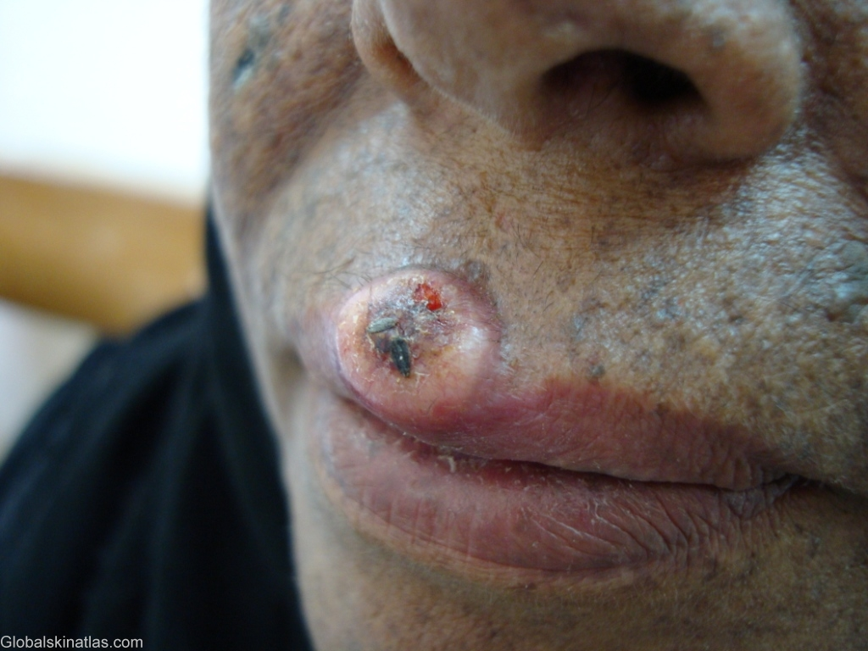
KA in a woman with xeroderma pigmentosum

Slide 28
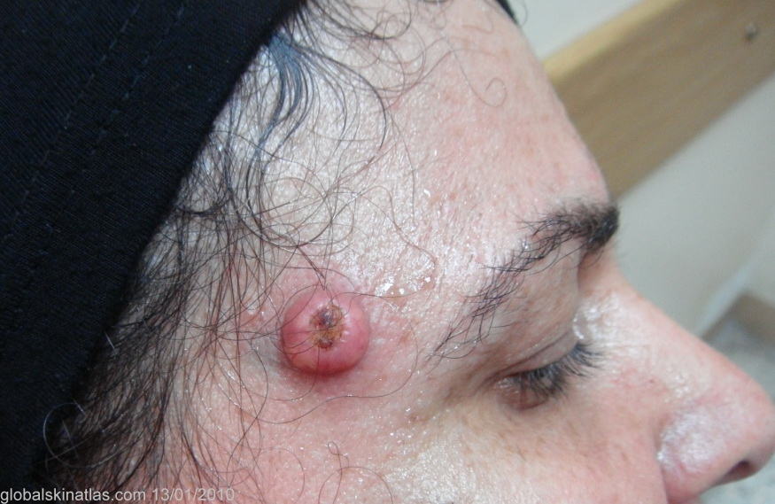
KA on the forehead: Dome-shaped nodule with a keratin-filled central crater

Slide 29
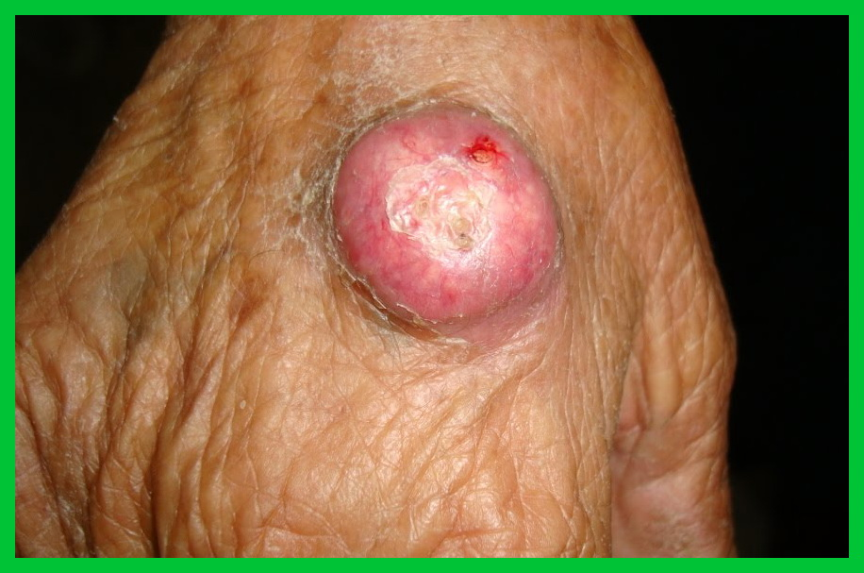
KA on the dorsum of the hand in an old woman

Slide 30
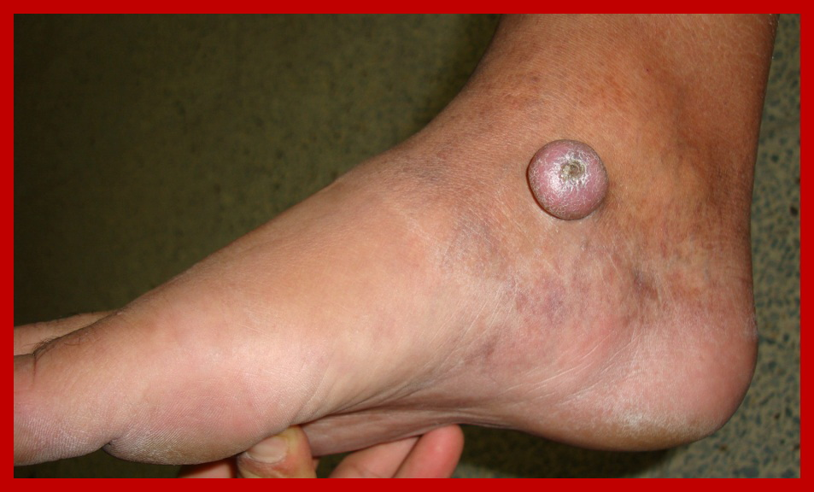
KA of an unusually long duration (3 years !)

Slide 31
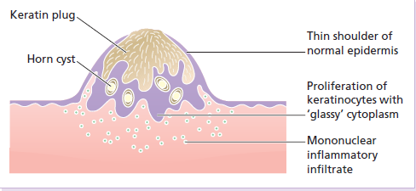
Histology of keratoacanthoma
The architecture of the whole lesion should be assessed, including its base. A typical lesion is symmetrical cup-shaped mass and composed of central crater filled with eosinophilic keratin. Thin shoulders of normal epidermis “epidermal lips” extends over the keratin-filled crater. At the base & sides of the crater, there is acanthosis in form of pseudoepitheliomatous hyperplasia. The epidermal cells are highly keratinized with eosinophilic ‘glassy’ cytoplasm. Outside keratinocyte proliferation, a dense lymphocytic infiltrate is frequently seen.

Slide 32
Differential diagnosis of KA
SCC
Cutaneous horn
Noduloulcerative BCC
Verruca vulgaris
Prurigo nodularis
Hypertrophic LP
Treatment: Spontaneous involution of KA often occurs, however, it can not be relied upon because:
The time for involution is unpredictable which means an unsightly tumor may remain as long as a year or more.
Low grade SCC (grade I) can't be excluded even with histologic examination.
Spontaneous involution usually leaves an ugly or unsightly atrophic scar.

Slide 33
Treatment modalities
Surgery: the lesion must be excised with a narrow margin of surrounding skin especially for lesions < 2 cm diameter. Moh’s microsurgery is best for facial lesions that may be deforming.
Curettage & Cautery.
Intralesional 5-Fluorouracil (5 FU).
Intralesional bleomycin.
Methotrexate (25 mg i.m injections weekly).
Topical 5-FU cream.
Podophyllum in compound of tincture benzoine (Podophylline solution) may be tried for giant KAs.
Radiation therapy: for giant KAs and good choice for subungual KAs in which surgery or electrocautery are not feasible.

Slide 34
Squamous cell carcinoma (SCC)
Synonyms: Prickle Cell Ca, Epidermoid Ca.
SCC is a common tumour in which malignant keratinocytes show a variable capacity to form keratin. It can affect both the skin and mucous membranes (oral cavity, lung and bladder).
Cause: SCCs often arise in skin damaged by:
UVR
X-ray
Chronic inflammation
Other carcinogens: pitch, tar, mineral oils and inorganic arsenic.
Rare genetic disorders e.g. xeroderma pigmentosum.
HPV: Oncogenic types may induce SCC.
Immunosuppression.

Slide 35
Clinical presentation of SCC
Tumours may arise as thickenings in an actinic keratosis or, de novo, as small scaling nodules; rapidly growing anaplastic lesions may start as ulcers with a granulating base and an indurated edge.
Squamous cell carcinomas are common on the lower lip and in the mouth.
SCC is more common than BCC on the lower lip and on the dorsum of the hands.
SCC usually occur in middle-aged and elderly people.

Slide 36
Course of SCC: SCCs arising in sun-exposed areas and in actinic keratoses seldom metastasize except in immunosuppressed patients.
The risk of metastasis (Metastatic potential) of SCC is higher in the following conditions:
Tumours > 2 cm in diameter.
Tumors > 4 mm in depth or invading to the SC tissue.
Poorly differentiated tumours.
Tumours with perineural involvement.
Tumors arising in the immunosuppressed, such as recipients of solid organ transplants.
Tumours arising in chronic draining sinuses, chronic ulcers, areas of previous X-radiation or thermal injury, or chronic inflammation.
Tumours arising in non-exposed sites, such as the perineum and sole of foot and on the ear and lip.

Slide 37
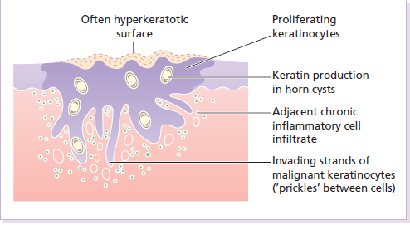
Histology of a SCC
Keratinocytes disrupt the dermo-epidermal junction and proliferate irregularly into the dermis. Malignant cells usually retain the capacity to produce keratin.

Slide 38
Treatment of SCC
After the diagnosis has been confirmed by biopsy, low-risk tumours should be excised with a 0.5-cm border of normal skin.
Wider excision (6 mm or more) or Mohs’ micrographic surgery is recommended for high-risk tumours. Sometimes keratin stains are used to help track perineural spread. Palpation of regional nodes is important in work-up and follow-up.
Radiotherapy is effective but should be reserved for the frail and elderly and special situations.
Follow-up for up to 5 years is recommended for patients with recurrent disease and for those with high-risk tumours.

Slide 39
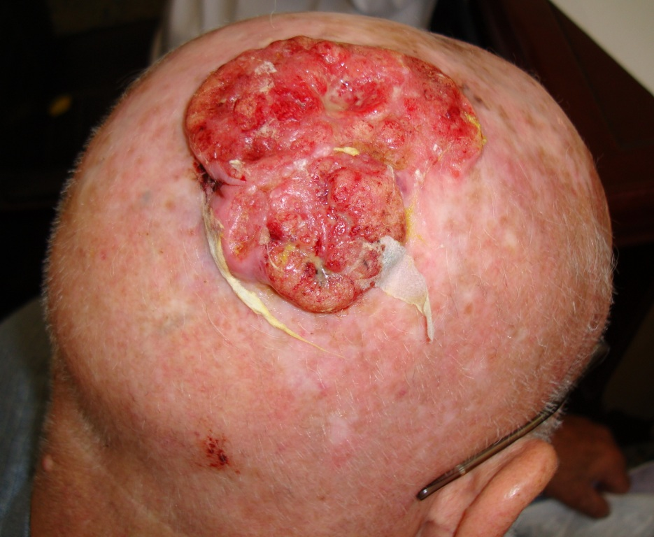
SCC on the scalp of an old man

Slide 40
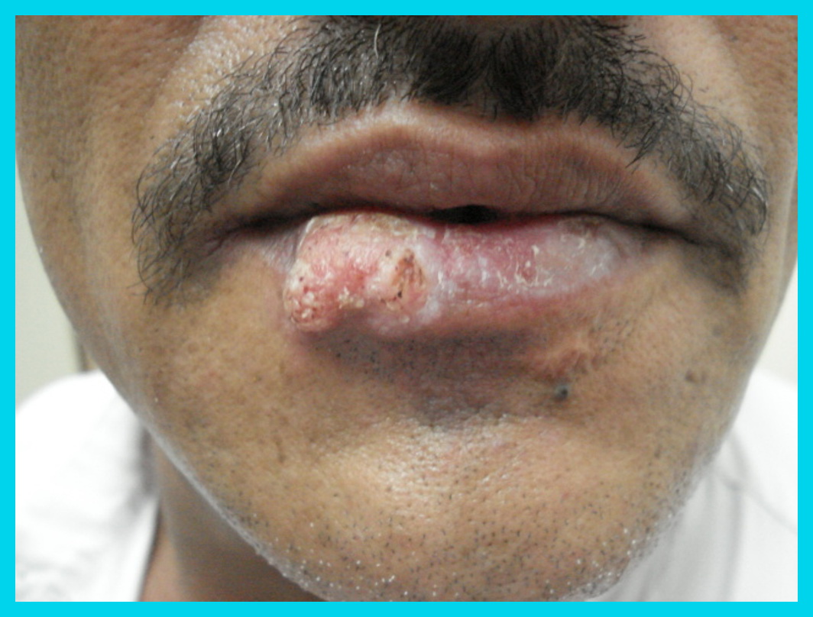
SCC presents as a keratotic nodule on the lower lip

Slide 41
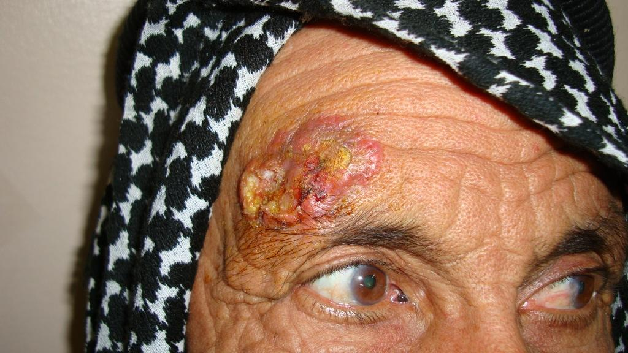
SCC with an everted edge in the supraorbital region

Slide 42
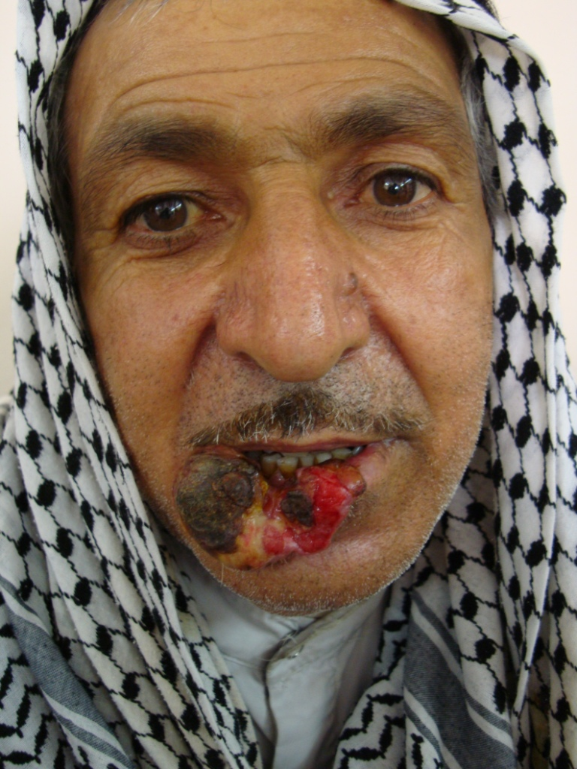
SCC presented as an ulcer destroying major portion of the lower lip.

Slide 43
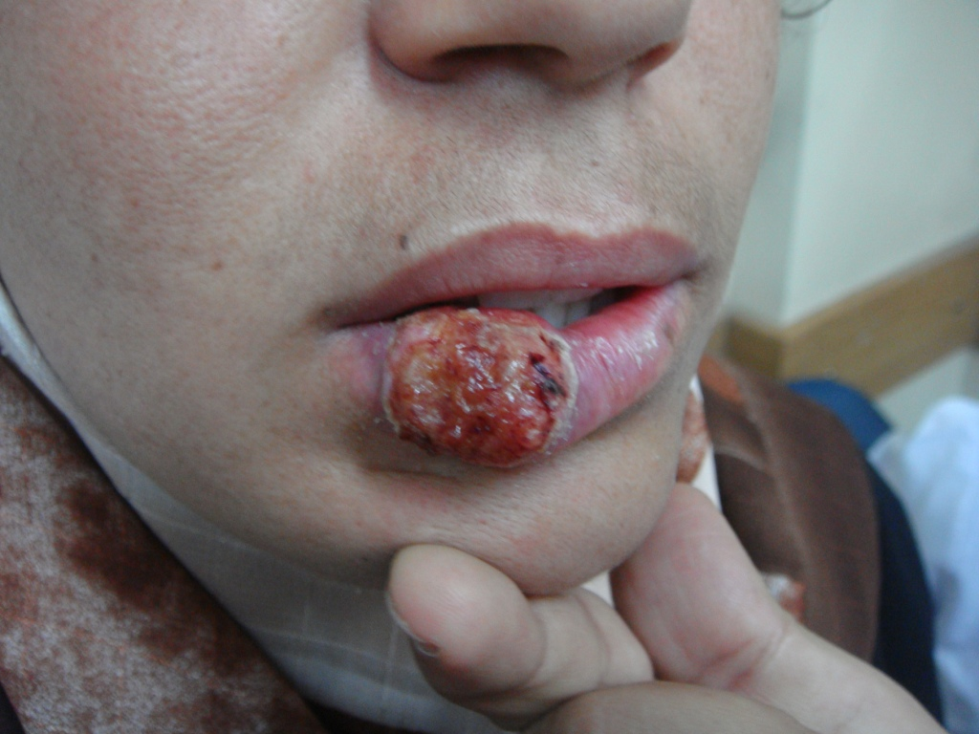
SCC on the lower lip in a young lady

Slide 44
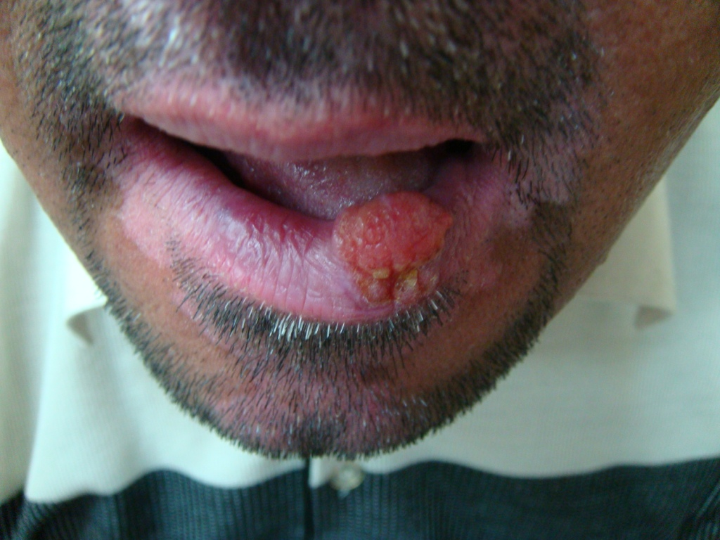
SCC of the lower lip on a background of vitiligo

Slide 45
Malignant melanoma
Malignant melanoma attracts a huge amount of publicity because it is so often lethal.
Incidence
The incidence in white people in the UK and USA is doubling every 10 years.
There is a higher incidence in white people living near the equator than in temperate zones.
The highest incidence (> 40 per 100 000 per year) is seen in white people living in Australia and New Zealand.
The tumour is rare before puberty and in black people, Asians and Orientals and when it does occur in these races it is most often on the palms, soles or mucous membranes.
Sex ratio is equal in some regions and female preponderance in other areas

Slide 46
Cause of Malignant Melanoma
Genetic
Susceptibility genes are found in around 6% of cases.
Familial melanomas (2 or more first-degree relatives have a melanoma.
Melanoma can affect several members of a single family in association with atypical (dysplastic) nevi.
Those of Celtic origin are especially susceptible.
2. Susceptible phenotypes: melanomas are most common in white people (tan poorly) with blond or red hair and many freckles.
3. Environmental factors (e.g. sunlight).
Episodic exposure of fair-skinned individuals to intense sunlight is thought to be the main cause of increasing incidence of melanoma worldwide. The number of sunburns seems more relevant than cumulative ultraviolet radiation dose.

Slide 47
4. Pre-existing melanocytic nevi: the risk of developing a melanoma is highest in those with atypical nevi, congenital melanocytic nevi or many banal melanocytic nevi. A pre-existing melanocytic nevus is seen histologically in about 30% of malignant melanomas.
Prevention and early diagnosis
1. Protection of skin from ultraviolet radiation is critical. This is best done by avoiding exposure of skin to sunlight, tanning booths and using tight-weave clothing, hats and sunscreens.
2. Early diagnosis is important. Melanoma publicity campaigns, regular self-examination and the education of primary care physicians have all played their part in reducing the mortality rate from melanoma.

Slide 48
Clinical features
Eighty per cent of invasive melanomas are preceded by a superficial and radial growth phase, shown clinically as the expansion of an irregularly pigmented macule or plaque.
Most melanomas are multicolored mixtures of black, brown, blue, tan and pink. Their margins are irregular with reniform projections and notches. Malignant cells are at first usually confined to the epidermis and uppermost dermis, but eventually invade more deeply and may metastasize.

Slide 49
Types of malignant melanoma: Four main types:
1. Lentigo maligna melanoma occurs on the exposed skin of the elderly. An irregularly pigmented, irregularly shaped macule (a lentigo maligna) may have been enlarging slowly for many years as an in situ melanoma before an invasive nodule (the lentigo maligna melanoma) appears.
2. Superficial spreading melanoma is the most common type in Caucasoids. Its radial growth phase shows varied colors and is often palpable. A nodule coming up within such a plaque signifies deep dermal invasion and a poor prognosis.

Slide 50
3. Acral lentiginous melanoma: occurs on the palms and soles and, although rare in Caucasoids, is the most common type in Chinese and Japanese people. The invasive phase is again signaled by a nodule coming up within an irregularly pigmented macule or patch.
4. Nodular melanoma: appears as a pigmented
nodule with no preceding in situ phase. It is the most rapidly growing and aggressive type.

Slide 51
Melanomas can also described by their color, site and degree of spread.
Totally amelanotic melanomas are rare and occur especially on the soles of the feet. Flecks of pigment can usually be seen with a lens.
Desmoplastic melanomas are rare. They are seen most often on the head, neck, palms and soles. They are sometimes amelanotic.
Subungual melanomas are painless areas of pigmentation expanding under the nail and onto the nail fold (Hutchinson’s sign).
Metastatic melanoma has spread to surrounding
skin, regional lymph nodes or to other organs. At
this stage it can rarely be cured.

Slide 52
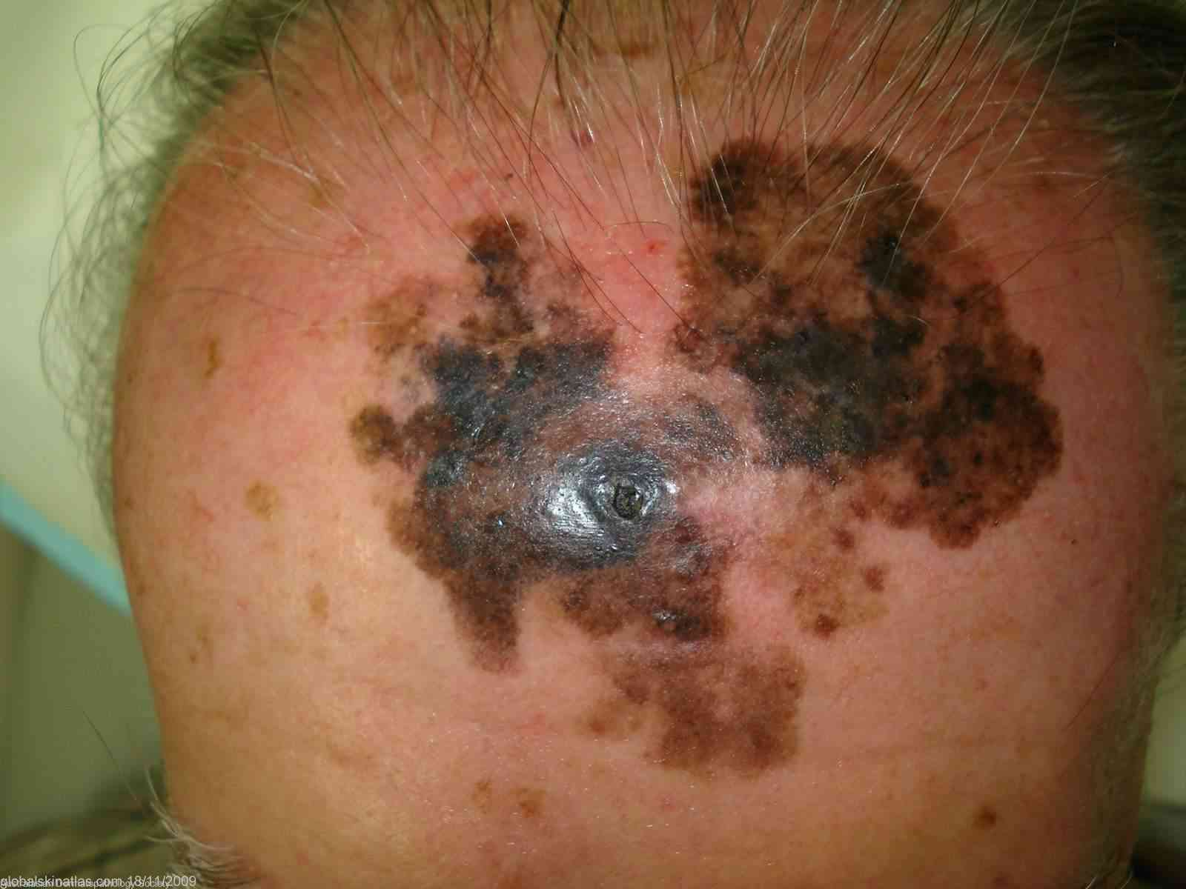
Lentigo maligna melanoma

Slide 53
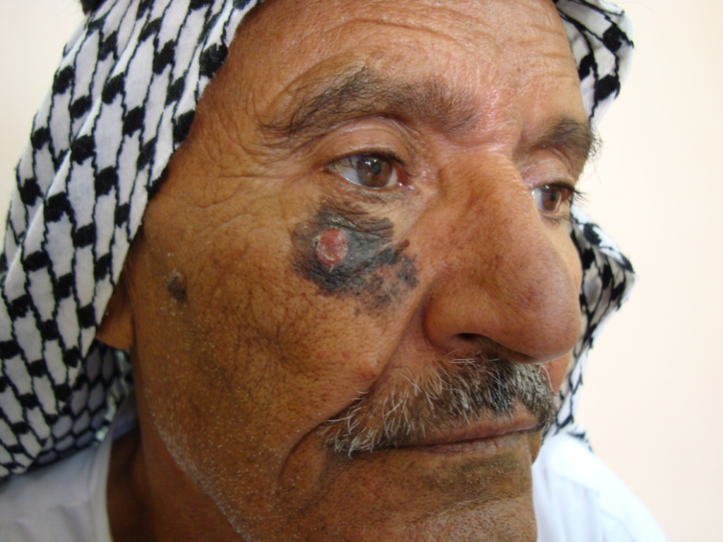
Nodule developed within a lentigo maligna signaling lentigo maligna melanoma

Slide 54
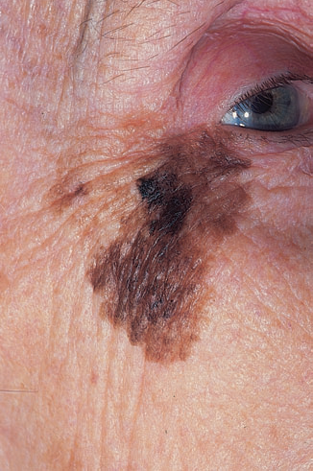
An old lady with a lentigo maligna ignored too long. Now she has a frankly invasive melanoma within it (the darker area)

Slide 55
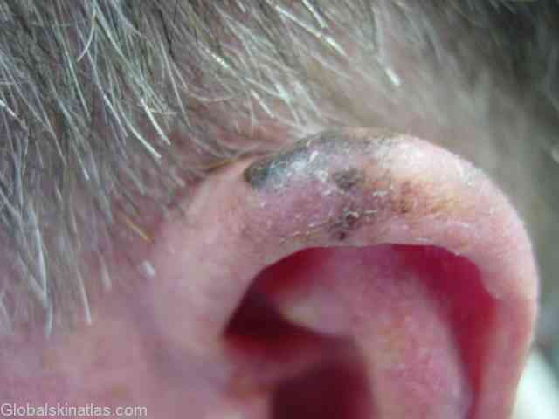
Superficial spreading melanoma

Slide 56
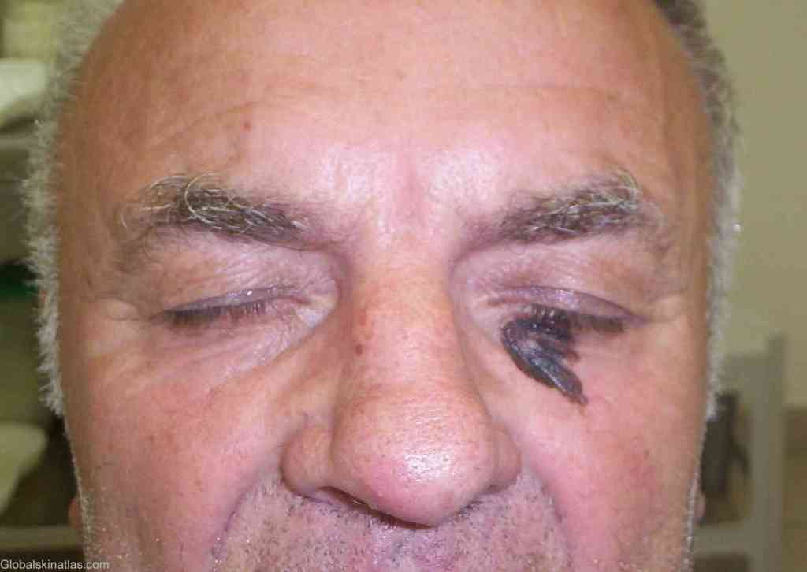
Superficial spreading melanoma near the eye

Slide 57
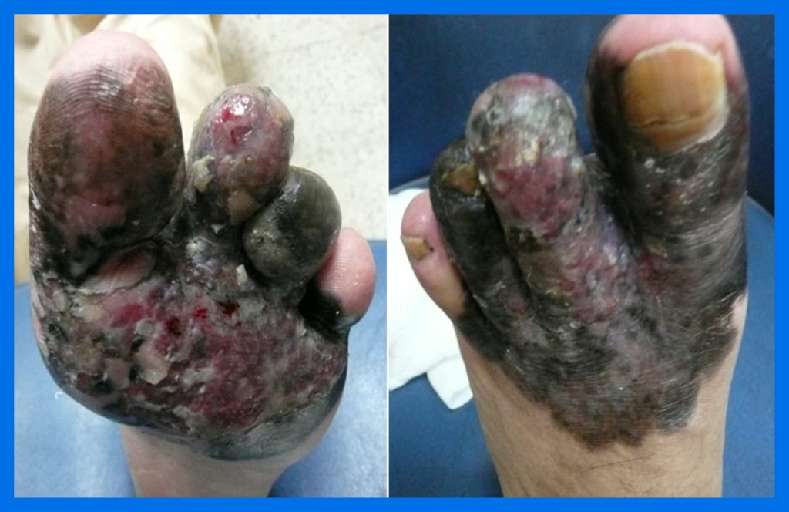
Acral lentiginous melanoma involving the forefoot

Slide 58
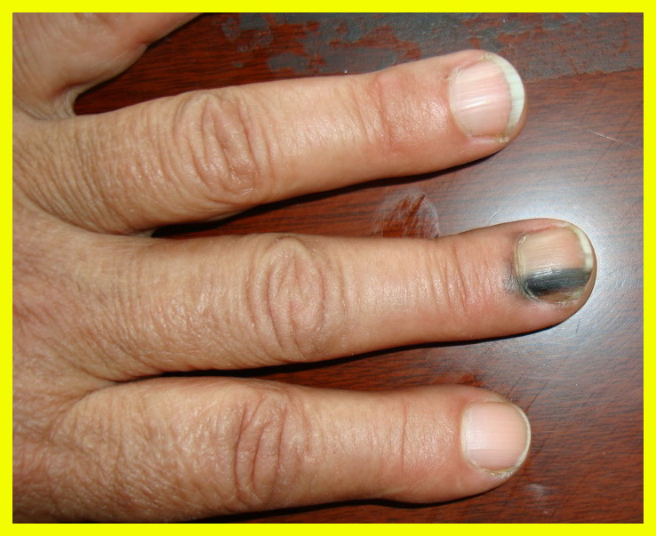
Acral lentiginous melanoma (Hutchison’s sign)

Slide 59
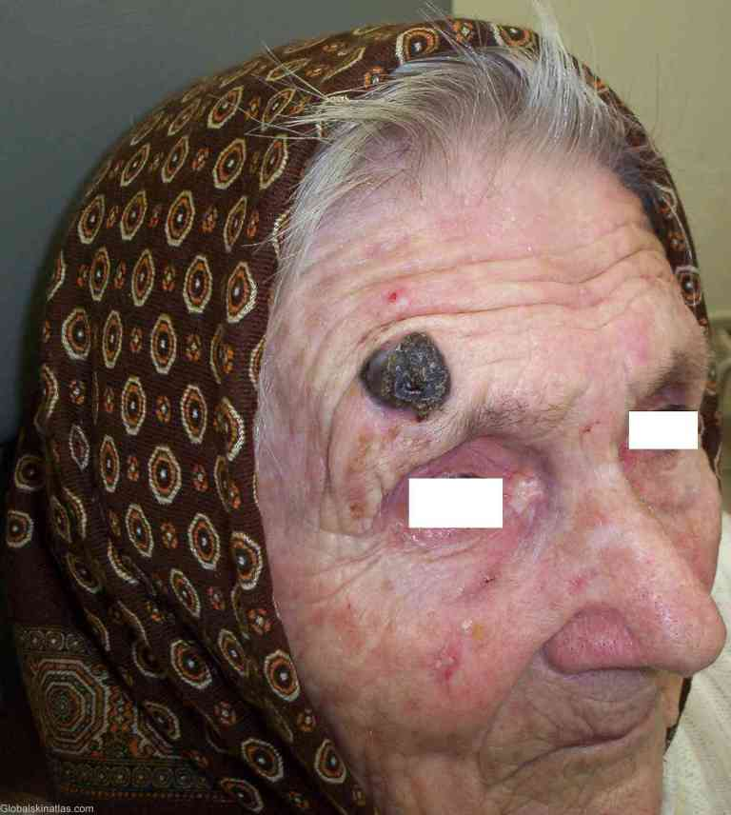
Nodular malignant melanoma

Slide 60
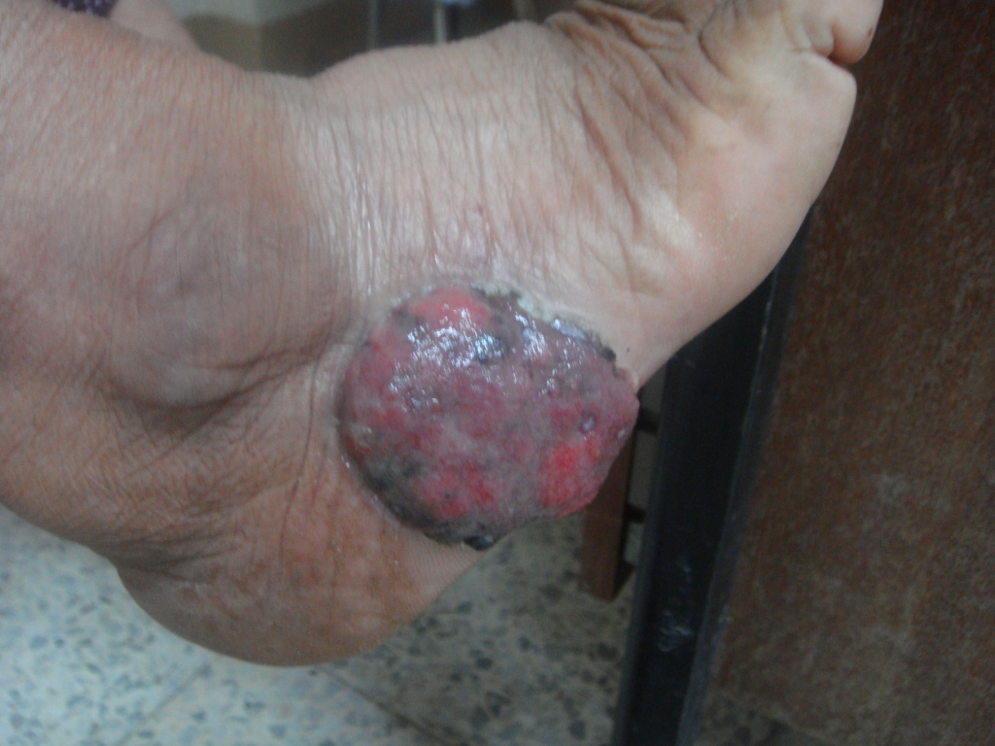
Amelanotic melanoma

Slide 61
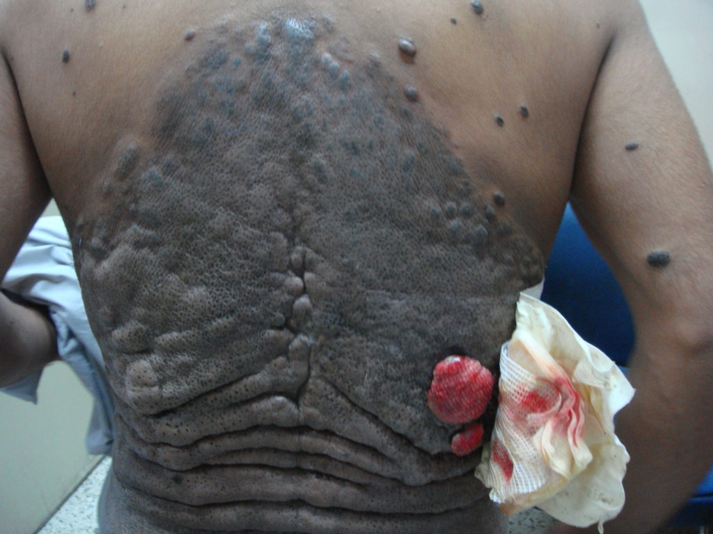
Nodular melanoma complicating congenital giant melanocytic nevus

Slide 62
Malignant melanoma should be considered if the following changes occur in a melanocytic nevus:
Enlargement
increased or decreased pigmentation
Altered shape
Altered contour
Inflammation
Ulceration
Itch
Bleeding
If changing lesions are examined carefully, remember the ‘ABCDE’ features of malignant melanoma:
Asymmetry
Border irregularity
Color variability
Diameter greater than 0.5 cm
Evolution (change)

Slide 63
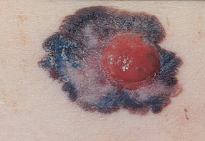
The hallmarks of a malignant melanoma with its asymmetry, irregular borders and variations in color. The pink amelanotic nodule signifies deep dermal invasion.

Slide 64
Differential diagnosis
Melanocytic nevus
Seborrhoeic keratosis
Pigmented actinic keratosis
Lentigo
Pigmented basal cell carcinoma
Sclerosing haemangioma
Subungual or periungual hematoma
‘Talon noir’ is a pigmented petechial area on the heel following minor trauma from ill-fitting training shoes.
An amelanotic melanoma is most often confused with a pyogenic granuloma and with a squamous cell carcinoma.

Slide 65
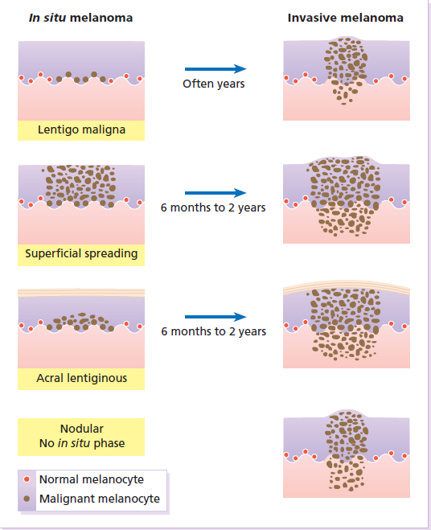
Histology of the different
types of melanoma.

Slide 66
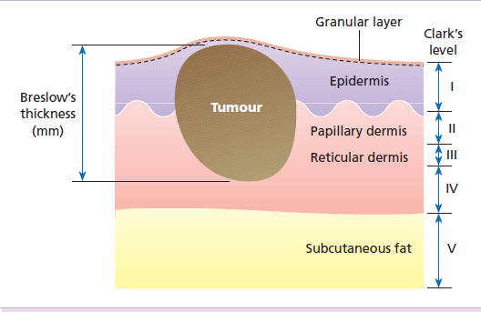
Breslow’s and Clark’s methods of
microstaging malignant melanoma.
Breslow’s method is to measure, with an ocular micrometer, the vertical distance from the granular cell layer to the deepest part of the tumour.
Clark’s method, used less frequently nowadays, is to assess the depth of penetration of the melanoma in relation to the different layers of the dermis. The thicker and more penetrating a lesion, the worse is its prognosis.

Slide 67
Treatment of malignant melanoma
Surgery is the treatment of choice in most malignant melanomas. Surgical excision, with minimal delay, is required. A minimum of 0.5 cm clearance for melanomas in situ and 1 cm clearance is required for all invasive melanomas. Nowadays many surgeons excise 1 cm of normal skin around the tumour for every millimeter of tumour thickness, up to 3 mm.
Adjuvant therapy: α-interferon. (controversial)
Chemotherapy: Dacarbazine is of choice. Chemotherapy is used as a palliative therapy in advanced cases.

Slide 68
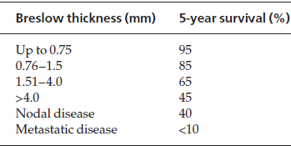
Prognosis of malignant melanoma
Tumor thickness is the most important prognostic pointer in malignant melanoma.

Slide 69

THANK YOU
الحمد لله رب العالمين

